Slide 1

National Summit on Good and Best Practices,
Mahatma Mandhir, Gandhinagar
Gujarat
16th – 18th November 2019
VIA Screening in Manipur through CHOs
By: Dr Y Premchandra Singh
State Nodal Officer
NCD-HWC,NHM Manipur

Slide 2
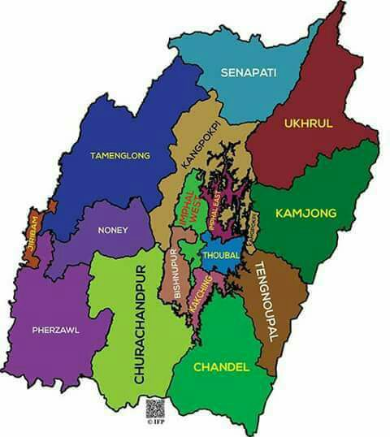
Outline of the presentation
Challenges in delivering Population Based Screening of Common NCDs by Sub-Health Centre –Cervix cancer Screening above 30 yr female population
Initiatives Taken
Outcome
Scalability
Future Roadmaps
16 Districts :10 Hilly districts
PBS is implemented in all 16 districts of Manipur in Health and Wellness Centre covered areas

Slide 3
Background
Background
Cervical cytology –though a standard screening tool for cervical cancer in developed countries -fails as a screening tool in low resource countries due to financial and technical constraints
VIA (Visual Examination Acetic acid) of the cervix has been included in NPCDCS population based screening
Transfer of all female patient (30-65 yrs ) for VIA screening at PHC is difficult
As such Community Health Officers are trained at Health and wellness centers to do VIA screening at their site

Slide 4
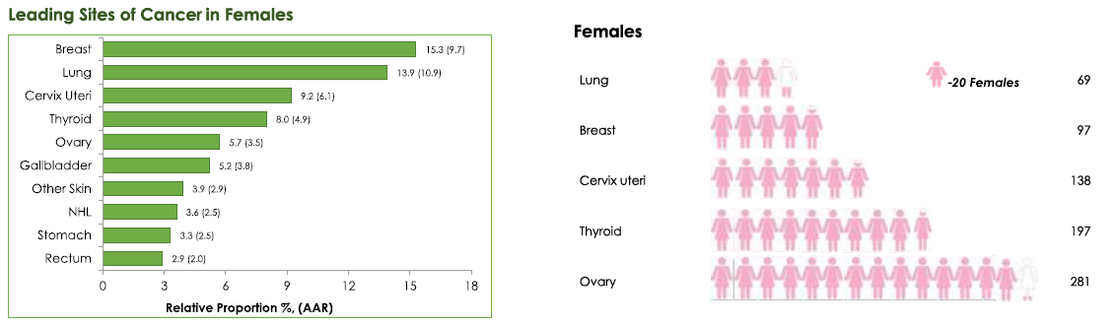
Leading site of cancer in female –Manipur
(ICMR 2017)
Cx 6.1%
2542 (F)
2081(M)
new case
AAR- Age adjusted incidence rate /100,000
Possiblity of one in number of persons developing cancer (0-70years)

Slide 5
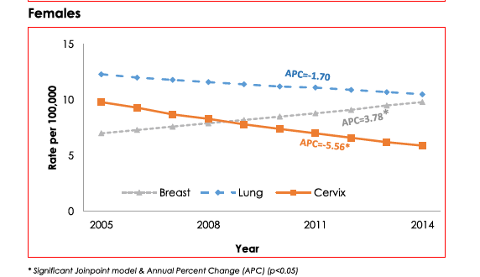
Trends Over Time in Cancer Incidence
In females Breast cancers is increasing and Cervix & Lung Cancers are decreasing

Slide 6
Plan for roll out of VIA in Health & Wellness Center in Manipur (FY2019-2020)
Region | Area (Sq. Km.) | No. of Districts | Population (2011 census) in lacs | Density of population | % of Rural Population
Hill | 20089 | 5(10) | 12.22 | 61 | 92.7
Valley | 2238 | 4(6) | 16.34 | 730 | 54.4
Total | 22327 | 9(16) | 28.56 | 128 | 70.8
Indicator | Status |  |  | Total
Number of Health and Wellness Center Approved till FY 2019-20 | PHC | SC | UPHC
 | 85 | 220 | 7 | 312
Number of Center Identified for Upgradation to HWC till date | 57 | 151 | 7 | 216
Number of CHO Posted till date | NA | 151 | NA | 151
Number of Tablet Issued for NCD GoI App | Nil | 84 CHO + 127 ANM | Nil | 211
HWCs Operational | 15 | 66 | 1 | 82
DH |  |  |  | 7
Medical college |  |  |  | 2
Estimated Population above 30 yrs | Estimated female population above 30 years
4,52,140 | 224590
6,04580 | 300312
10,56720 | 5,24,903

Slide 7

Comprehensive Primary Health Care Services Package in Manipur launched In August 2018
1.Care in Pregnancy and Child-birth
2.Neonatal and Infant Health Care Services
3.Childhood and Adolescent Health Care Services
4. Family Planning,and other Reproductive Health Care Services
5.Management of Communicable Diseases: National Health Programmes
VIA –PBS screening
6. General Out-patient Care for Acute Simple Illnesses and Minor Ailments
7. Screening, Prevention, Control and Management of Non-communicable Diseases –VIA screening
8. Elderly and Palliative Health Care Services

Slide 8
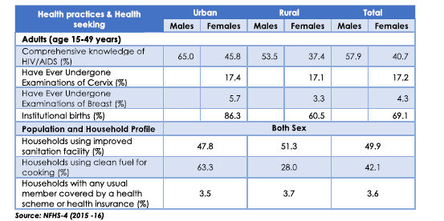
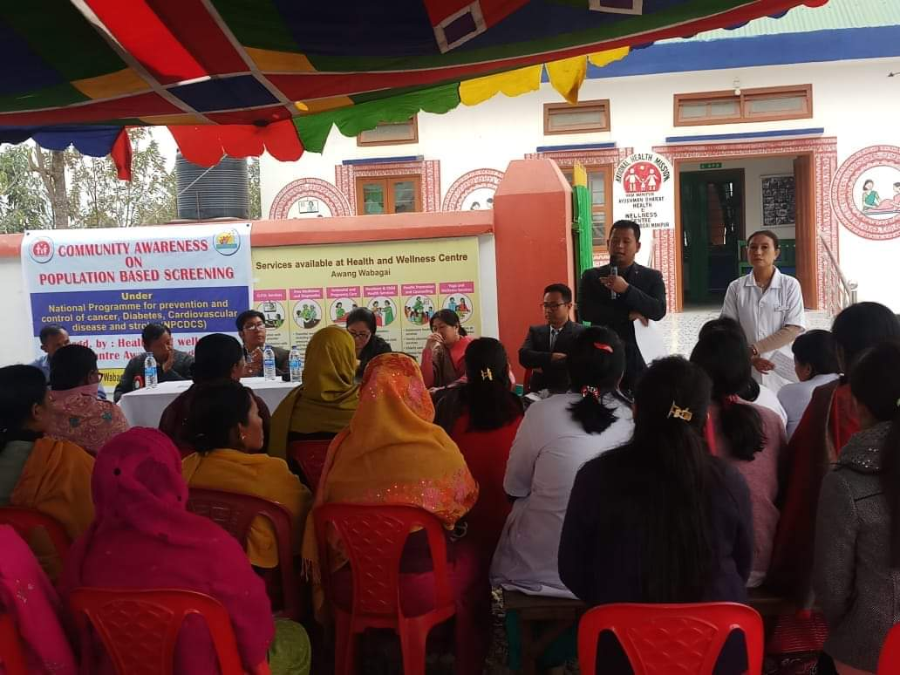
Enhanced Health Seeking Behaviour
Community Awareness on PBS of NCD and VIA screening
Conduct community awareness program on NCD-PBS at every SC-HWCs by the District NCD cell through newly posted CHOs
Informed about the need of NCD screening including VIA program and other services which are to be rendered under HWCs
Gathering ranges from 30-80 people

Slide 9
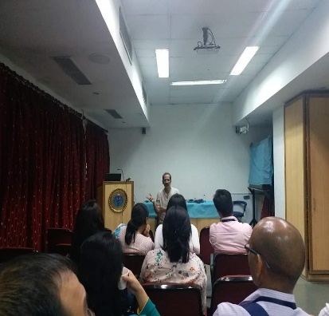
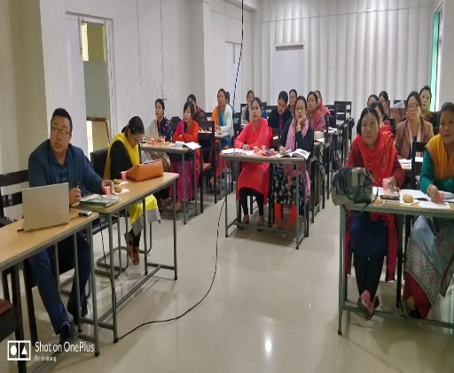
STAKEHOLDER CONSULTSATIONS &
TRAINING WORKSHOPS
VIA Screenings at HWCs
Health Department
NHM
SC- HWC, PHC, CHC
District Hospitals
VIA screening at HWC
RIMS Radiotherapy Dept.
Colposcopy & Cryotherapy at District Hospital
Training of 8 Master Trainers at AIIMS, New Delhi and NIPCR
State Level training for Medical Officers and Gynaecologist On PBS NCD, VIA & Follow up therapy at District Hospitals
District level training of CHO ,ANMs and ASHAS on PBS NCD
Orientation meeting of Stakeholders

Slide 10
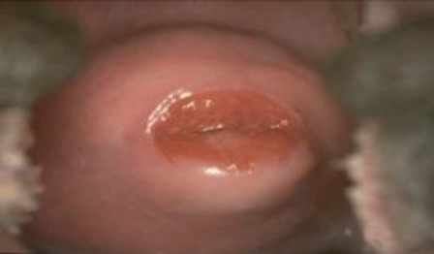
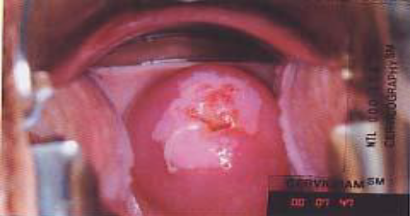
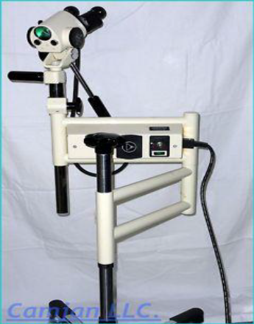
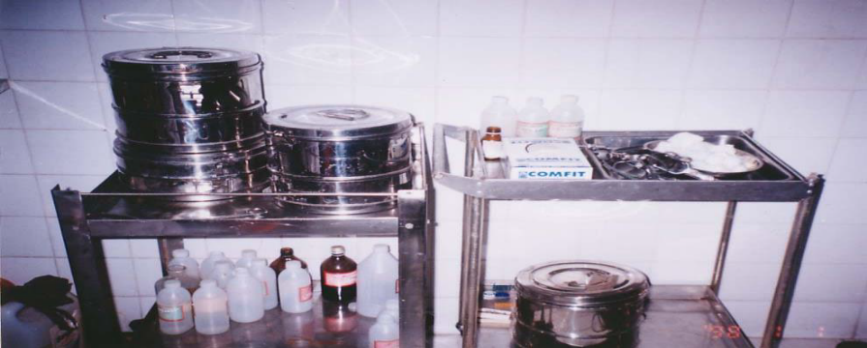
VIA steps and Findings
Process-Swabbing the cervix with 5 % acetic acid solution
Precancerous cell structure temporarily turn white
Can be easily identified by trained Doctors/CHO / Nurses/ Paramedics
Relatively simple / low-Cost /Minimum infrastructure
Results -available immediately
FINDINGS OF VIA TEST DONE BY CHO AT HWC
Normal : VIA NEGATIVE
REPEAT VIA AFTER 3 YRS
VIA POSITIVE
COLPOSCOPY at MC/DH
Biopsy /Treatment JNIMS,RIMS/DH

Slide 11
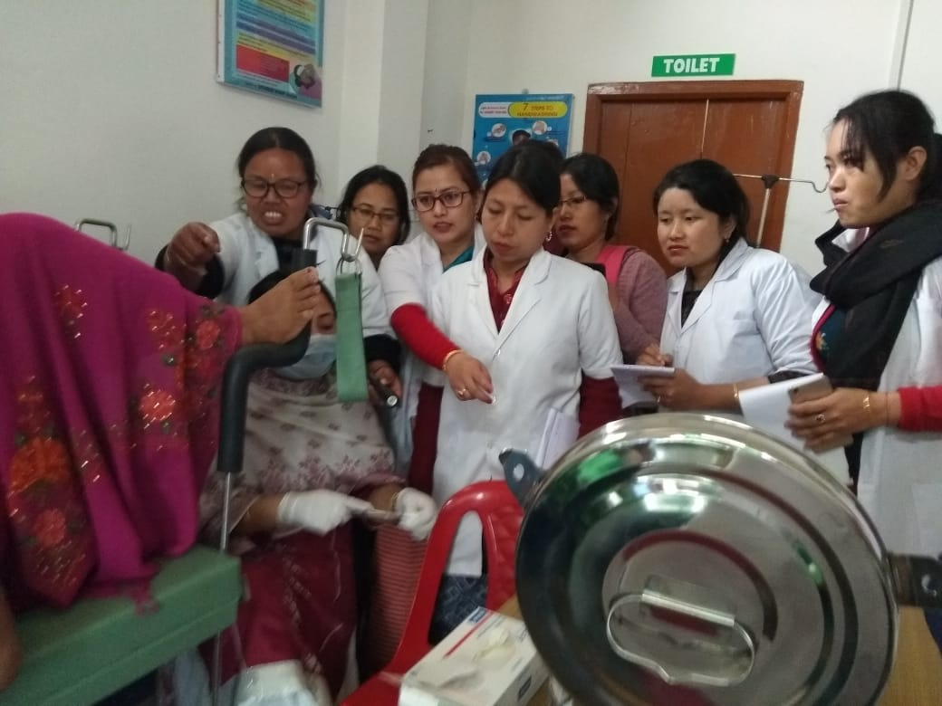
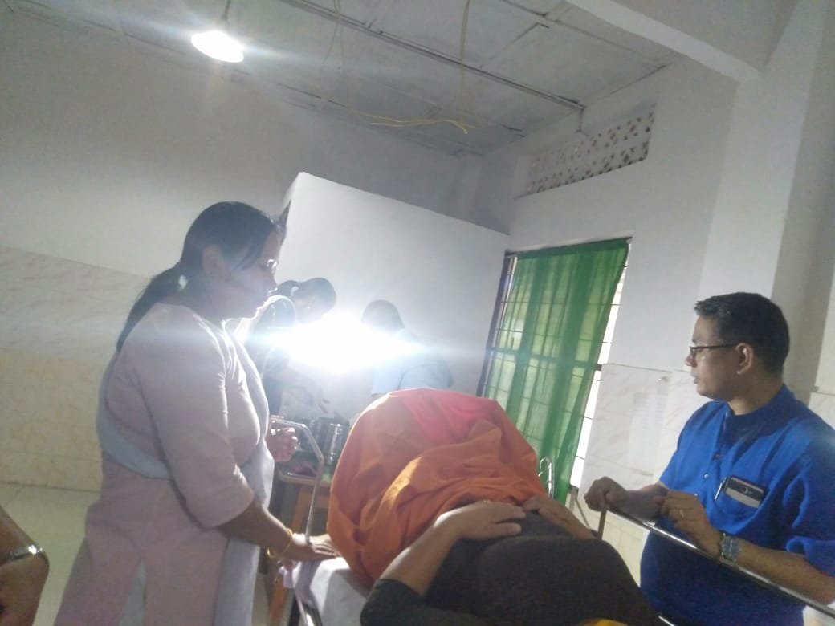
Program outlay and Benefit
Thoubal and Imphal West Districts HWC
CHOs mobilize women through community awareness and ASHA
Class room Training cum screening Done in HWC at least once in three –four months .
CHOs have been given at least 7 days of cumulative VIA trg – First formal theory of 3 days and 2 days of practical and another two days during Supervised visit by MO (once a month) for at least 20 patients /day
Yearly calendar prepared
MO/Gynaecologist also conduct once a month visit to this selected HWC for VIA and other examination
Work plan are prepared to complete partially screened patient within one month

Slide 12
Outcome
Phase I Total CHO Trained in 2018 Phase II Total CHO Trained in 2019 | 27 64
Total number of patients were VIA is done by CHO during first 2days of practical Training (at first phase: 9 HWCs ) Total VIA done during Training at second phase:10 HWCs | 281 481
Total VIA done by CHOs at 19 HWCs after the Training | 1654
Total Eligible Women for VIA at first 9 centres | 7357
VIA positive patient refered by CHO to PHC /DH | 123 (3.6%)
Screen and Treat started in third phase HWC 6 centres

Slide 13
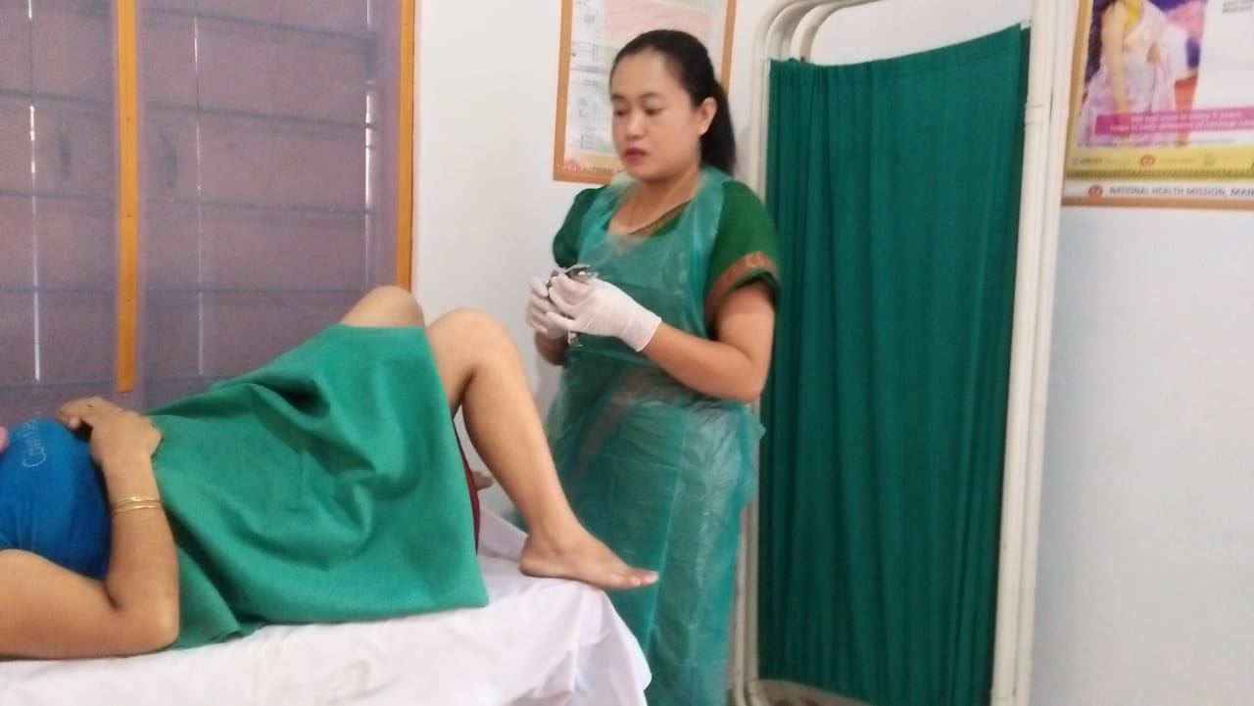
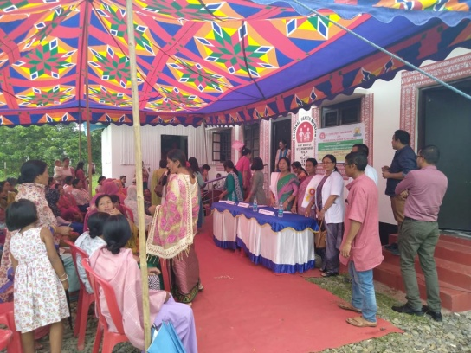
Multiple Benefits
Population Aware Of Cervical Cancer
CHO Trained
Women come forward for VIA
Infrastructure Developed
Early screening of Cervix by VIA
Community participations
Trust and support to Primary health care

Slide 14
SCALABILITY & Future Road maps
Funds are available and marked for each HWC
Adequate Number of community Health Officers available and trainings going on
A strong organizational structure and dedicated State and District Team is now available .
Technical Support by JHPEIGO and TATA TRUST available
Beneficiaries and Public are satisfied and coming forward
PLANS
Other Districts ,Viz Bishnupur has started rolling out similar program since October 2019 and other districts are prepared
Proper follow up mechanisms and treatment –Screen and Treat at selected HWC
Designated ‘ VIA and CBE’ room at all HWC
Training more doctors,CHO and nurses on cryotherapy etc .
Orientation/outreachclinics

Slide 15
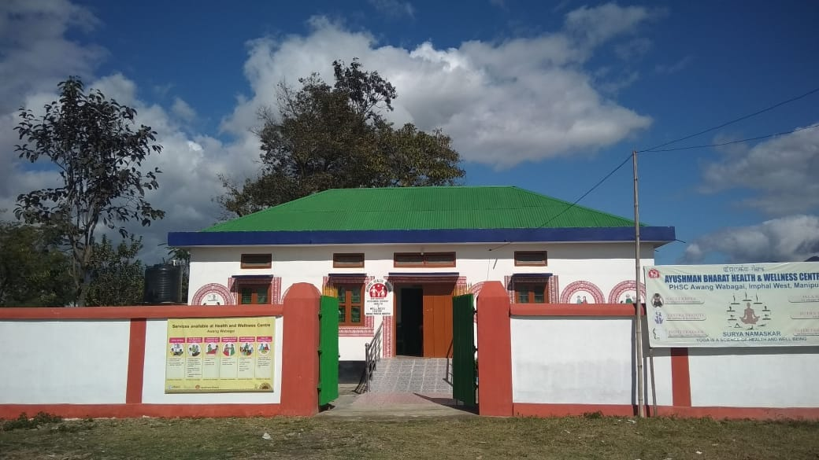

Thank You
Thank You

Slide 16
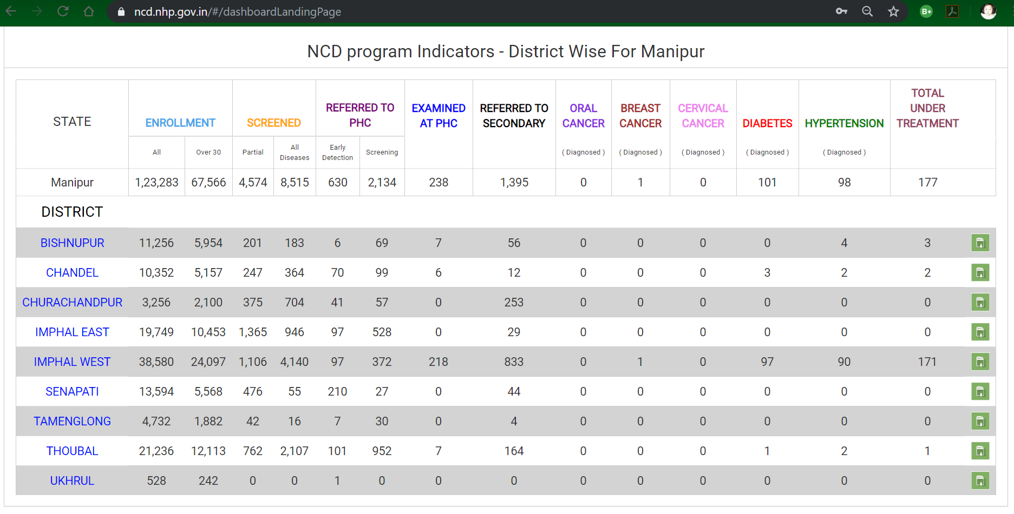
Status of PBS NCD as on 8th Nov 2018

