Slide 1




Aardram Mission
Dr C K Jagadeesan
Deputy DHS &
State Nodal Officer Aardram Mission
jagadeesancu@gmail.com
919447124413

Slide 2
Framework of presentation
Brief overview of Kerala & Newer health initiatives
Aardram Mission-Broad outline
Aardram Mission- Comprehensive Primary Health Care through Family Health Centers (FHC)
-Institutional level changes at FHC & Sub Centre
- Community level interventions for prevention & health promotion
Discussion

Slide 3
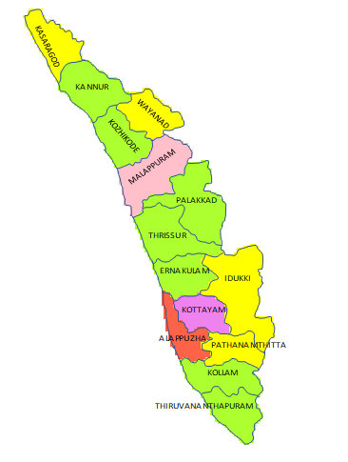

SOCIO-DEMOGRAPHIC BACKGROUND
Total Population : 3,34,06061 ( 2011 Census)
Area : 38,863 Km²
Population Density : 860/ Km²
Literacy rate : 94% (Males - 96.11%, Females 92.07%)
Sex ratio : 1084
Population below poverty line : 7.05 % (2011-12)(RBI)

Slide 4
HEALTH INDICATORS :KERALA AND INDIA
Health Indicators | Kerala | India
Life Expectancy | Males : 72.5 | Males : 67.8
 | Females : 77.8 | Females : 70.4
Birth rate | 14. 2 | 20. 2
Death rate | 6.8 | 6. 3
TFR | 1.7 | 2.2
MMR | 42 | 122
IMR | 10 | 33
Neonatal mortality rate | 5 | 23
Under 5 mortality rate | 12 | 37
Source : SRS 2017

Slide 5
MAJOR CHALLENGES
High prevalence of NCD
Periodic outbreaks of communicable diseases
Elderly Population
Out of pocket expenditure – Highest
Trauma and RTA
Mental health issues & suicides
Health of marginalized populations

Slide 6
NEW INTERVENTIONS IN HEALTH SECTOR
State Health Policy
Aardram Mission
eHealth
State specific SDG intervention
State specific NCD programme
IMR/MMR reduction Programme
Decentralized planning for addressing social determinants of health

Slide 7
AARDRAM MISSION
People friendly transformation of OP services & hospitals
Transforming Primary Health Centres to Family Health Centres
Standardization of District & Taluk level hospitals with super specialty & specialty services
Ensuring protocol/ guideline-based management at all health care institutions
Access to basic health services for tribal communities
Special focus on urban primary health care

Slide 8
STANDARDISATION OF HOSPITALS
Additional posts created
Improving infrastructure – based on Master Plan
KIIFB support of around Rs 4000 crore
Ensuring availability of hospital machineries and equipment
Ensuring standard policies & procedure for case management
Cath Labs & Coronary care units in DH
Dialysis Units in Taluk level hospitals

Slide 9
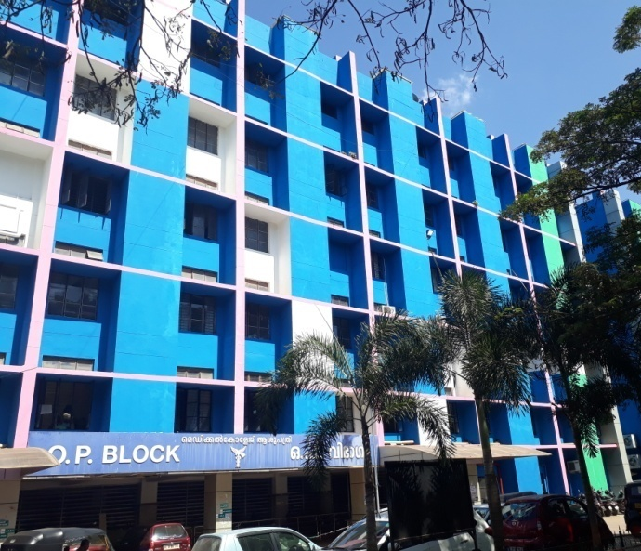
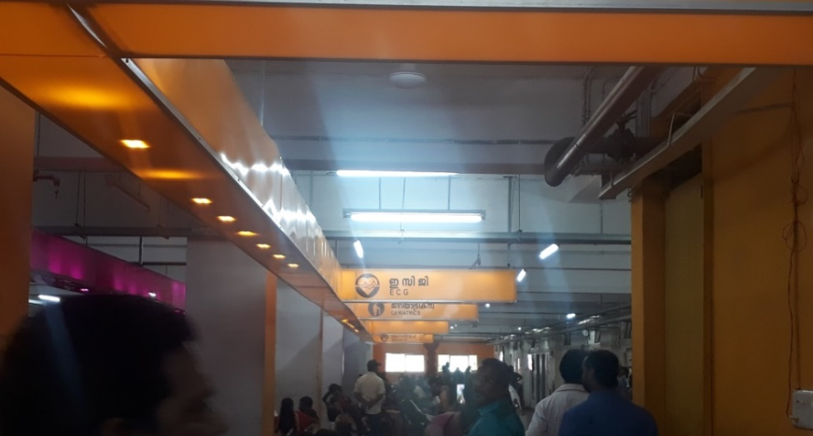
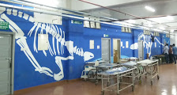
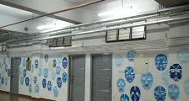

Slide 10
FAMILY HEALTH CENTRES (FHCs)
FHCs will become the foundation and gatekeeper for the entire health care system
VISION
To provide comprehensive and complete health care for every individual
MISSION
To achieve the Sustainable Development Goals
To provide quality, comprehensive health care affordable and accessible to all
Strengthen comprehensive primary health care
Improve the quality of services
Address social determinants of health
Community participation

Slide 11
PHC to FHC Transformation
Focus on comprehensive primary health care (CPHC) by providing promotive , preventive, curative , rehabilitative and palliative services
By Improving services quality and quantity, infrastructure and manpower
Strengthening of Sub-centres
Community based Health promotion & preventive strategies
Addressing social determinants of health
Ensuring effective convergence & community participation

Slide 12
Patient friendly/ people friendly transformations
Adequate waiting areas – primary & secondary
Seating facilities with airport model chair
Drinking water supply & adequate toilet facilities
Child/women/elderly/ women friendly arrangements
Breast feeding area, indoor /outdoor play areas for children
Electronic display boards, IEC materials & Public Address System
Uniform colour, branding , logo , landscaping & beautification etc.
Ensuring effective convergence & community participation

Slide 13
How an FHC differs from a PHC ?
Characteristics | Family Health Centre (FHC) | PHC
OP hours | 9 am to 6 pm | 9 am to 2 pm
Nurse’s role | Amplified | Peripheral
Referral and follow up | As per CPHC guidelines | Limited compliance
Laboratory services | Available at all centres | Only in few centres
Sub-centre clinics | Six days a week | Not all days
Institution based care | Becomes regular with Staff Nurses | Erratic
Human resources | 3 doctors, 4 staff nurses | 1-2 doctors, 0-1 Staff Nurses

Slide 14
FHC- Clinical care
OP time from 9 Am to 6 Pm
At least 3 Doctors, 4 Staff nurses, 2 Pharmacists and 1 Lab technician provided
Pre-check up & Counseling services by staff nurses
Outreach institutional services through staff nurses at old age homes, hostels etc.
Specialty clinics like SWAAS and Aswasam Clinics
NCD Clinics on all days
Laboratory in all FHCs
Treatment guideline based management
Electronic medical records

Slide 15
Components of SWAAS programme for Asthma and COPD
Screening & Diagnosis using Spirometry
Staging of Disease
Guideline based Treatment for Asthma and COPD
Provision of Inhaler medications
Pulmonary Rehabilitation Programme
    Smoking cessation clinics
    Exercise clinics
    Depression Screening
    Dietary Advices
Referral & Follow up Services

Slide 16
Aaswasam – the depression management program as on Oct 19
SCREENED
44276
PHARMACO
THERAPY
5039
PSYCHOSOCIAL INTERVENTION
8267
REFERRED TO DMHP
1774

Slide 17
Sub Centre Clinics 2-4 PM
Clinics | Beneficiaries | Services | In charge | Supervision
Women | Women and girls | Adolescents, reproductive age group (18 -49) | JPHN | PHN
NCD | Adults >30 yrs NCD cases | Prevention, screening, monitoring, referral, rehab | JHI/JPHN | HI/PHN
Geriatric | Elderly (>60yrs) | Prevention, screening , rehab | Men -JHI Women -JPHN | HI/PHN
Immunisation & ANC | Children <15 yrs, antenatal, Postnatal women | Immunization ANC PNC | JPHN & JHI | HI/PHN
Life style Education | General public | Health Education, screening, monitoring | ASHA & Arogyasena | JPHN&JHI
SWAAS /ASWAAS | General public | Prevention, Screening, rehab | JHI/JPHN | HI/PHN

Slide 18
PHC to FHC Transformation status
170 institutions selected for 2017-18 , 504 in 2018-19 around 250 operational
Posts created : 570 doctors, 640 nurses, 370 lab technicians, 150 Pharmacists
Total posts created:1730
Infrastructure modification- state plan fund , NHM, PRI fund ,MP/MLA fund, local resource generation
Lab equipment & FHC equipment - Plan fund and NHM
Sub-centre renovation and equipment via NHM
UPHC transformation with NUHM fund -83 nos

Slide 19
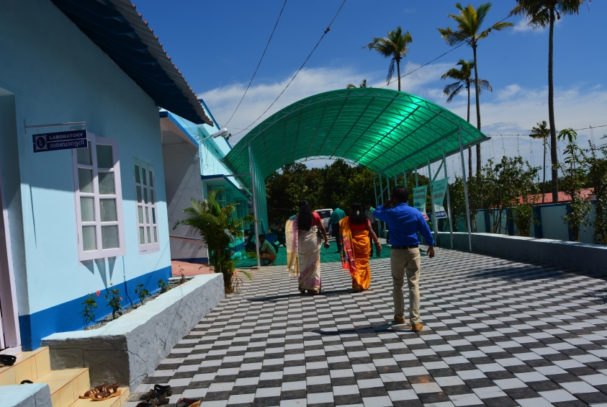
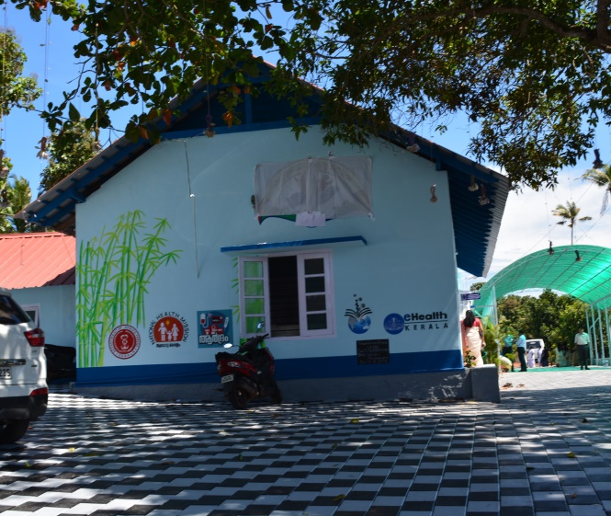
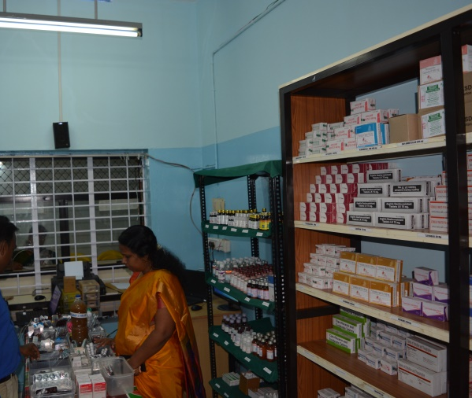
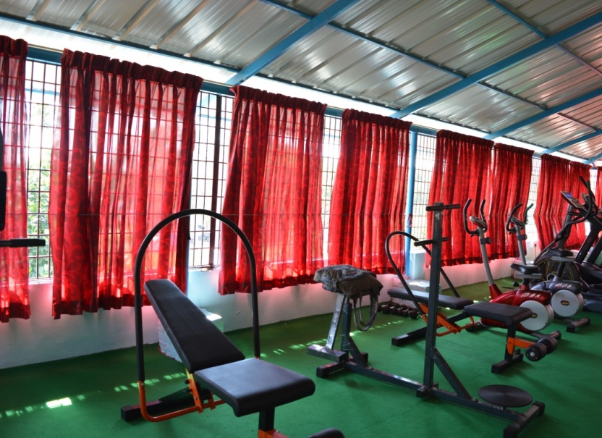
FHC Chemmaruthy

Slide 20
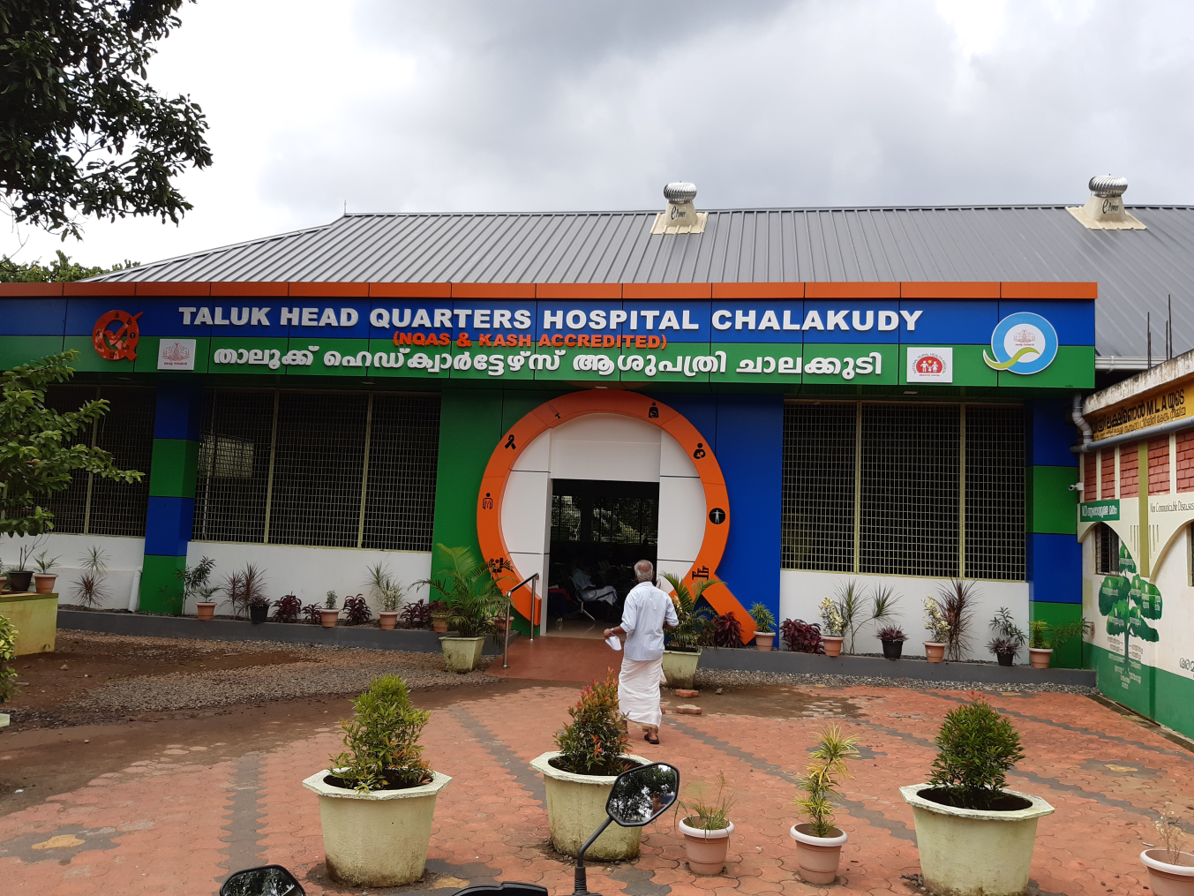
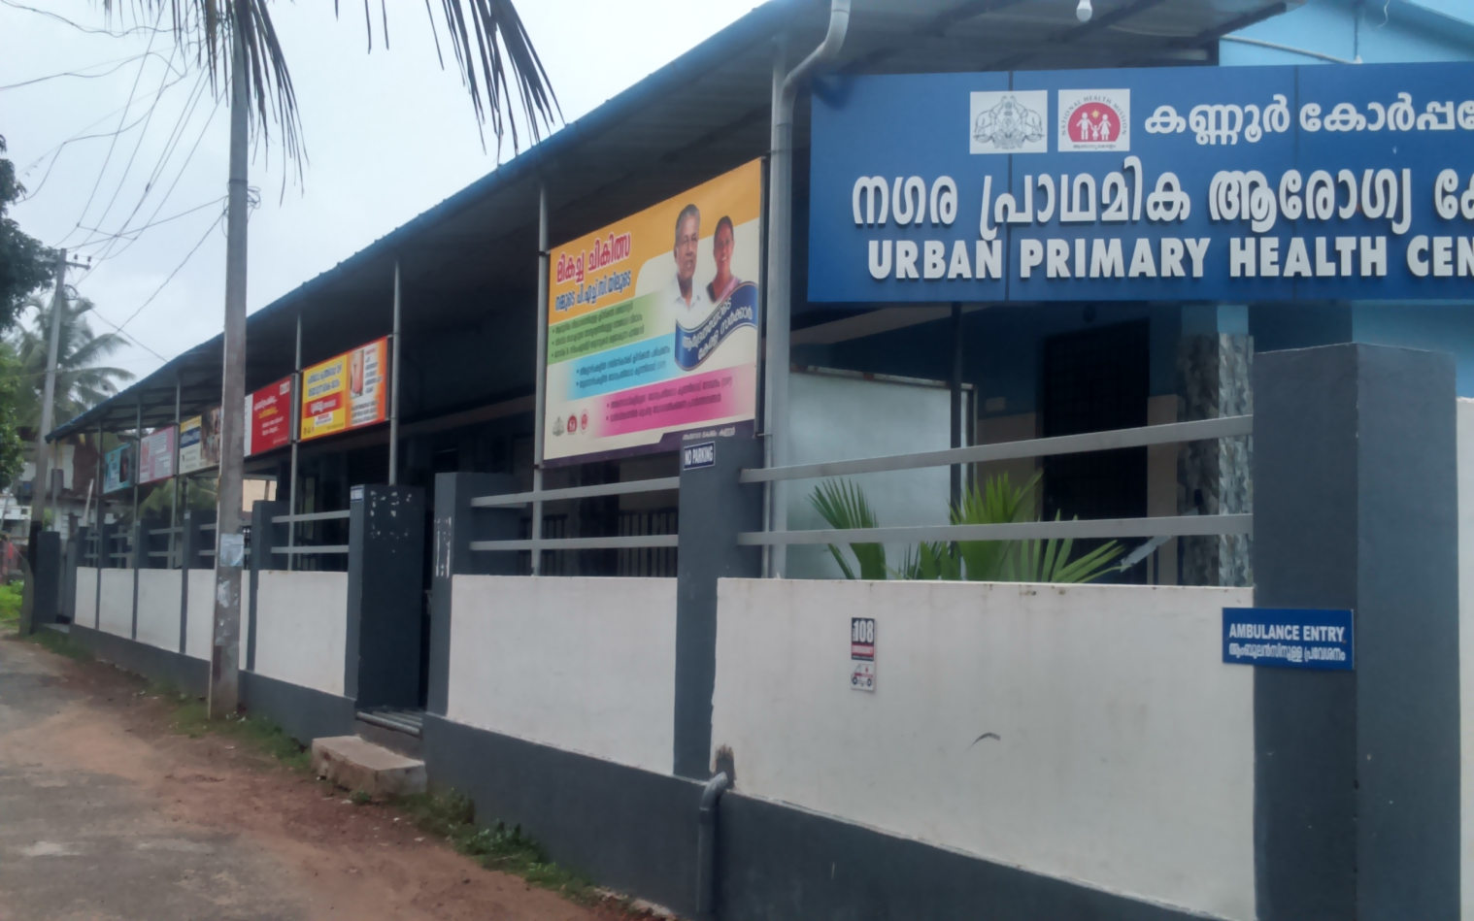
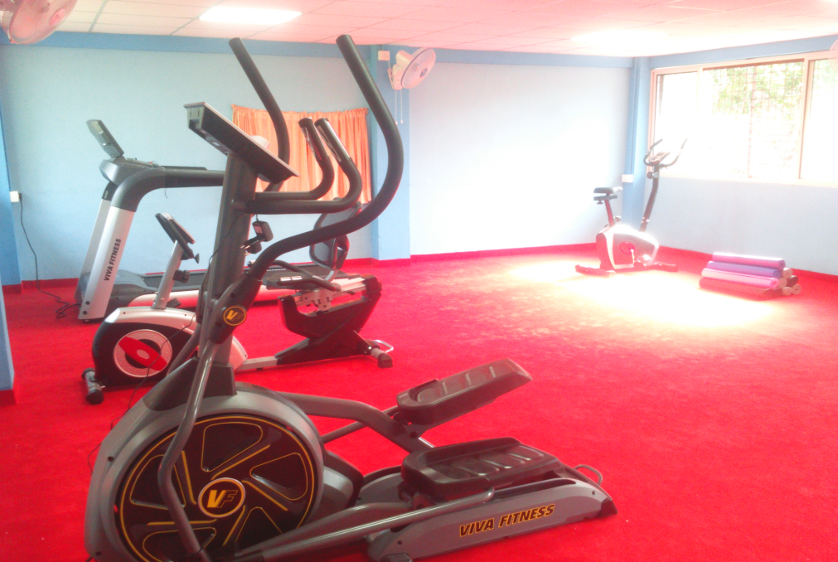
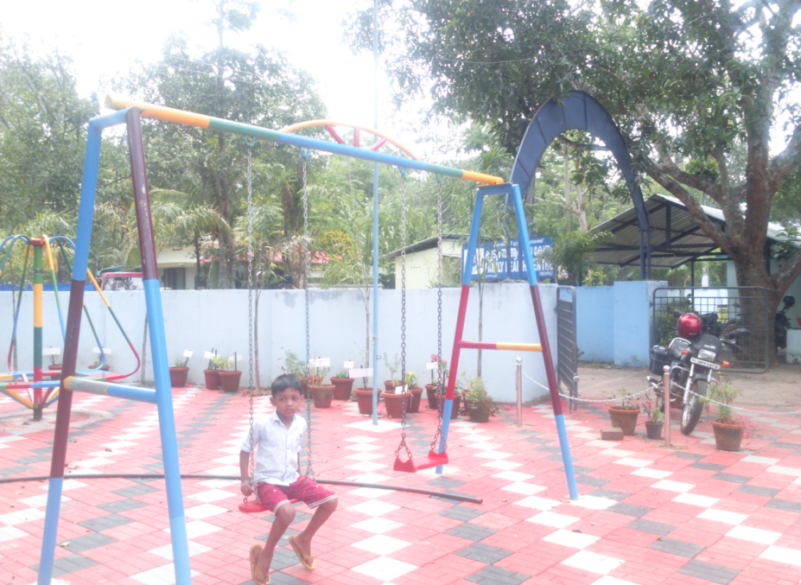
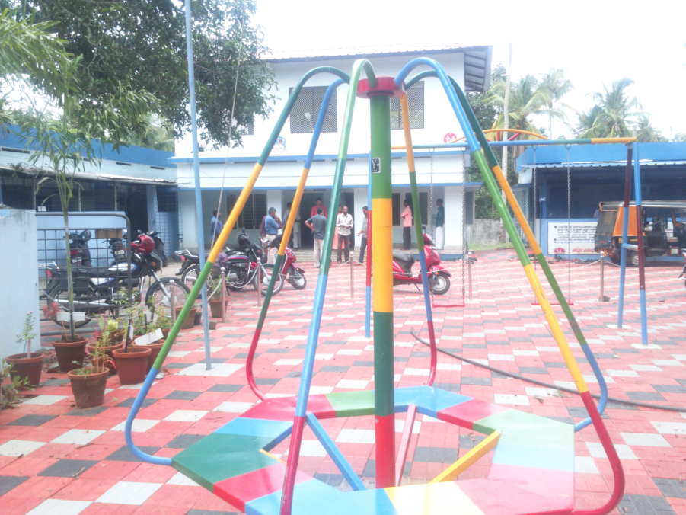

Slide 21
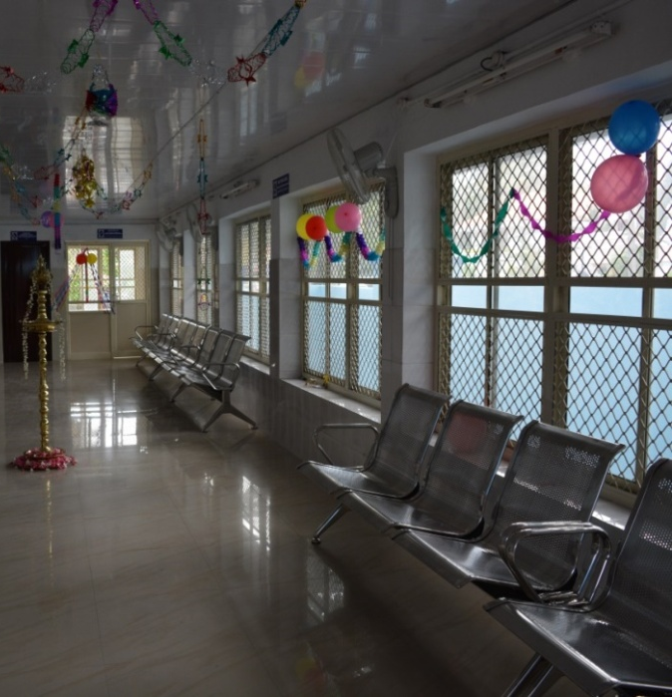
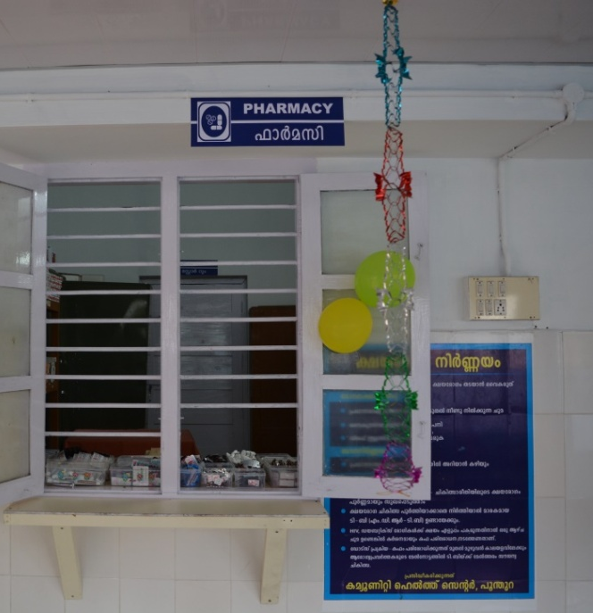
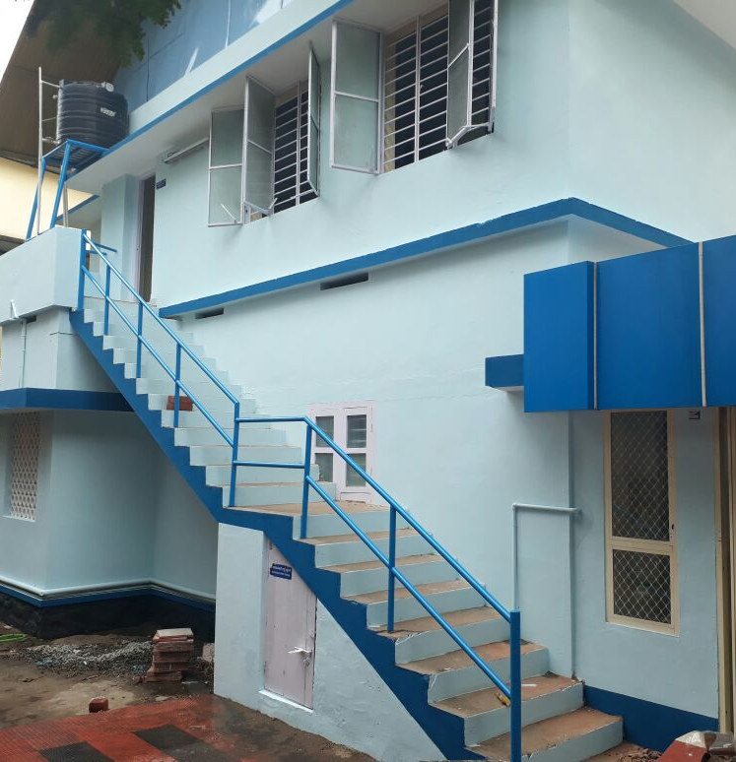
FHC Kadakampally

Slide 22
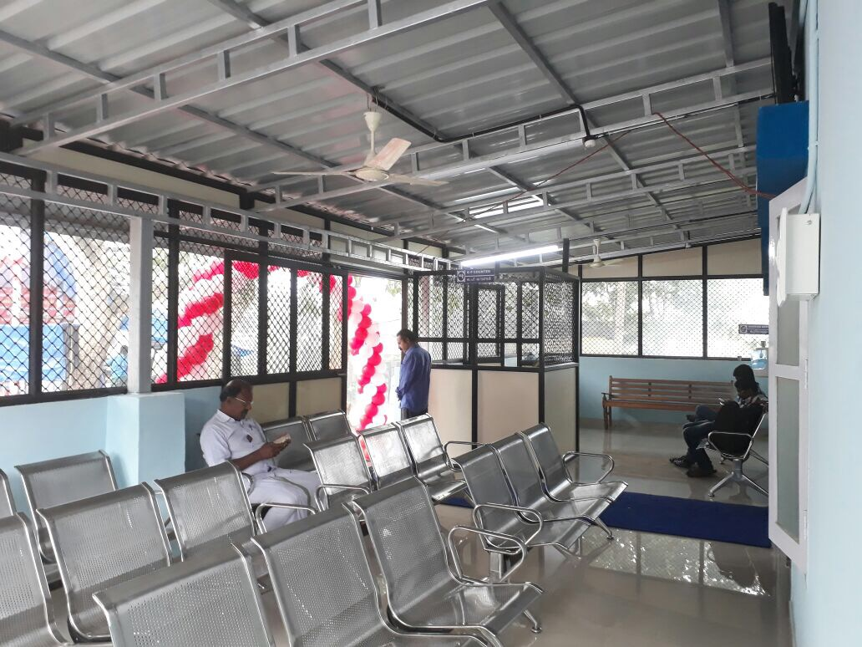
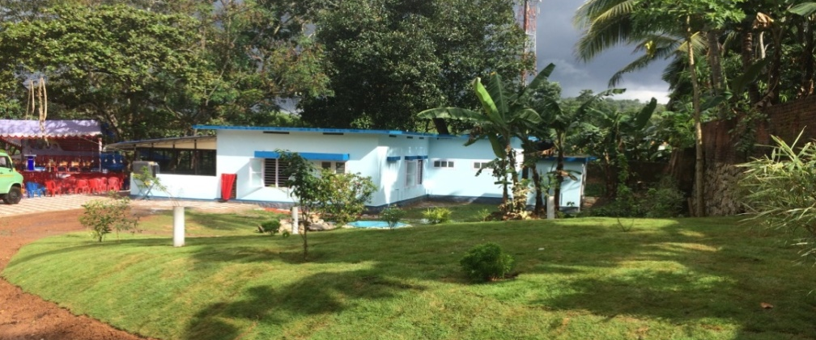
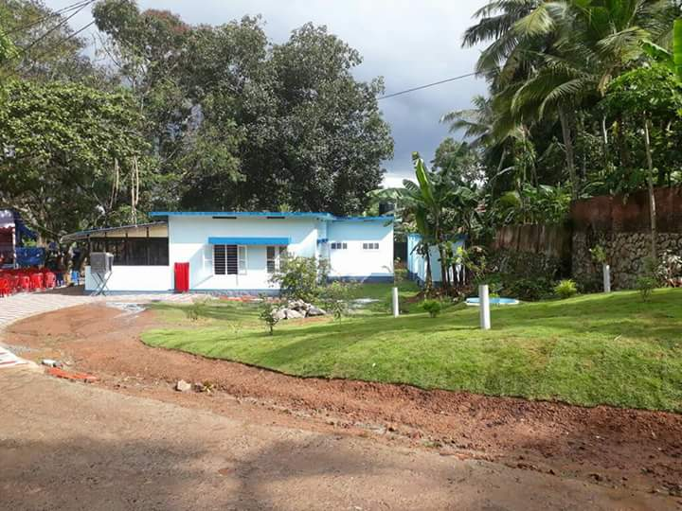
FHC Aruvikkara

Slide 23
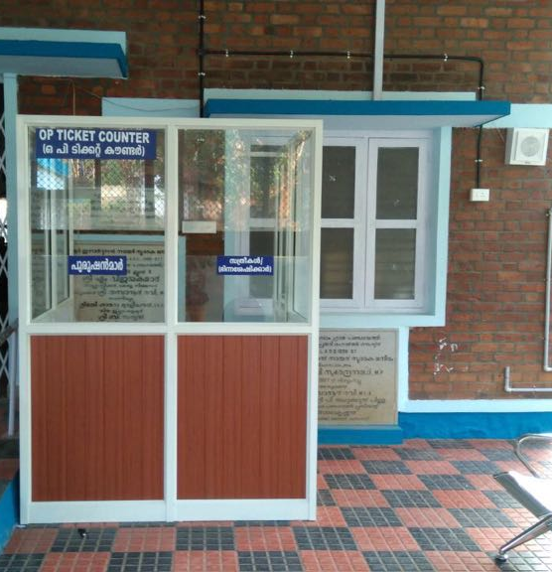
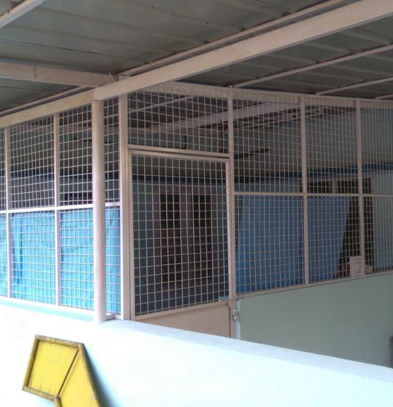
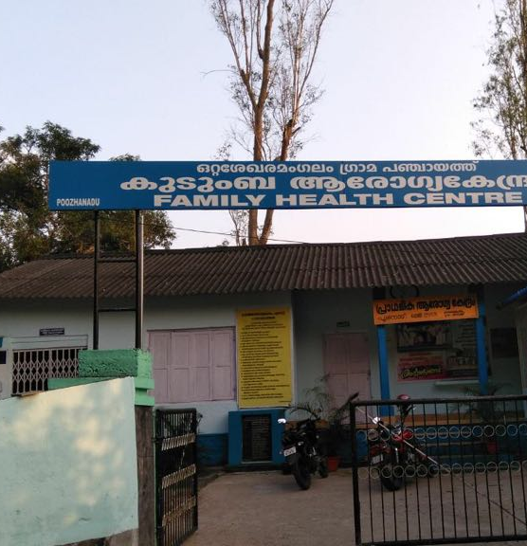
FHC Poozhanad

Slide 24
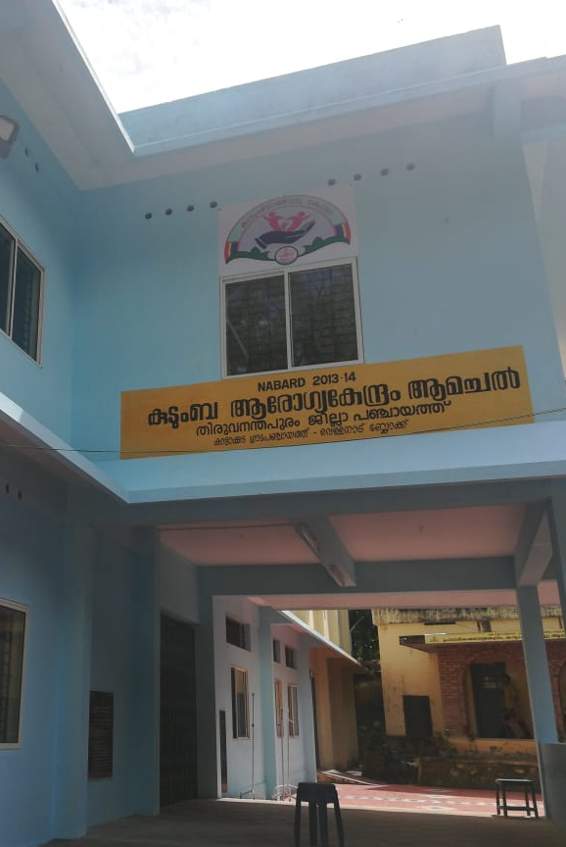
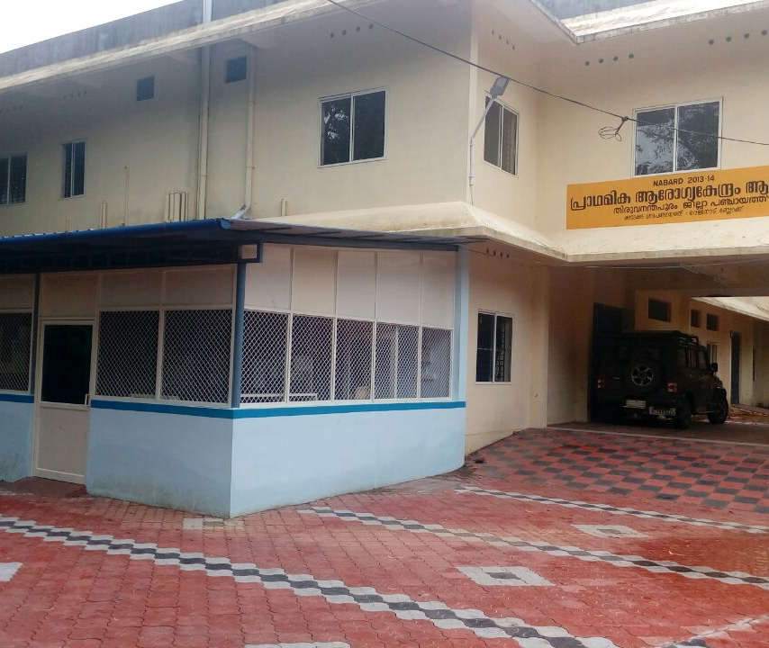
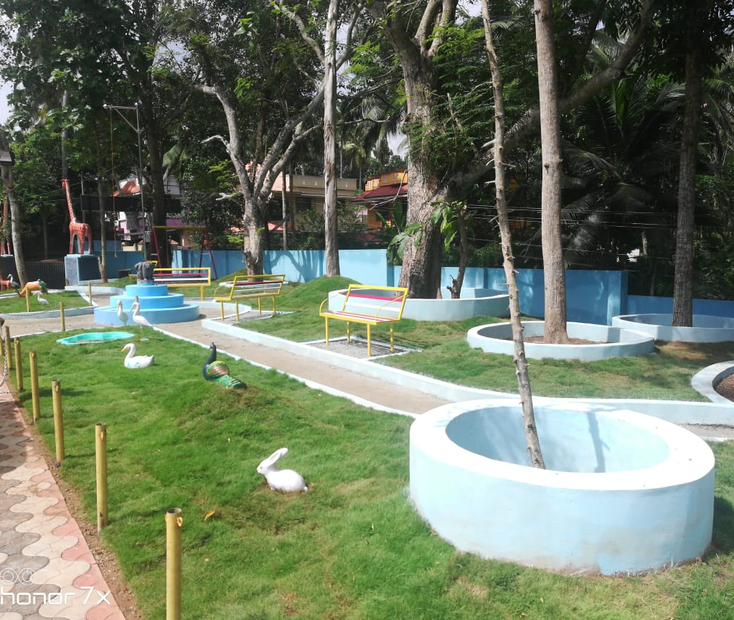
FHC Amachal

Slide 25
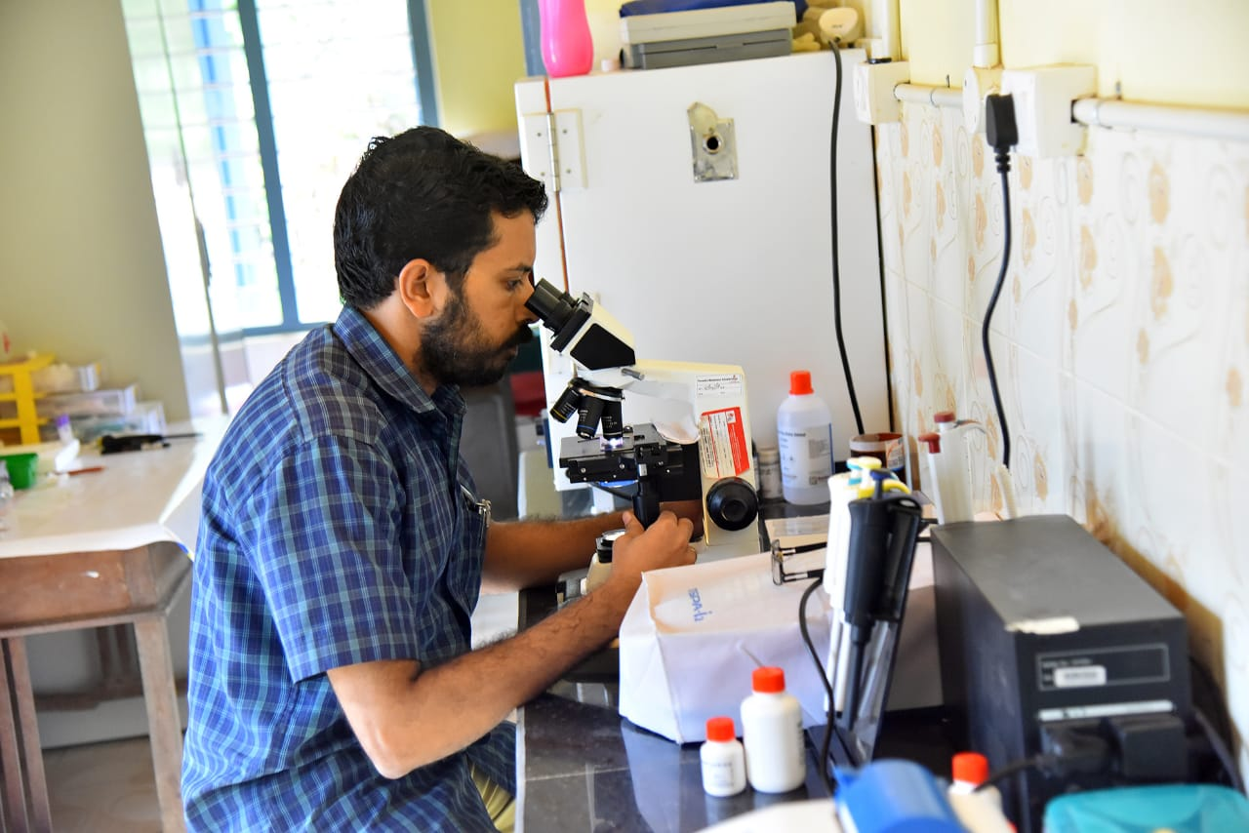
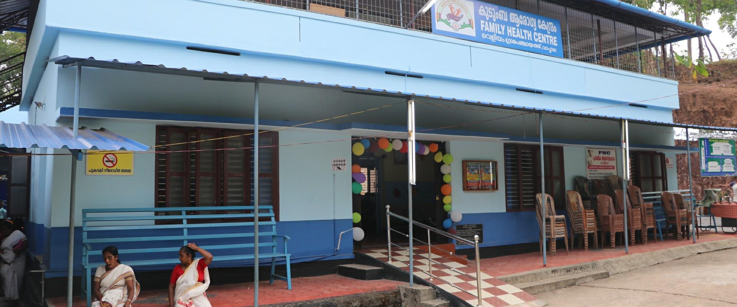
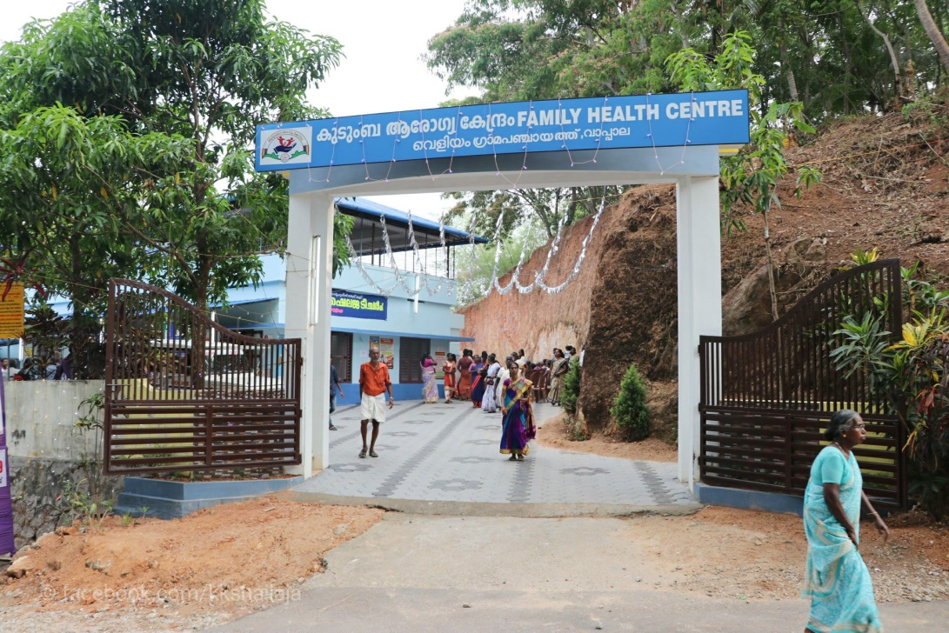
FHC Veliyam

Slide 26
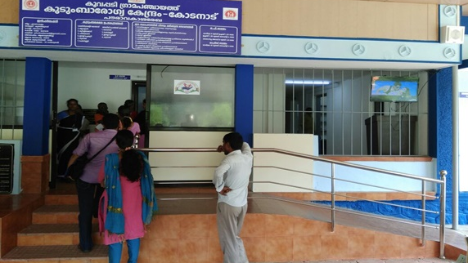
FHC Kodanad

Slide 27
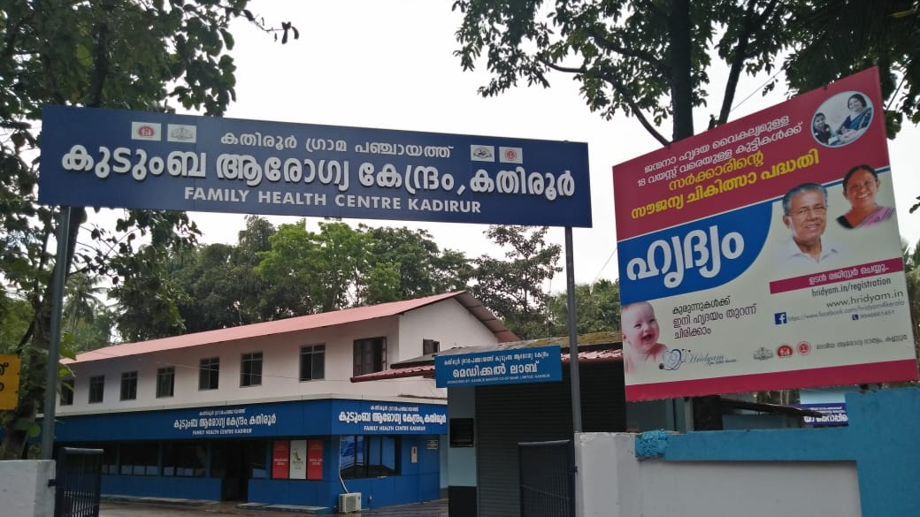
FHC kathiroor

Slide 28
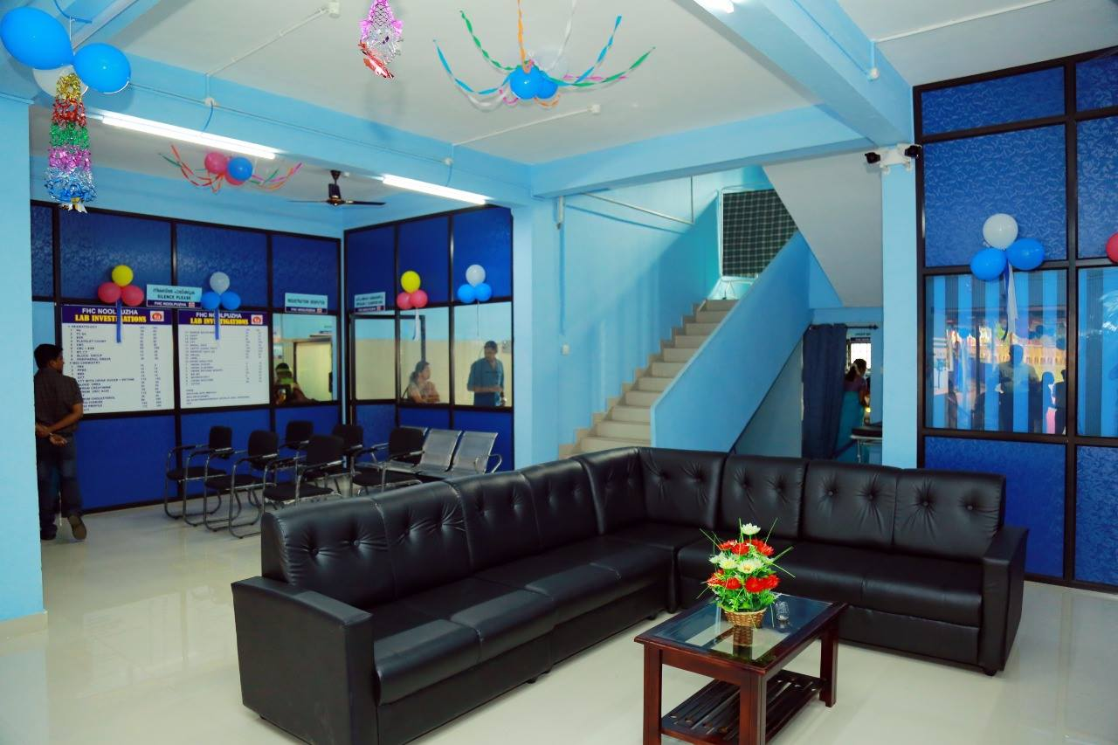
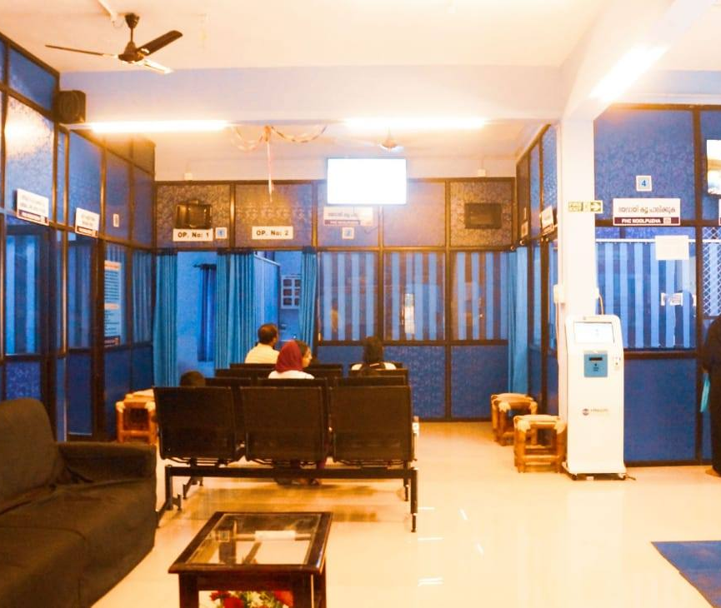
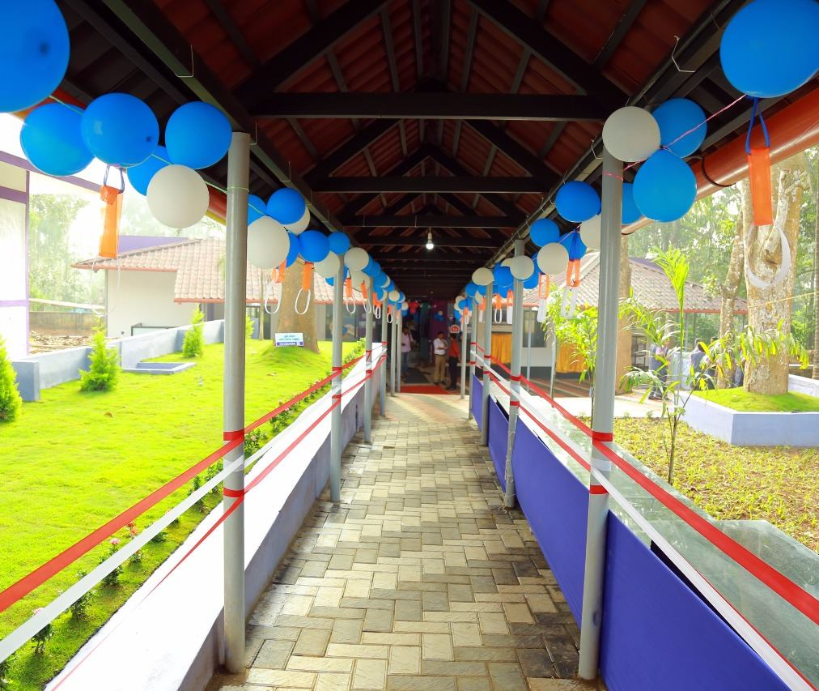
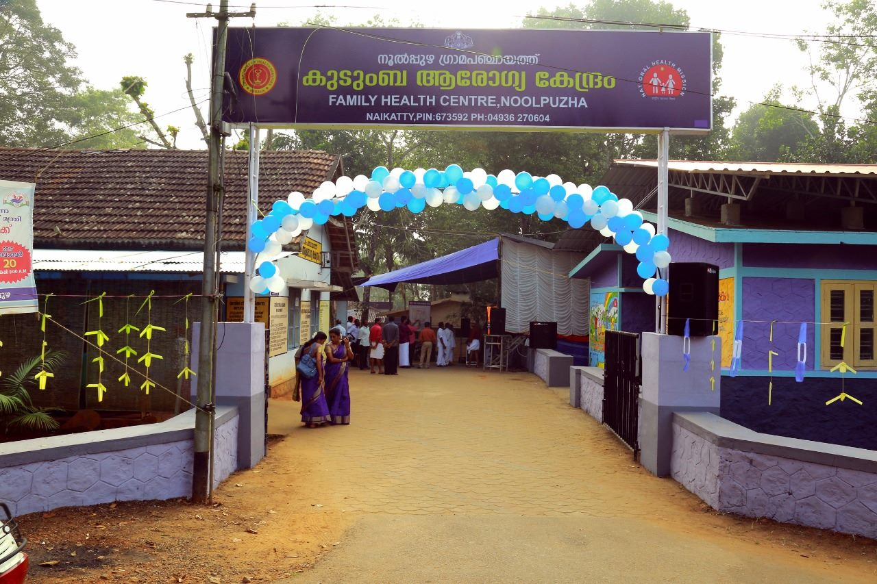
FHC Noolpuzha

Slide 29
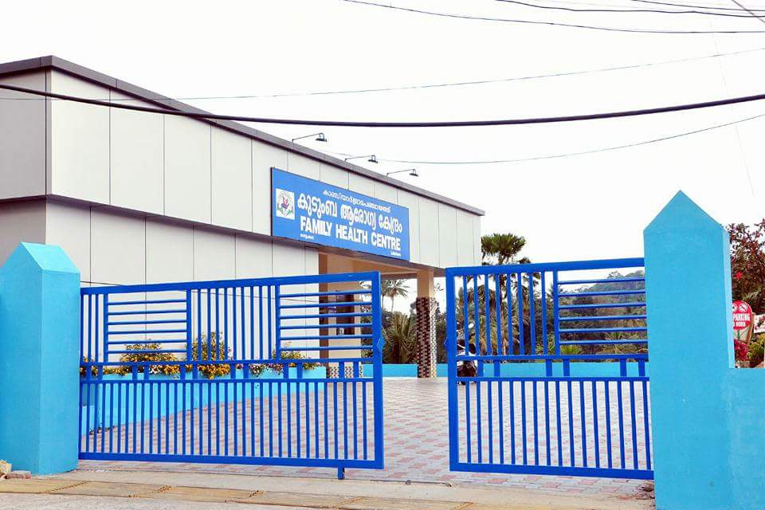
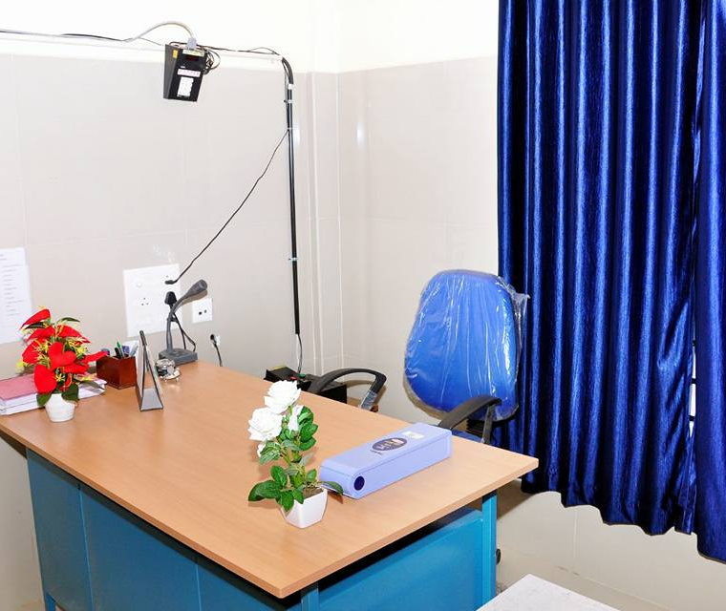
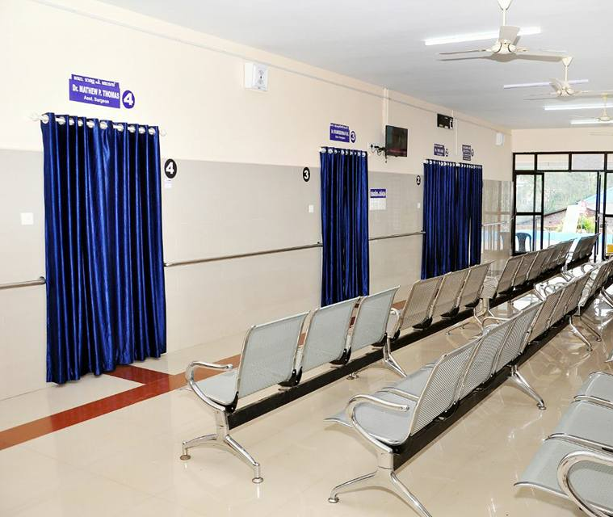
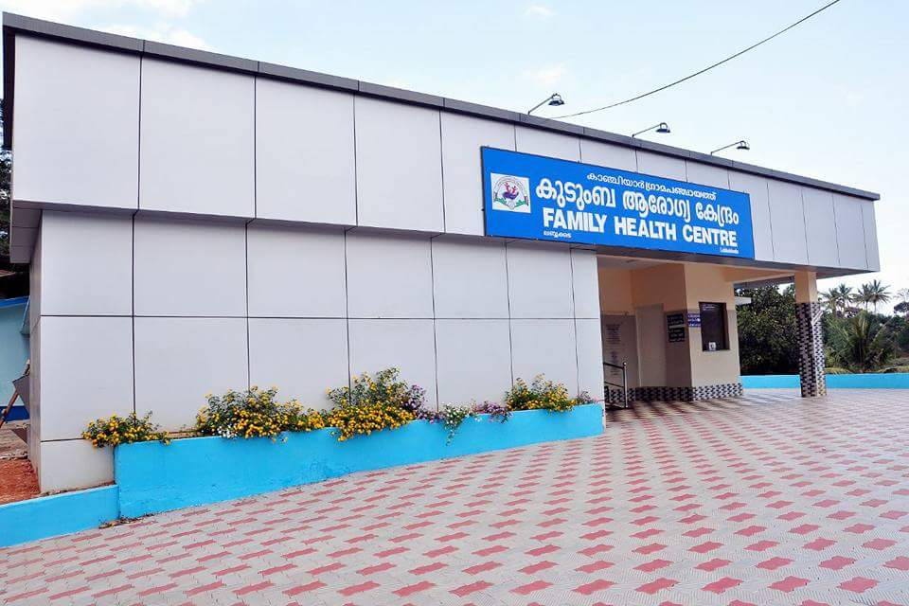
FHC kanchiyar

Slide 30
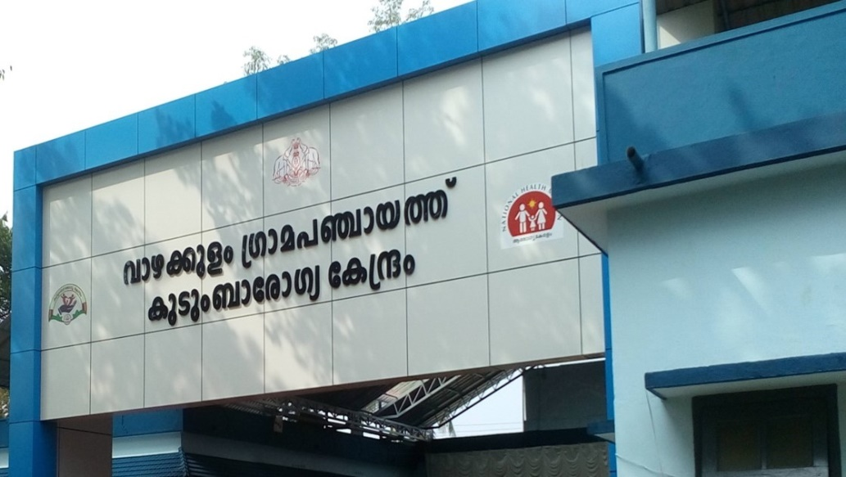
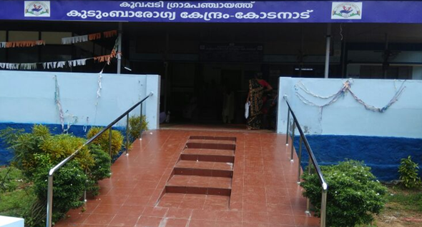
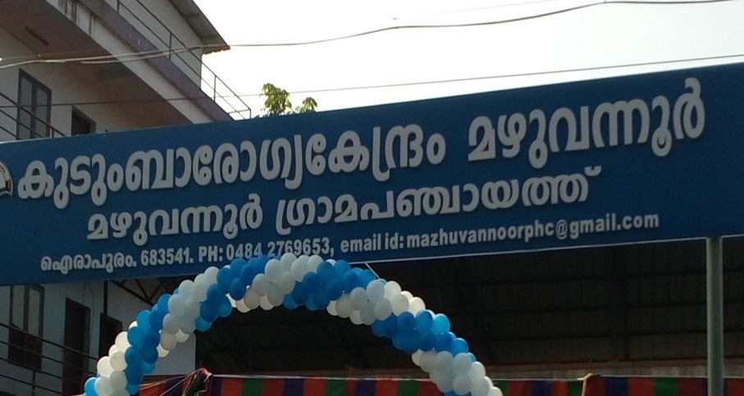
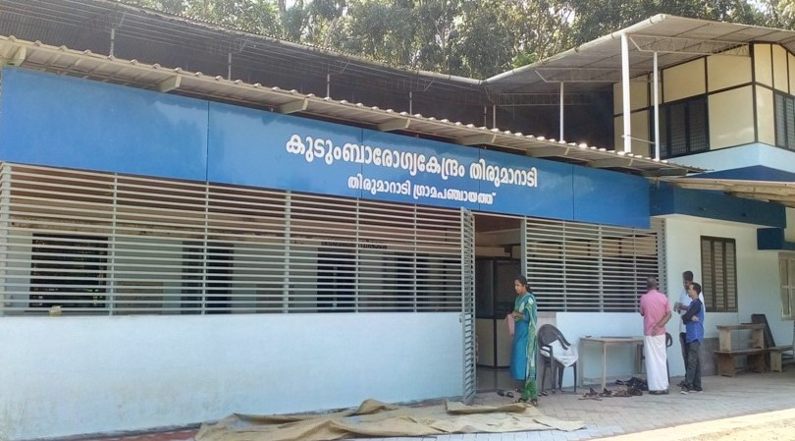

Slide 31
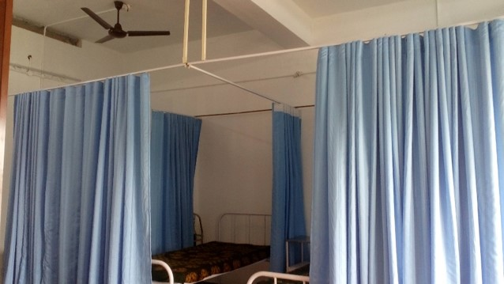
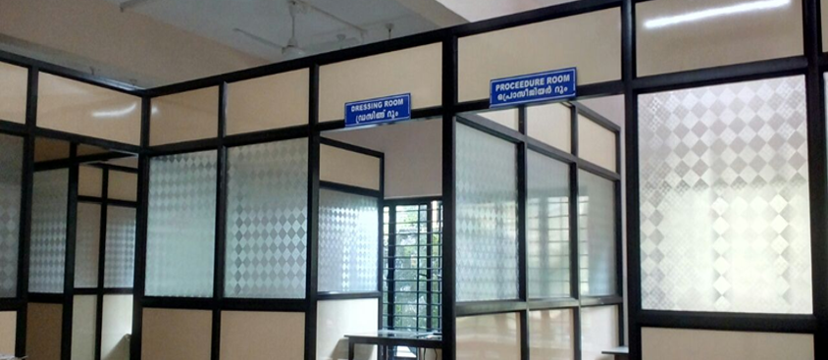
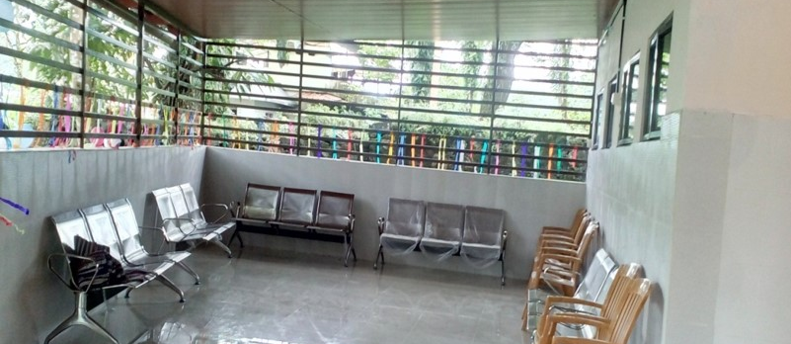
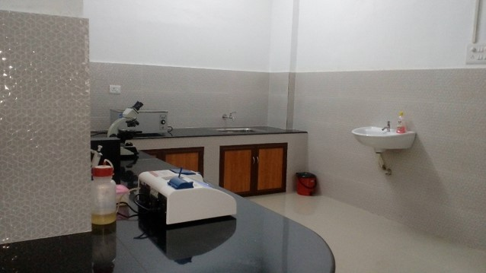

Slide 32
HEALTH CARE SERVICE DELIVERY PLAN
Family Health Register
Ward Health Plan
Grama Panchayath Health Plan
Family Health Care Service Delivery Plan
Individual Health Plan
Social Determinants

Slide 33
SERVICE PACKAGES
Newborn | Immunisation
Infants | NCD
Under Five | Diabetes
Children 6 to 9 years | Hypertension
Girls (10-17 years) | PWD
Boys (10-17 years) | COPD
Men (18-59 years) | CAD
Women (18-59 years) | Stroke
Older Women | Mental Illness
Older Men | Cancer Care
Accidents & Injuries | Palliative Care
Obesity | Leprosy
Substance Abuse | Tuberculosis
Underweight

Slide 34
FAMILY SERVICE PACKAGES
Addresses health needs of all family members
Drinking water
Well chlorination
Vector control
Indoor air quality
Household waste disposal &
Kitchen garden

Slide 35
FAMILY SERVICE PACKAGES
Waste management: Biodegradable and non-biodegradable
Ensure green protocol
Provision of sanitary latrine
Care for domestic animals to prevent zoonosis
Provisions to decrease indoor air pollution
Adequate ventilation and lighting inside the house
Prevent domestic accidents/injuries

Slide 36
WARD AND PANCHAYAT PACKAGES
Provision of safe drinking water
Solid and liquid waste management
Places for promoting physical activity & Recreation
Ward level health care service delivery through WHSNCs
Arogyasena : additional health volunteer for every 15-20 houses

Slide 37
PRIs & FHCs
PRIs support for :
Infrastructure- Panchayaths fund for infrastructure & public health programmes
Human resources- One doctor & One Paramedical staff
Other logistic support as and when required
Community Partnership and Participation
Convergence with other departments
Preparation of Annual Health Status Report (HSR)
Panchayat specific SDG targets

Slide 38
COMMUNITY PARTICIPATION
Convergence of Missions, Depts, Agencies
Harithakeralam
Ward Sabha
Grama Sabha
Local NGOs
Kudumbasree
Oorukoottam
Other organisations
LIFE
Pothuvidyabhyasa Samrakshana Yajnam
Ayal Sabha
Community Structures
Community Health Volunteers
ASHA
Arogyasena
Anganwadi worker
Kudumbasree volunteer
Tribal promoter
SC Promoter
Other volunteers
Line depts./ agencies

Slide 39
Community participation: Arogyasena
In addition to ASHA workers & Kudumbasree volunteers
One Health Volunteers for each 15-20 households
~25 Health Volunteers from each ward
~500 Health Volunteers from each panchayath
To improve Male participation:
Any dedicated person can be part of Arogyasena
Retired/working persons
Students,
NGOs
Residents Associations etc.

Slide 40
Arogyasena
Mode of work
Work in collaboration with WHSNC
Activities:
prevention and control of Communicable Diseases
prevention and control of Non-Communicable Diseases
Promoting physical activity
Mental health
Palliative and Elderly care
Nutrition

Slide 41
Mental health programs under Aardram
ASWAASAM program- FHC level depression management clinics
Sampoorna manasikarogyam- FHC linked field level Mental health programme
Amma manass: Maternal & Infant Mental Health programme

Slide 42
Out reach Institutional services by Staff nurses
Services at elderly care homes, orphanages, work places, offices etc
NCD screening , follow up counseling
Management of minor medical problems
Health promotion & prevention.
IPC &IEC

Slide 43
Focused Health Promotion prevention programmes
Communicable Disease Control
Yearlong Aroya Jagratha programme
Newer initiatives for NCD Control , Elderly health care , cancer control etc.
Physical activity promotion- Gymnasium at FHCs, Open Gym. at public places, walk ways
Yoga halls in FHCs and Yoga training programmes
Cycling , swimming promotion activities with sports council, PRI etc
Elderly get-together and cultural programmes
Further expanding the Palliative and Elderly care services
Nutrition

Slide 44
PHC to FHC Transformation Process
Other managerial mechanisms
Combined training of Health Staff & PRI members
Exposure visits to good first generation centers
Category wise training to doctors & all health staff.
Revised Job responsibility - Govt. order for all category staff.
Training manuals & modules for all category staff.
Monthly monitoring system
Supportive supervision from state & dist. Level.

Slide 45
Aardram People’s Campaign
Focussing five areas
Healthy food
Promotion of physical activity
Positive mental health & de-addiction
Cleanliness & waste management
Health Promotion ,Prevention and improving health seeking behaviour.
Hon’ble CM inaugurating the state wide campaign on 18th November 2019

Slide 46
Enabling Environment in Kerala for CPHC
Political will, State Health Policy
Enhanced State Budget Allocation
Decentralized Planning , and transfer of Health care Institutions to PRIs
Support through NHM for new schemes/ Innovations
eHealth & New IT support systems
Enabling environment through PRI &Community involvement - Decentralized planning

Slide 47
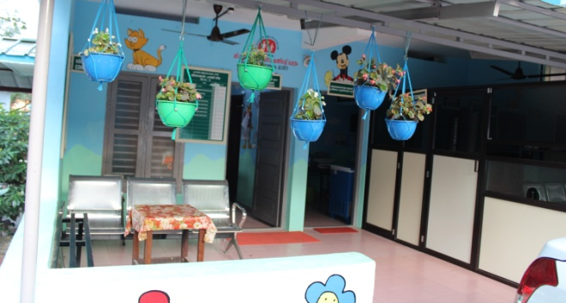
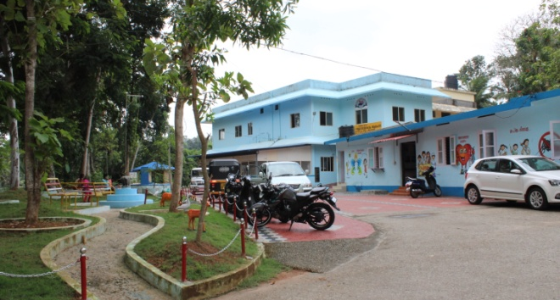
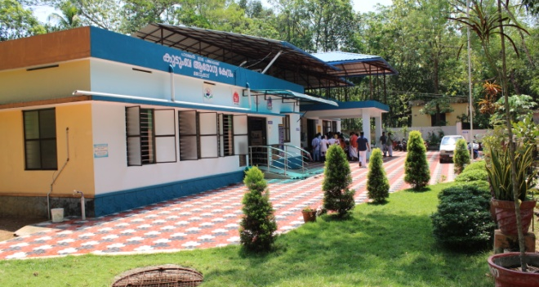


Slide 48





Slide 49





Slide 50

Thank You

