Slide 1

MUKHYA MANTRI KSHAY ROG NIVARAN YOJNA (MMKRNY)
State’s initiative for complementing RNTCP to end TB in Himachal Pradesh
Dr. Nipun Jindal IAS
Special Secretary Health cum
Mission Director NHM
Himachal Pradesh

Slide 2

TB Burden -2019 ( Global & India)
Estimates of TB Burden (2018) | Global (lakh) | India (lakh) | % of Global
Incidence TB cases | 100 | 26.9 | 27%
Mortality of TB | 12 | 4.40 | 31%
MDR-TB | 5 | 1.30 | 24%
Tuberculosis is number one infectious killer disease at global and also at national level in India
Source: Global TB Report 2019

Slide 3

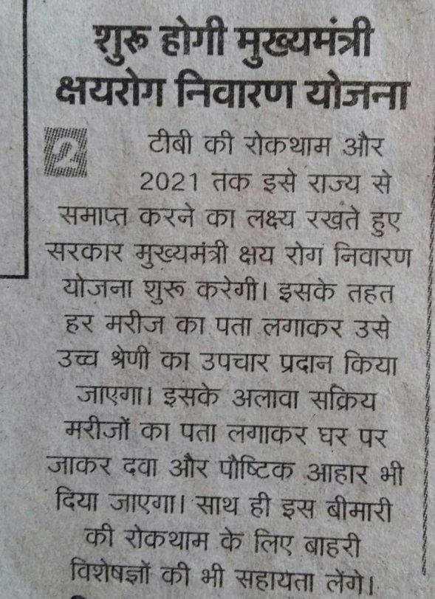
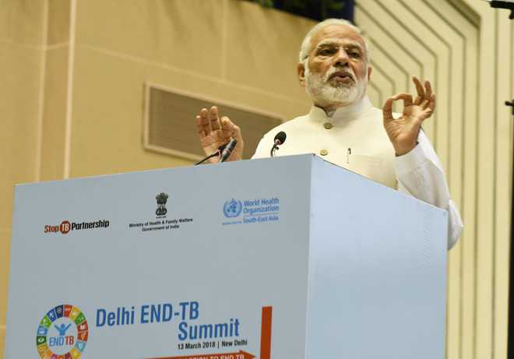
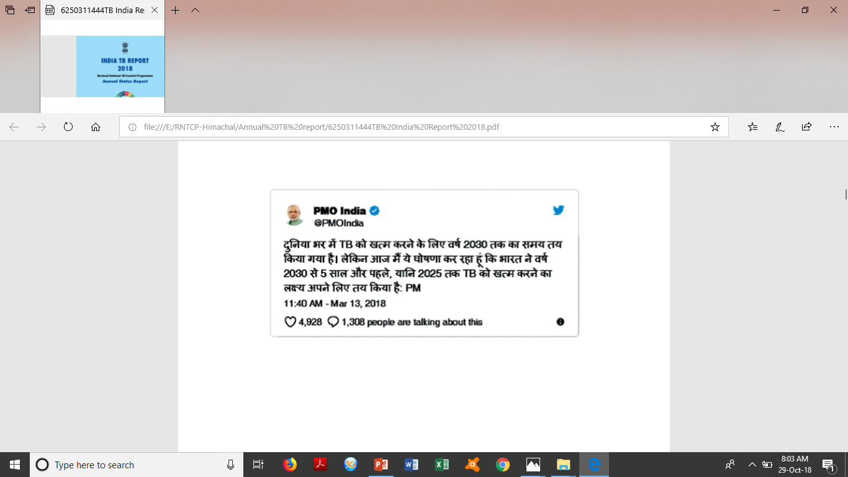
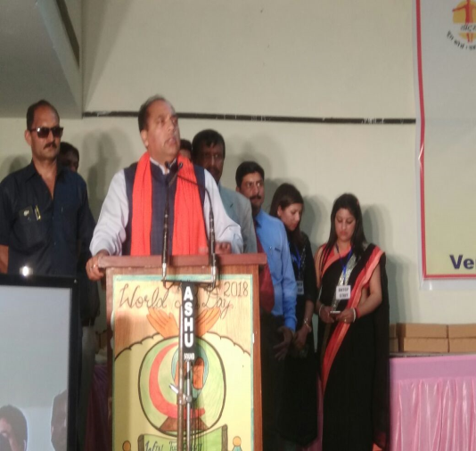

Slide 4
What does ending TB exactly mean?

Slide 5
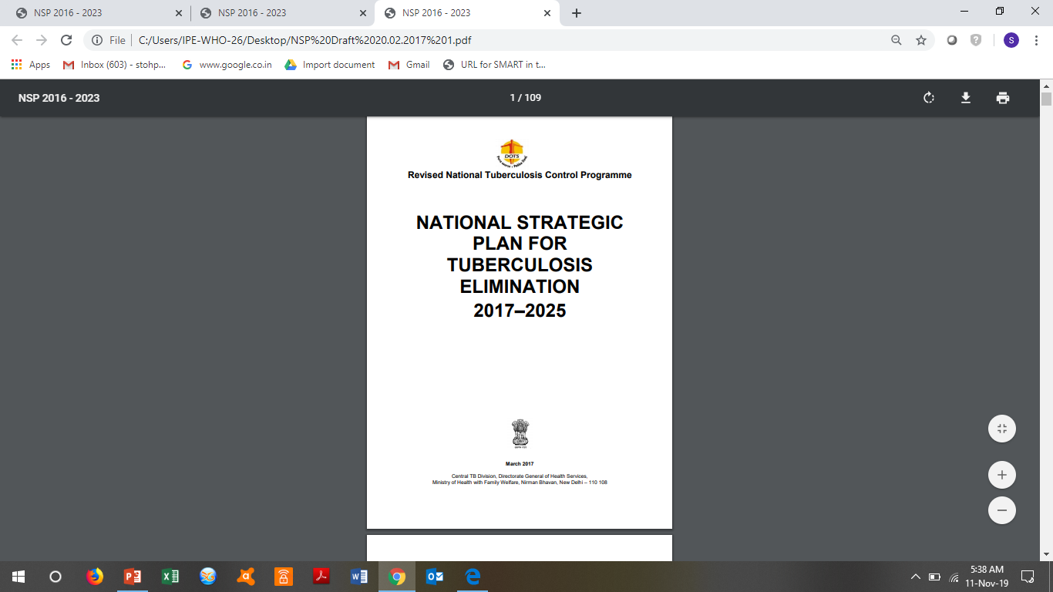
END TB
DETECT
TREAT
PREVENT
BUILD
Notes:
NSP 2017-2025 builds on the success and learnings of the last NSP and encapsulates the bold and innovative steps required to eliminate TB in India by 2030. It is crafted in line with other health sector strategies and global efforts, such as the draft National Health Policy 2015, World Health Organization’s (WHO) End TB Strategy, and the Sustainable Development Goals (SDGs) of the United Nations (UN

Slide 6
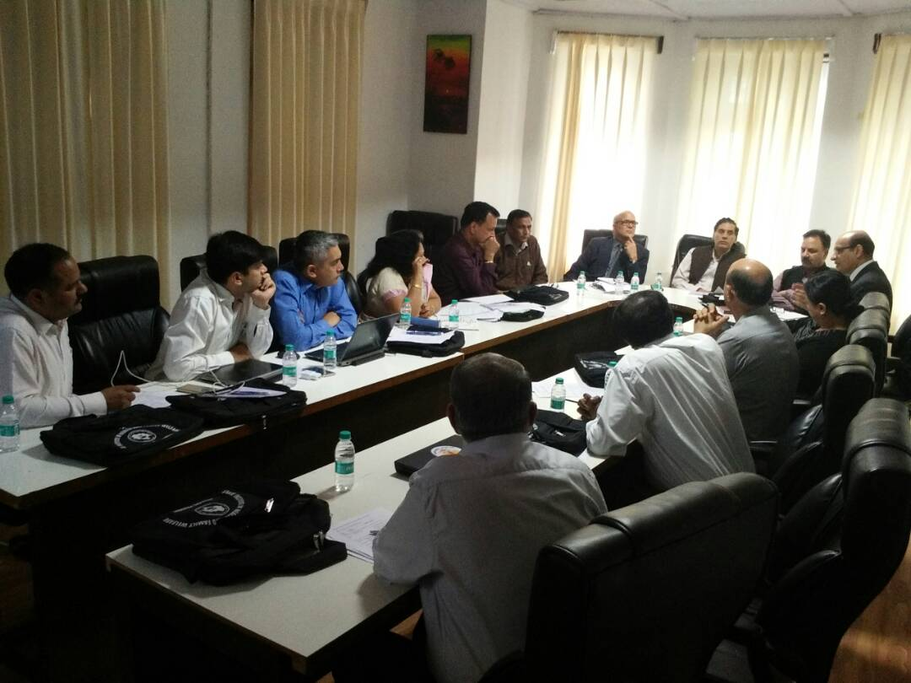
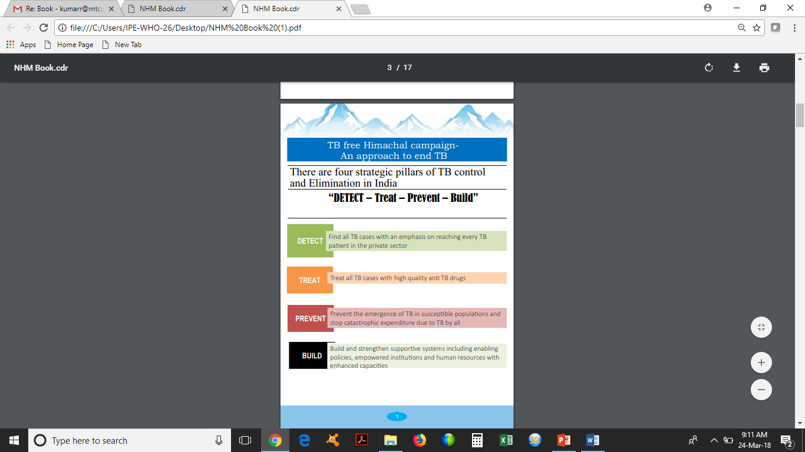
To achieve this herculean task, a brainstorming session was held on 29th May 2017 involving all stakeholders (including IMA representatives) and representatives from WHO-CTD, The Union and NITRD New Delhi (who provided technical support) and MMKRNY was born.

Slide 7

Decreasing incidence?
Stop detecting cases
Detect all cases, treat them and prevent disease spread in contacts

Slide 8
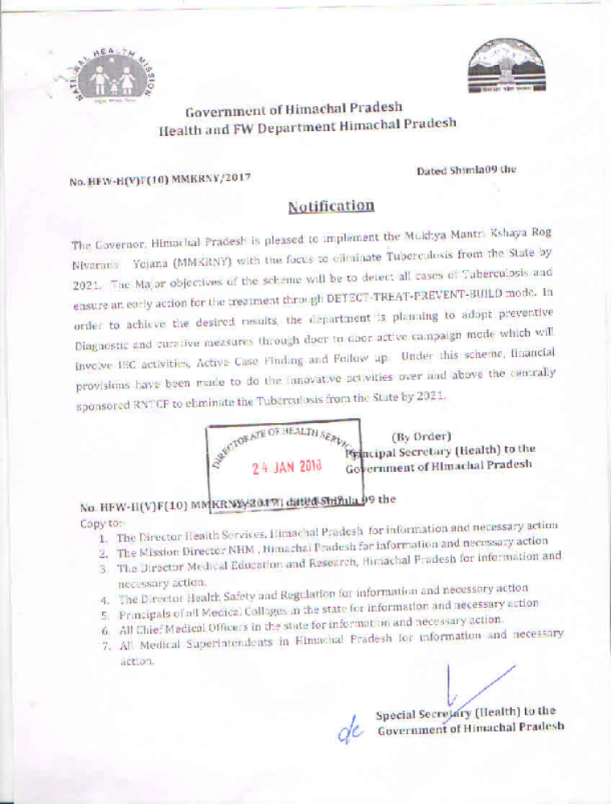
24 January 2018: Scheme notified by Government of Himachal Pradesh
OBJECTIVES:
1. Detect all the cases and ensure early action.
2. IEC activities, Active Case Finding, Follow up
MMKRNY is a scheme under PLAN head
Budgetary provision of Rs 2 Crore per annum.
Budget can be supplemented as per the need

Slide 9

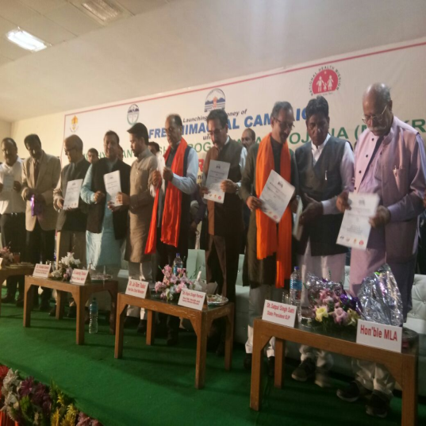
24 March 2018
Hon’ble CM Sh. Jai Ram Thakur formally launched
MUKHYA MANTRI KSHAY ROG NIVARAN YOJNA (MMKRNY)

Slide 10
DETECT
Detect all the DRTB cases
TB patients in private sector
TB case in high risk populations
Involvement of Ayurveda Systems
Effective regulation of chemists

Slide 11
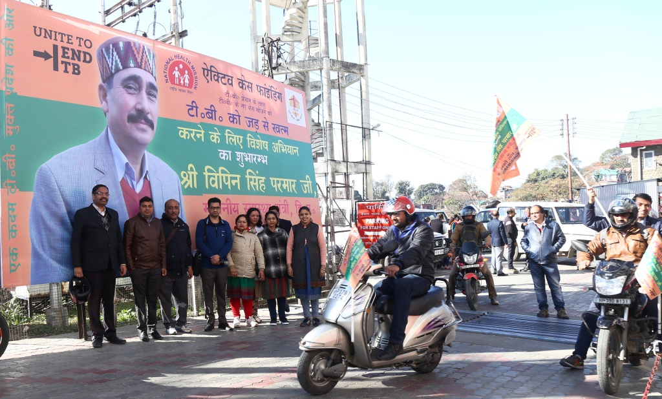
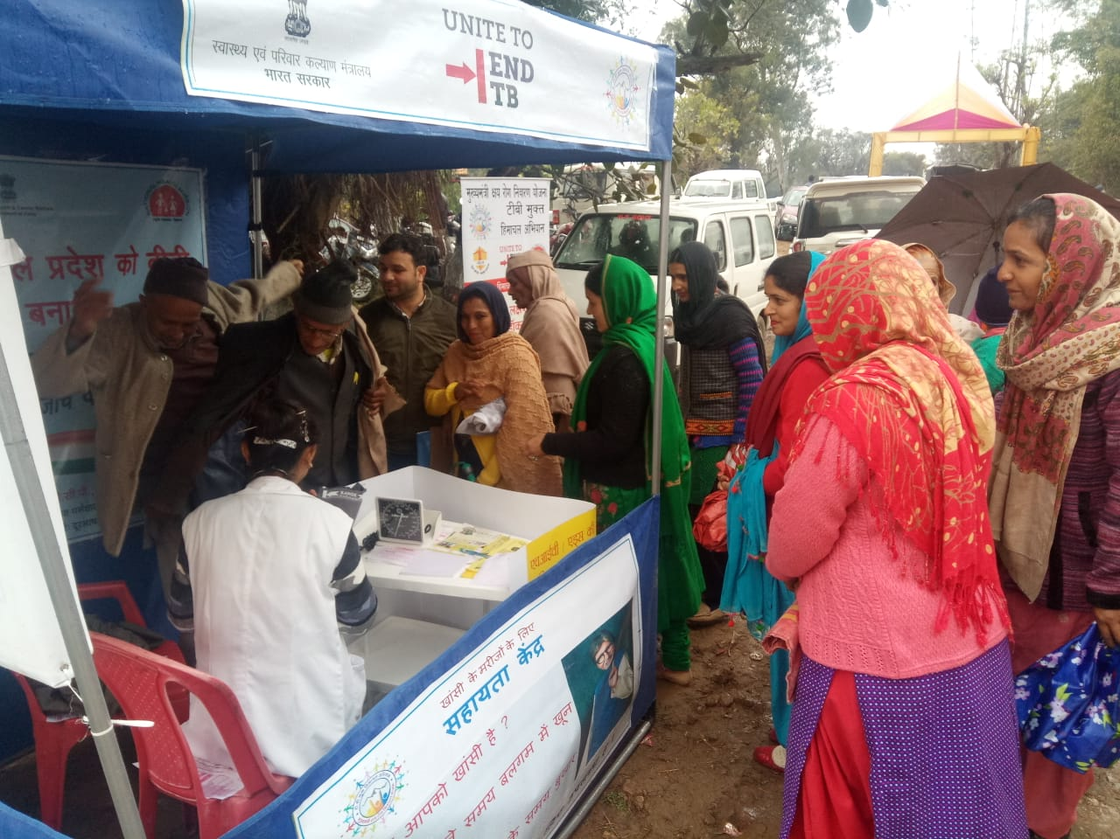
TB Case detection in High Risk Population
Special Active Case Finding fortnightly campaigns by the ASHA workers and ANMs

Slide 12
TB Case detection in High Risk Population
Over 18 lakh population (1/4th of total population) screened by the field team in round 1 (1-15 January 2019)
100% high risk population were screened
Special cough corners established during the ACF campaigns in all medical colleges, district hospitals and civil hospitals
17775 patients undergone smear microscopy
3908 patients were offered CXR free of cost
6327 patients were offered CBNAAT
Total 494 new cases were diagnosed
Round II of TB Mukt Himachal Abhiyan Pakhwada is being conducted from 16 to 30 November 2019 under MMKRNY.

Slide 13
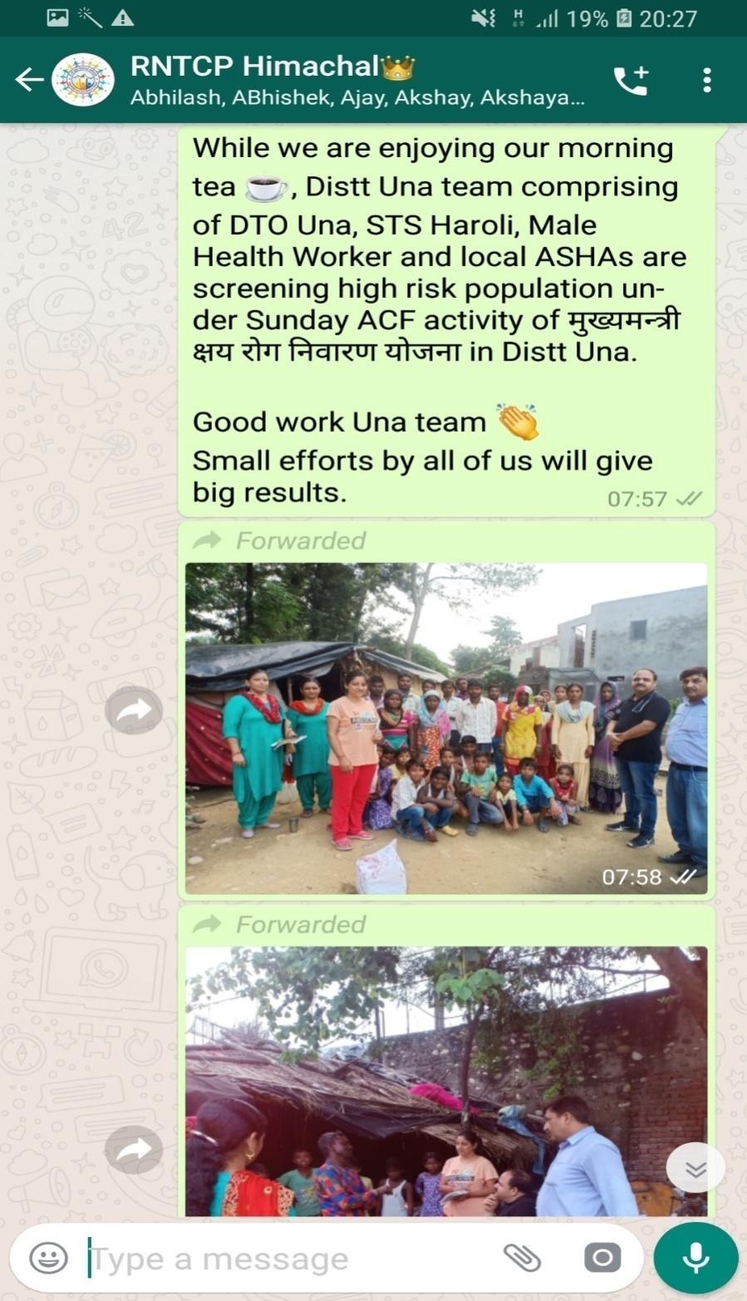
Sunday ACF through ASHA Network
In six high load districts, ASHA carries out ACF on every Sunday in her village
So far, more than 2 lakh population has been screened under Sunday ACF.
Samples of 1631 presumptive TB patients has been transported by ASHA to the nearest DMC.
Total 64 patients has been diagnosed since April 2019.

Slide 14
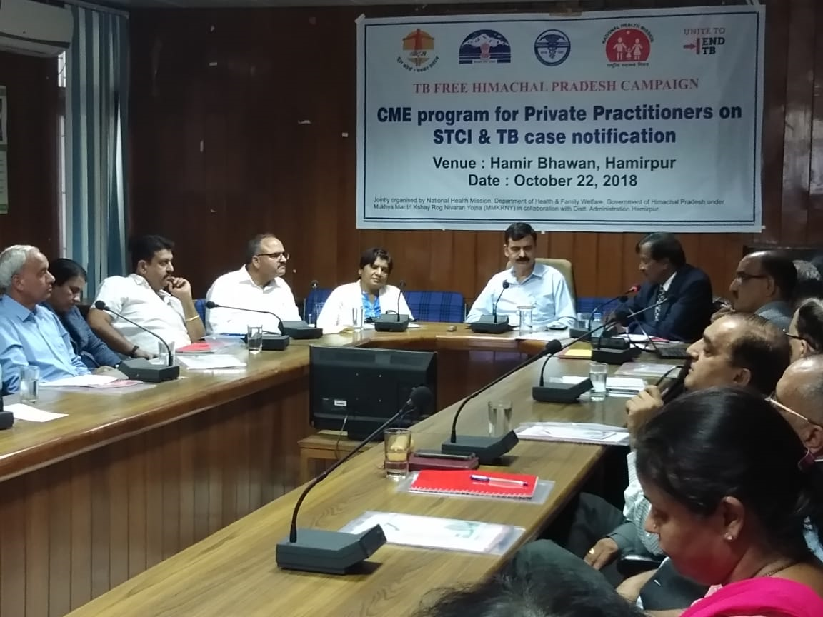
Cases in private sector
12 CME programs under MMKRNY were conducted across the State in association with District Administration.
Invitations to PPs were made by Deputy Commissioner and CME venue was conference hall in o/o respective DC.

Slide 15
Cases in private sector
396 leading Private Practitioners attended CMEs
State registered 61% increase in private TB case notification in 2018.
Referral from PPs to DMC/CBNAAT sites increased multifold after the CME.

Slide 16
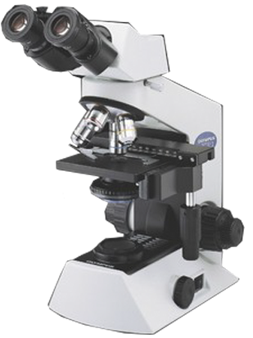
Expansion of Diagnostic Services
  10 days comprehensive course at TBS, Dharampur – State nodal Centre for Tuberculosis for Lab technicians
  All PHIs in State, where LT is placed from any source, it is being upgraded to provide DMC services with support from MMKRNY
  Till now, 214 DMCs functional against population of 70 lakhs

Slide 17
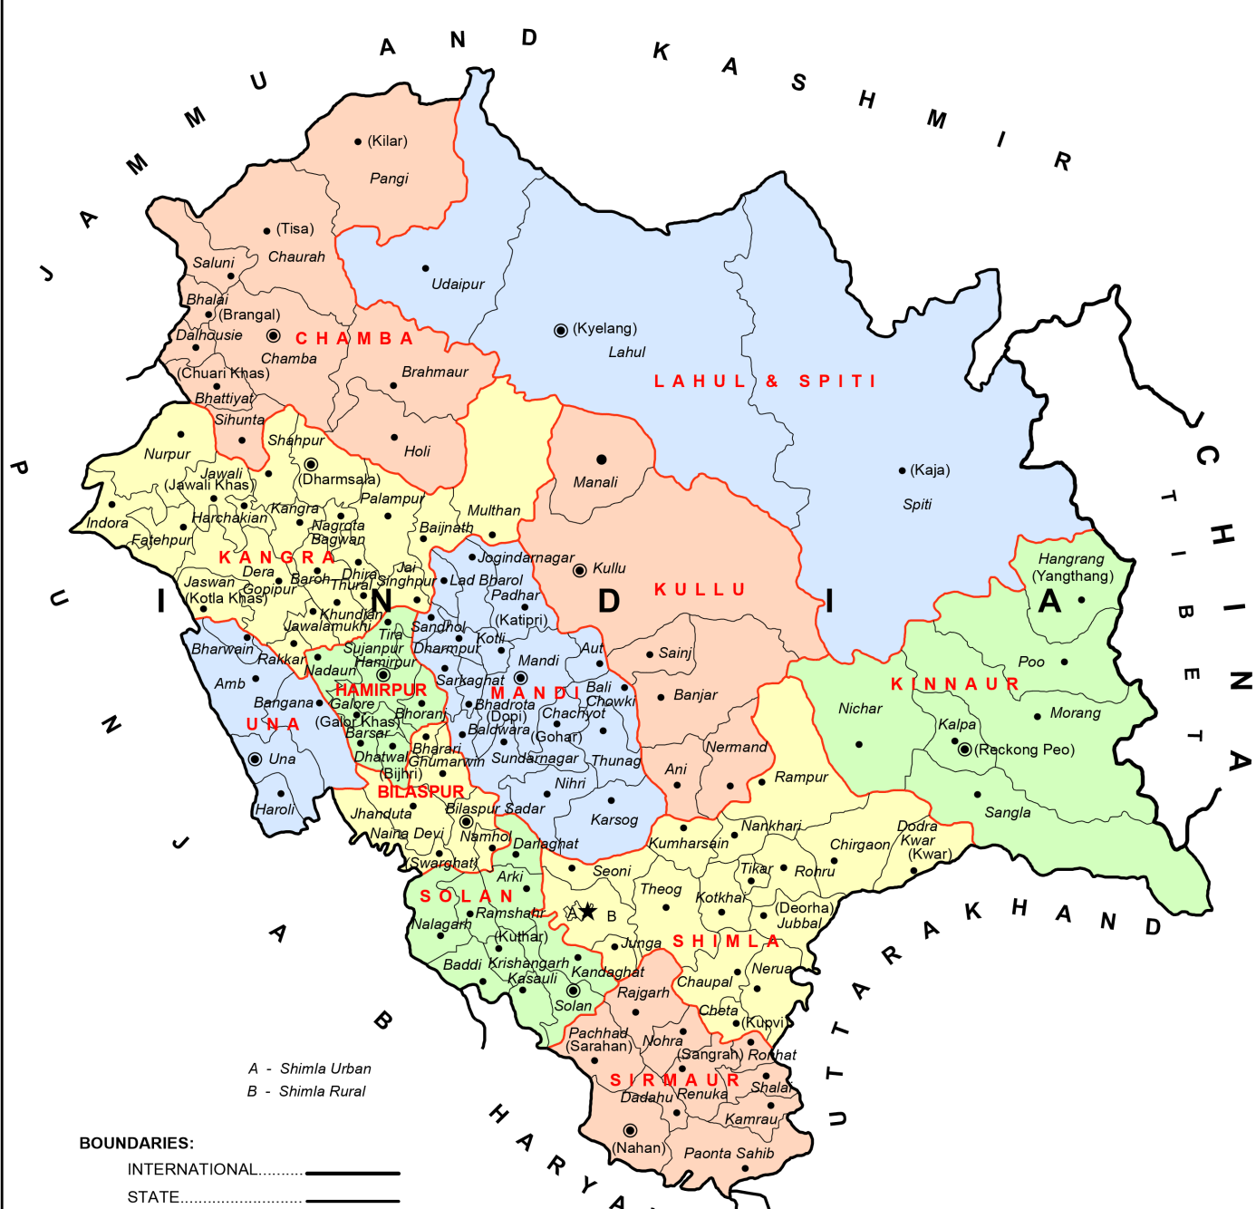
Universal Drug Susceptibility Testing
17 CBNAAT Machines provided under RNTCP + one mobile CBNAAT Machine
C
C
C
C
C
C
C
C
C
C
C
C
C
C
Gap analysis of high load facilities and areas done - 6 more CBNAAT machines provided under MMKRNY
C
C
C
C
C
C
C
C

Slide 18

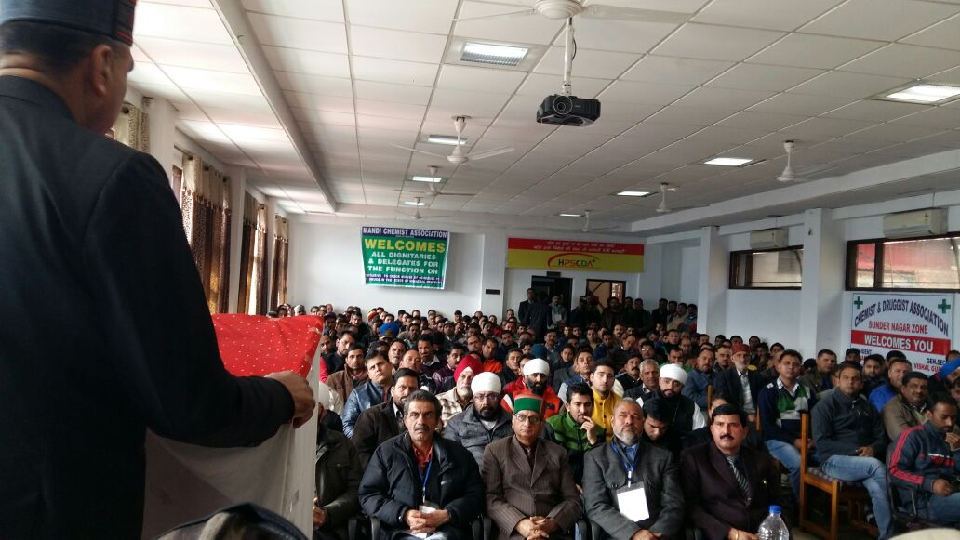
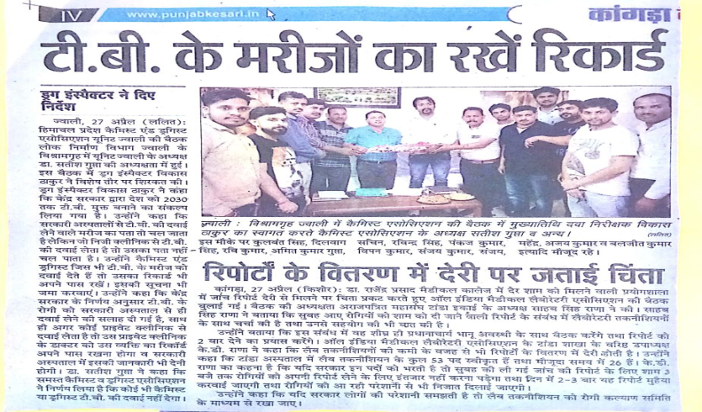
Orientation for Chemists on Schedule H1
15 CME programs under MMKRNY were conducted across the State in association with Chemist Association
Total 930 chemists attended the session

Slide 19
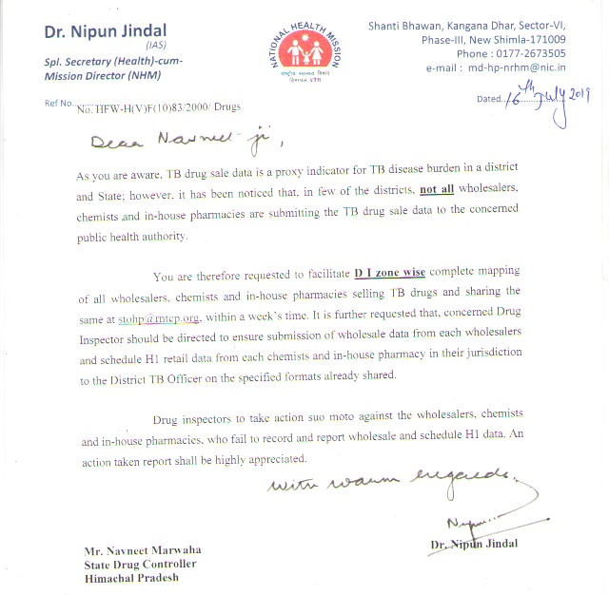
Orientation for Chemists on Schedule H1
State has an established system of recording and reporting mechanism from Chemists and Wholesalers.
DTC staff analyzes reports from Schedule H1 reports from Chemist and notification reports from PPs.
Over 750 new cases has been notified so far from schedule H1 reports

Slide 20
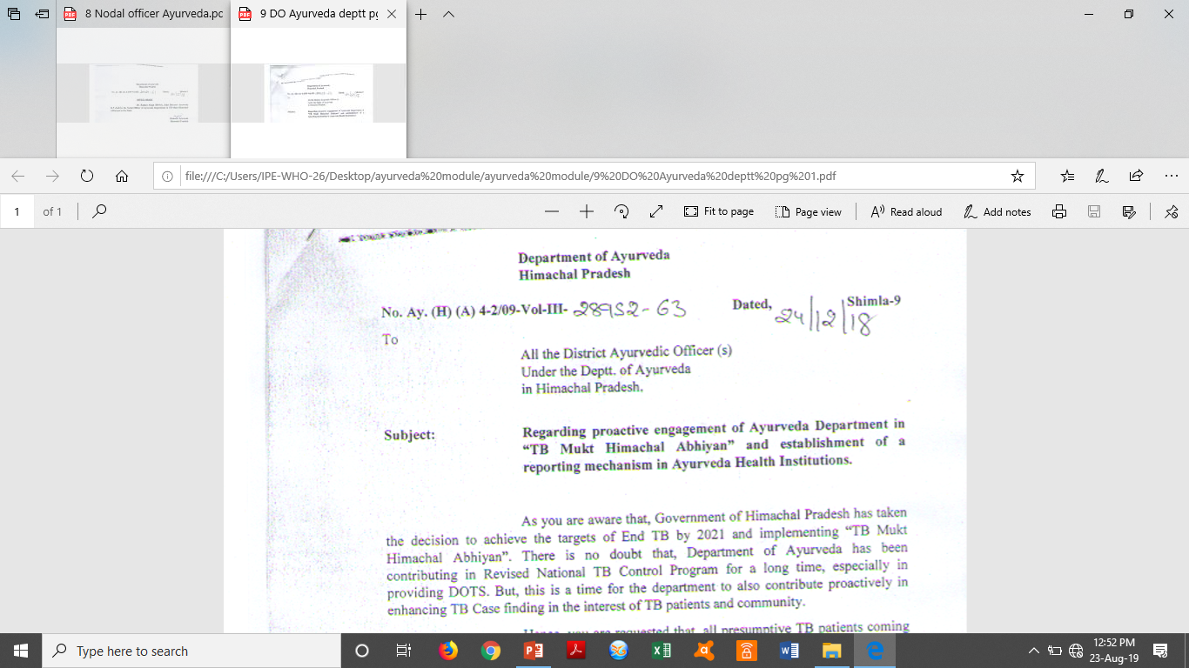
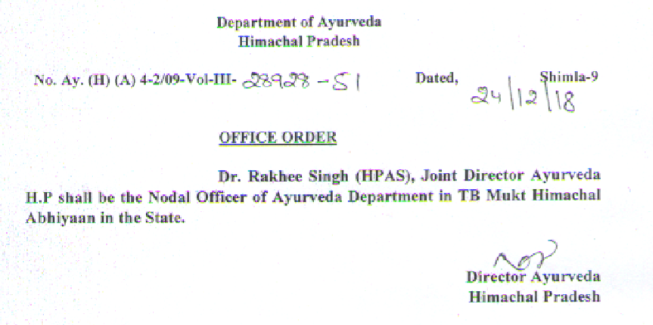
Engagement of Ayurveda Department

Slide 21
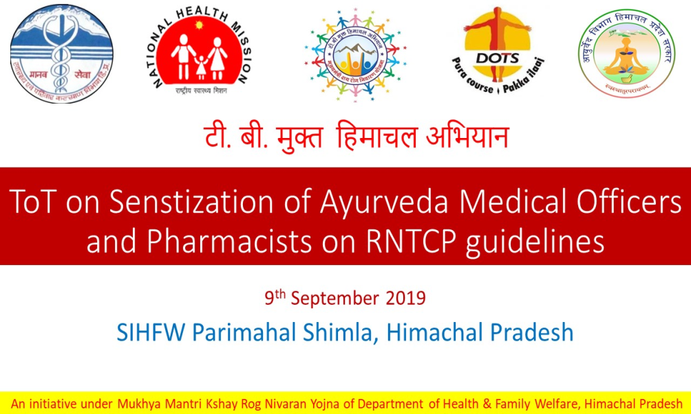
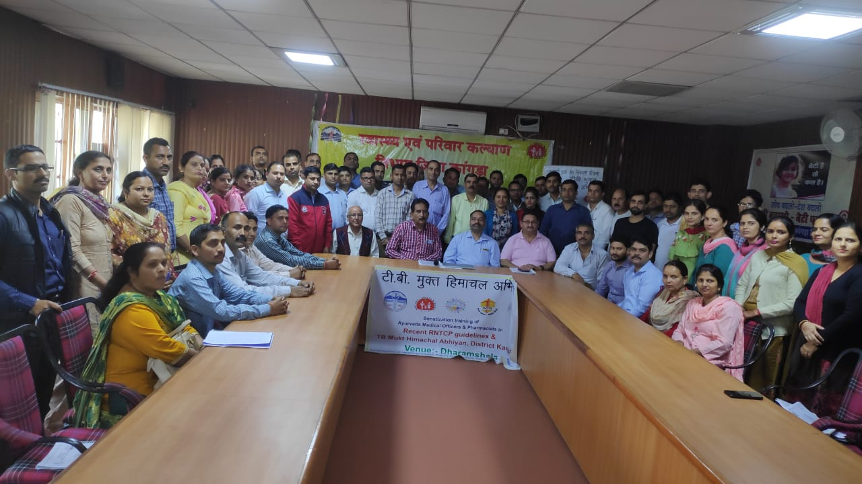
Engagement of Ayurveda Department
2 TOT batches conducted at State level for Ayurveda Doctors and pharmacists.
Cascade of modular training conducted at District and block level.
Reporting format at AHC level, SDAMO level, DAO level and Directorate Ayurveda level.
Distt Ayurvedic officer/Representative attends the RNTCP Monthly review meeting at the o/o CMO.

Slide 22
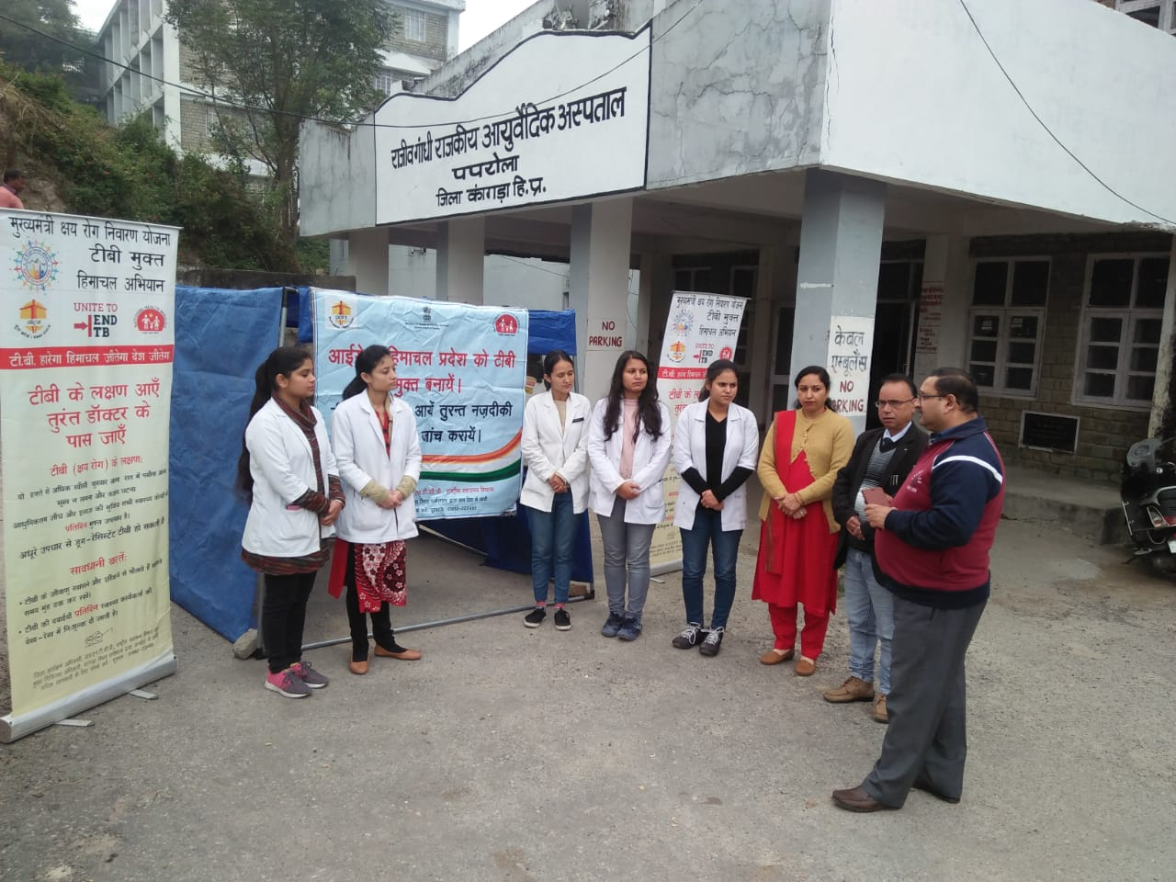
Engagement of Ayurveda Department
Total 629 AMOs and 1027 Ayurvedic pharmacists has been trained so far.
Major focus on case finding and patient management.
Since April 2019, over 800 presumptive TB patients have been
referred from Ayurveda Health Institutions to the DMCs,
out of which 69 cases has been detected.

Slide 23
TREAT
Drugs
Nutritional Support
Co-morbidities
TB Mukt HIMACHAL APP

Slide 24
Performance under Nikshay Aushadhi and Nikshay Poshan

Slide 25
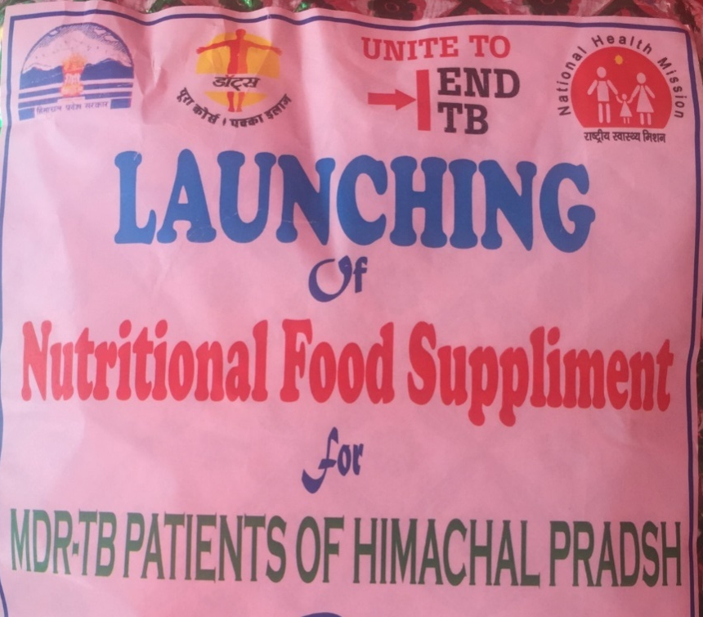
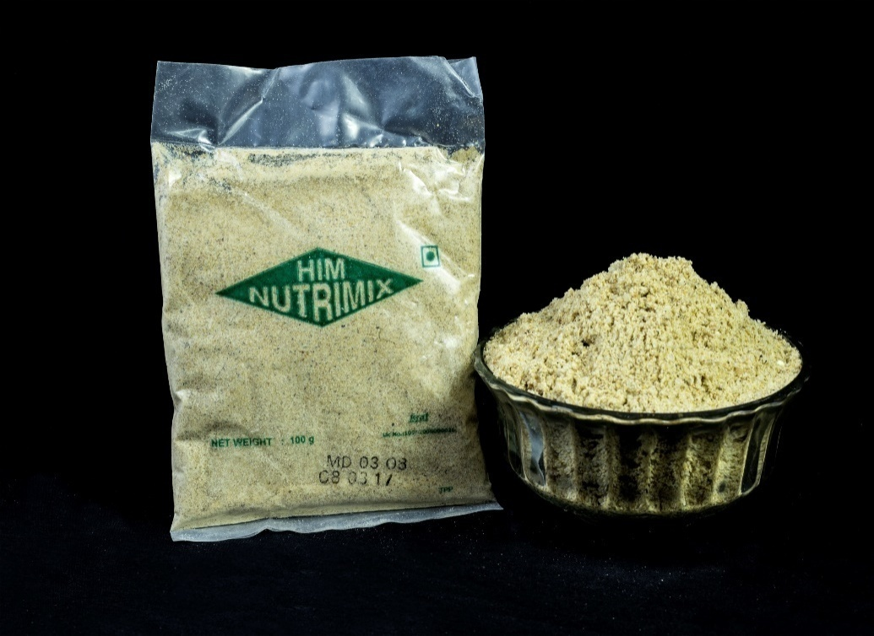
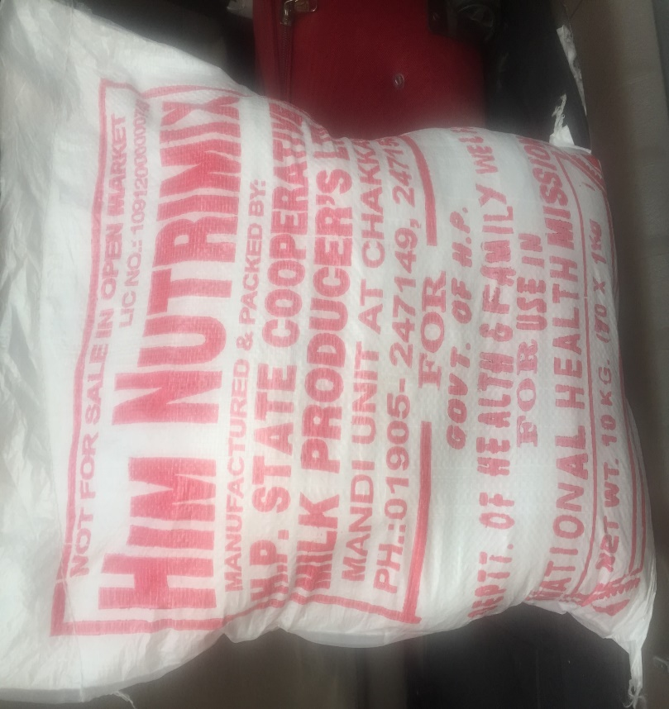
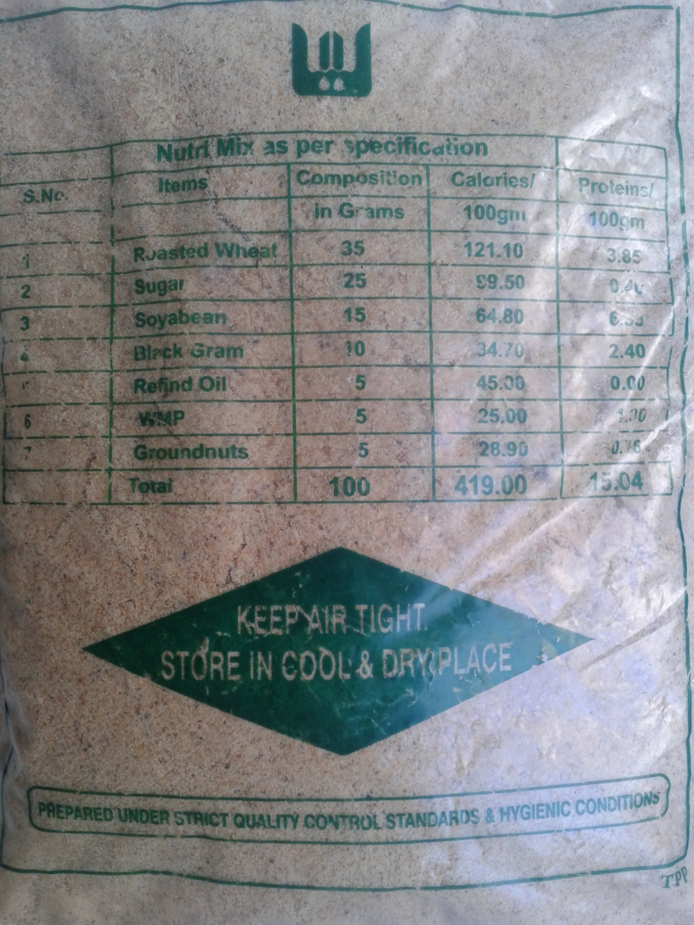
Supplement nutrition
“Him Nutrimix”
All DRTB Patients are provided “Him Nutrimix”- a supplement nutrition support under MMKRNY
This is over and above of Nikshay Poshan Yojna of Government of India.
There are near 500 beneficiaries every year.
100 gm of Nutrimix provides 419 calories and 15.04 gram protein

Slide 26
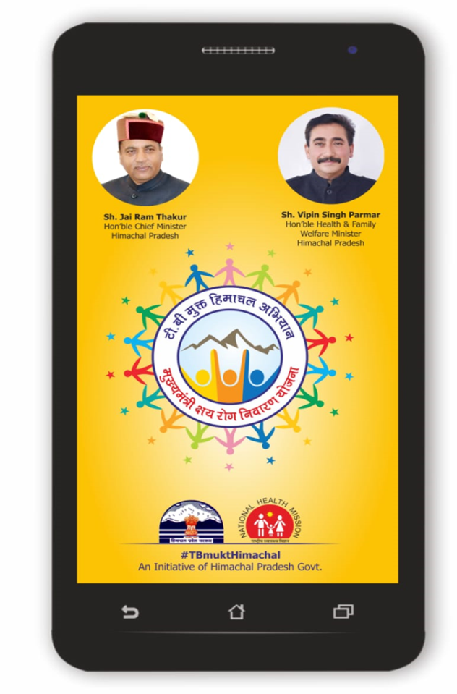
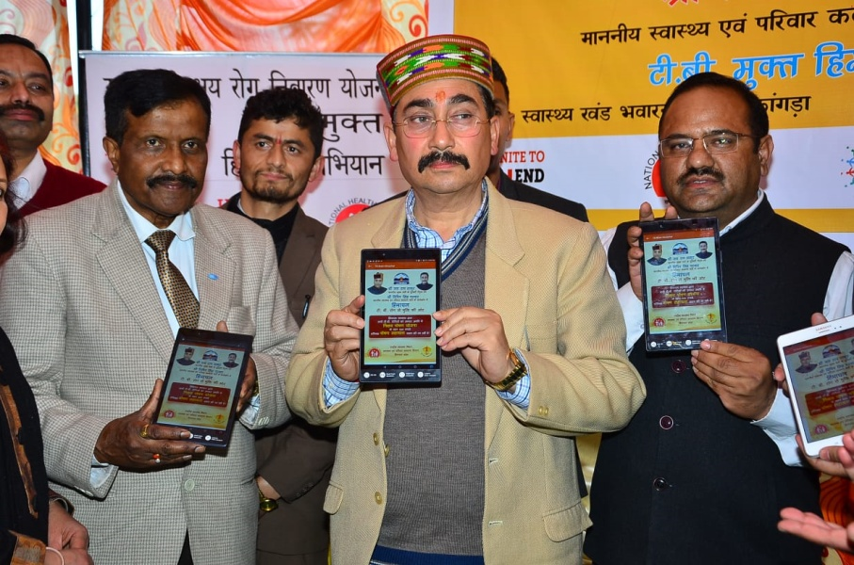
-Launched by Hon’ble Health Minister on 9th March 2019
-Over 4010 downloads has been be made so far.
TB Mukt Himachal APP

Slide 27
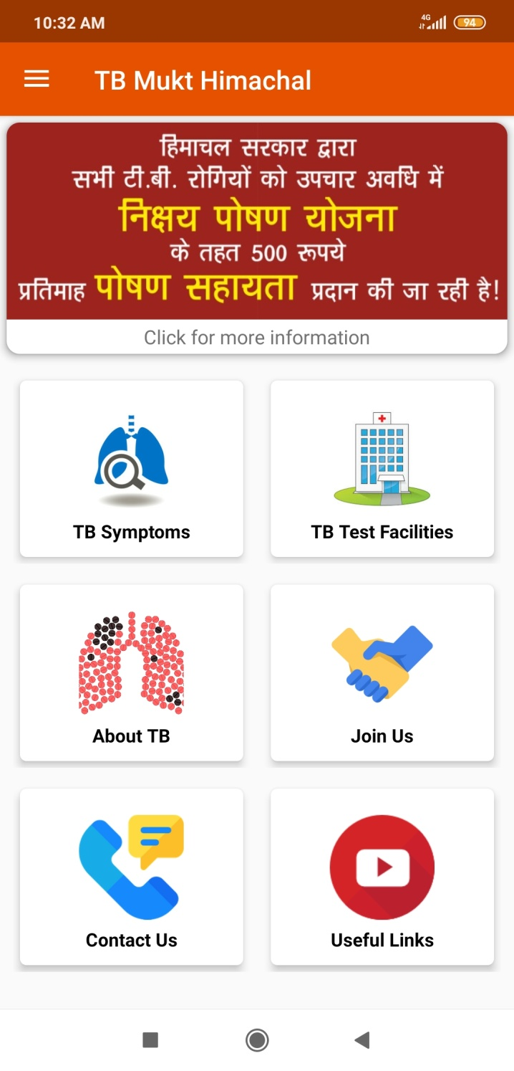
TB Mukt Himachal APP
Basic information/general awareness about TB disease, symptoms, prevention etc.
App has been very useful for the users to know about diagnostic and treatment services available in the State.

Slide 28
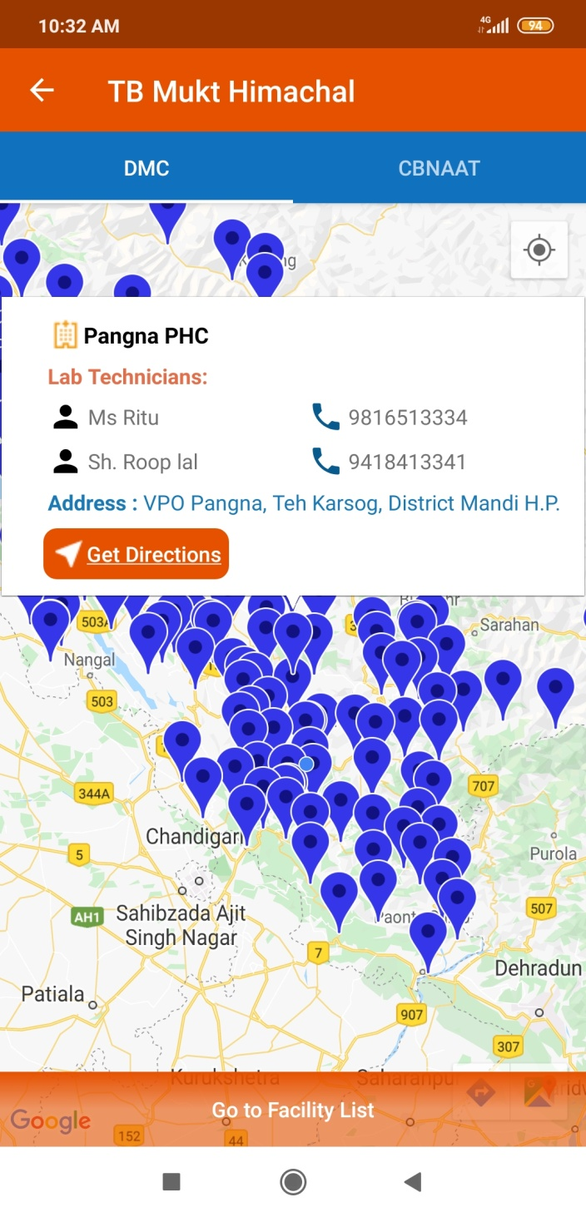
TB Mukt Himachal APP
Users can access nearest DMC and CBNAAT along with details of Laboratory Technician.
YouTube video links on IEC activities also uploaded

Slide 29
PREVENT
Air Borne Infection Control Measures
Isoniazid Preventive Therapy
Contact tracing
Cough Corners

Slide 30
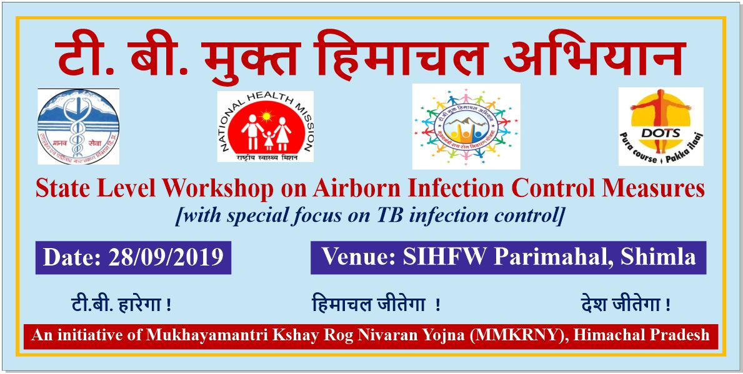
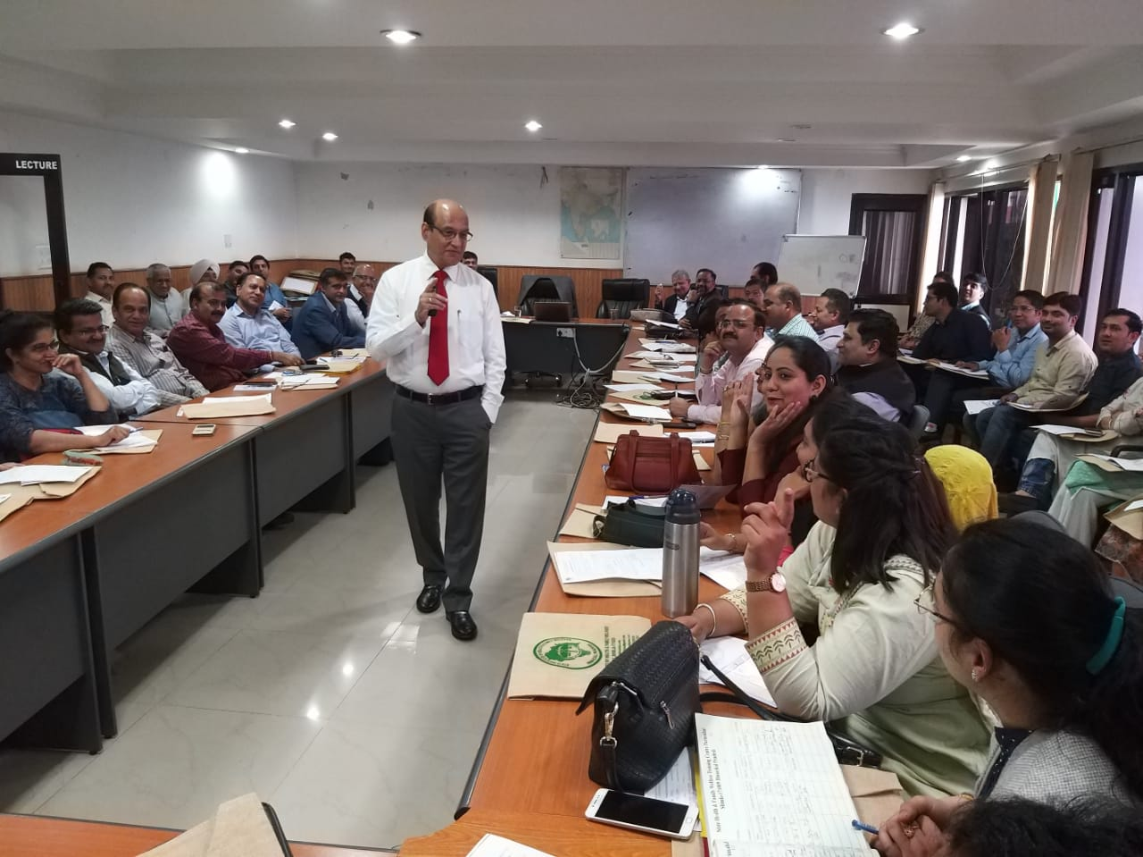
Air Borne Infection control measures
State level workshop conducted on 28/09/2019 at Shimla for Sr. Medical Supdt of Medical colleges Hospitals & district hospitals and Quality consultants with faculty support from WHO-CTD, NITRD New Delhi and The Union.
District level trainings of Hospital staff will be followed soon.
Assessment of all major hospitals up to the level of Civil Hospitals will be done for air borne infection control measures.

Slide 31
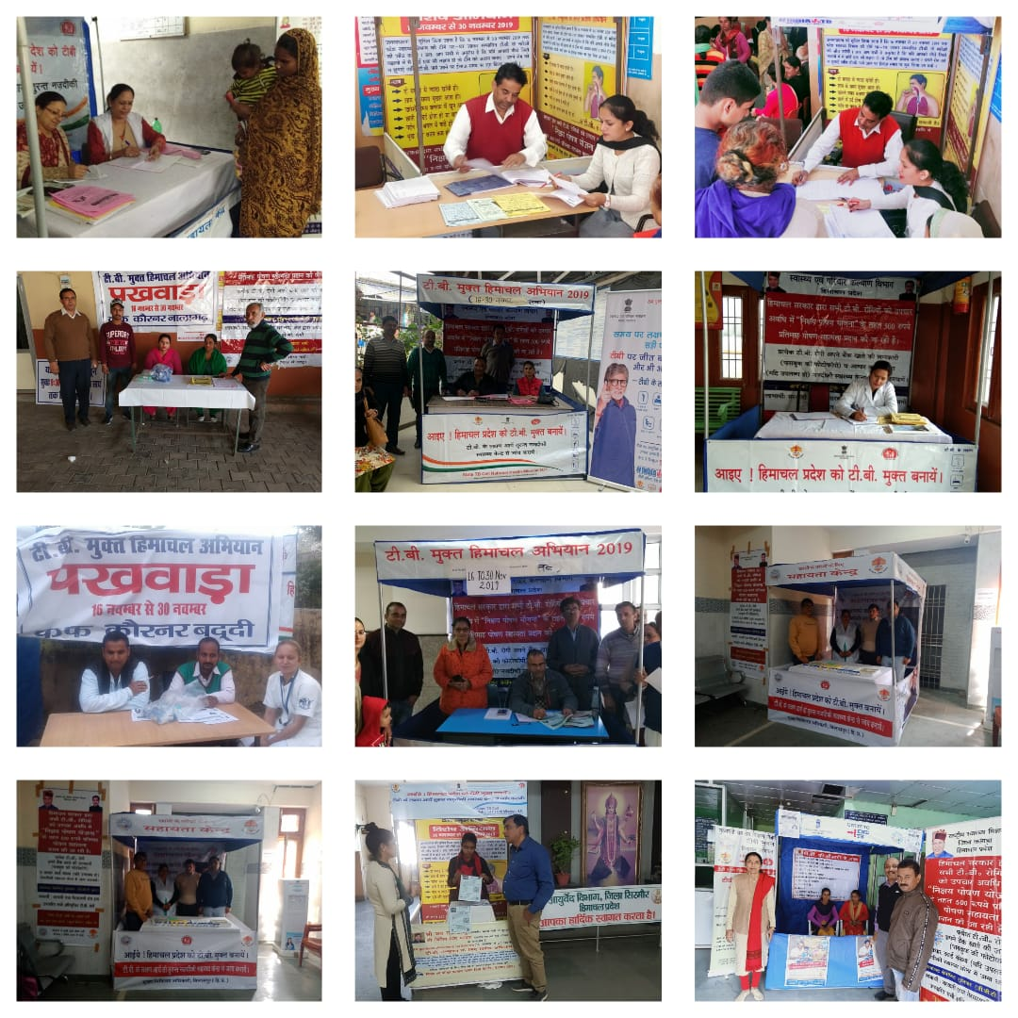
Establishment of COUGH CORNERS in every major hospital to prevent spread in Health care facilities.

Slide 32
BUILD
Policies
Intersectoral convergence
Capacity building

Slide 33
BUILD
Private practitioners
Chemists
Alternate Systems of medicine
IEC
Legislators
PRIs

Slide 34
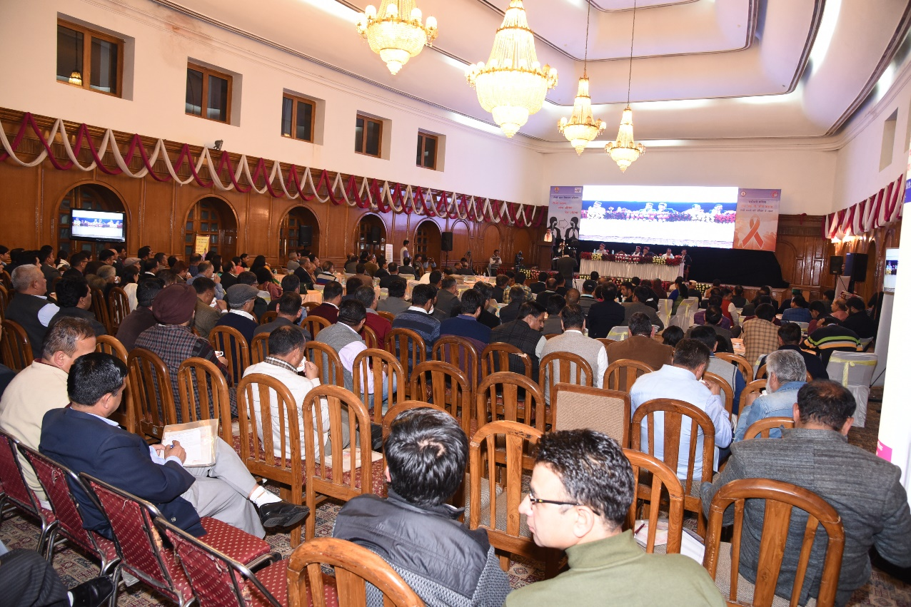
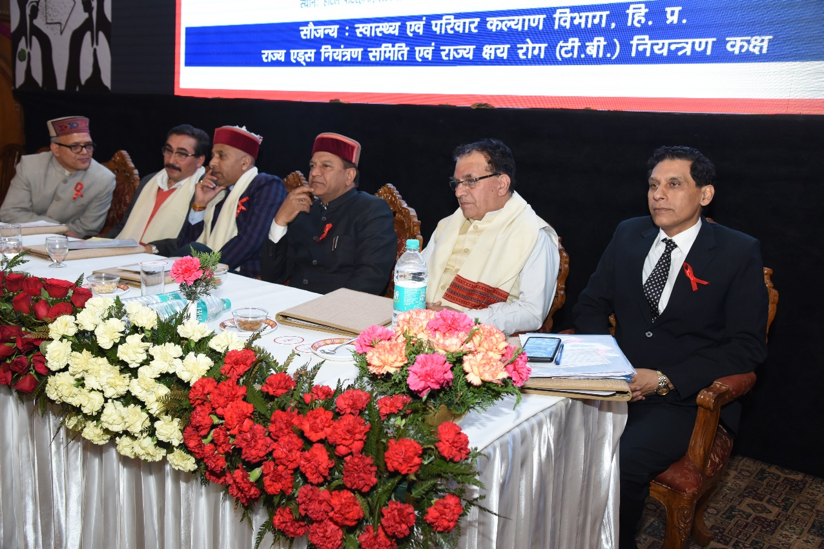
Sensitisation for MLAs
State level intersectoral coordination meeting cum Sensitization program for Hon'ble MLAs held on 2nd April 2018

Slide 35
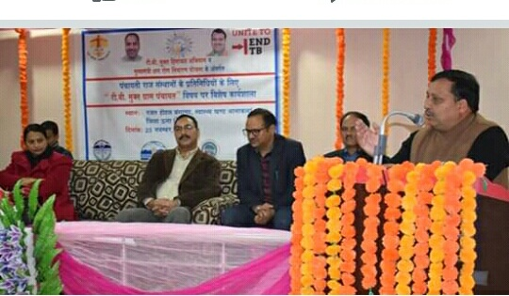
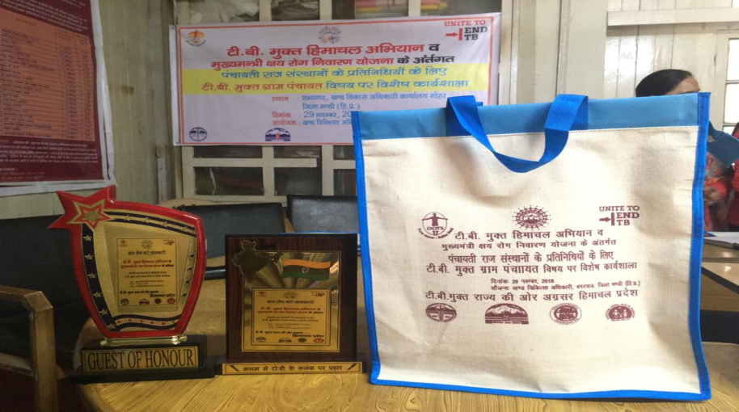
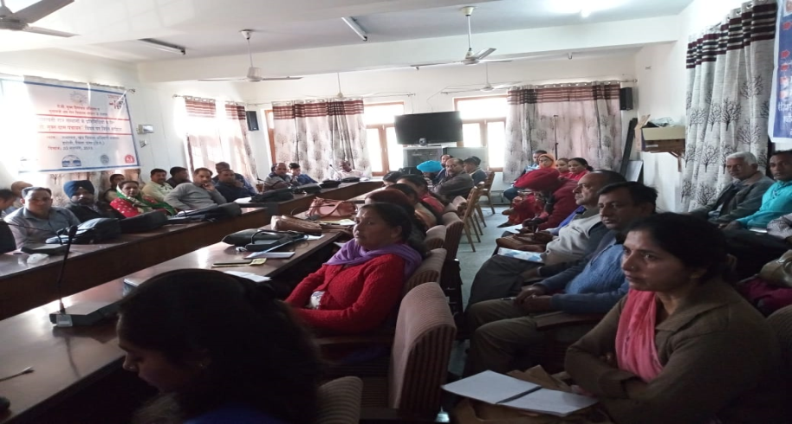
Sensitisation for PRIs
State level intersectoral coordination meeting cum Sensitization for TOT workshops (2 No.) conducted in Sep 2018
Total 5527 PRI representatives has been sensitized about TB Mukt Himachal Abhiyan from 3301 gram panchayats in 72 Health blocks across the State.
Hon’ble PRI Minister also attended one of program in a Gram panchyat.
PRIs supporting the Department in IEC activities, case finding, improving treatment adherence and reducing Lost to Follow Up.

Slide 36
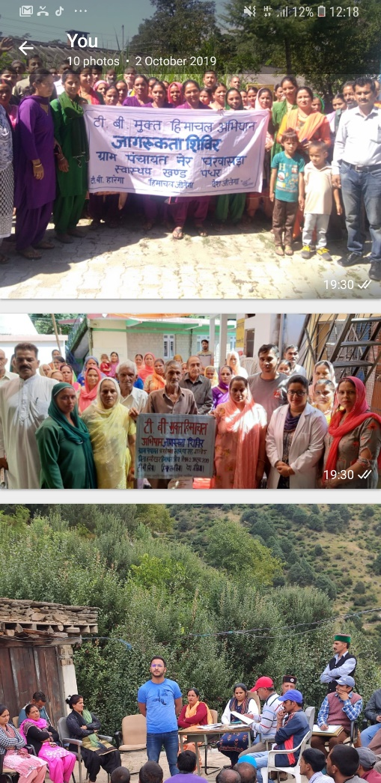
TB mukt Himachal-now an agenda in Gram Sabha meeting
TB mukt Himachal-a special awareness session was conducted in all gram panchayats of Himachal Pradesh across the State on 2nd October 2019.
This session generated a mass movement across the State on same time to go for TB free by 2021.
One of Hon'ble MP and hon’ble MLA also attended in two gram panchayats.
Wide media coverage in print and electronic media

Slide 37
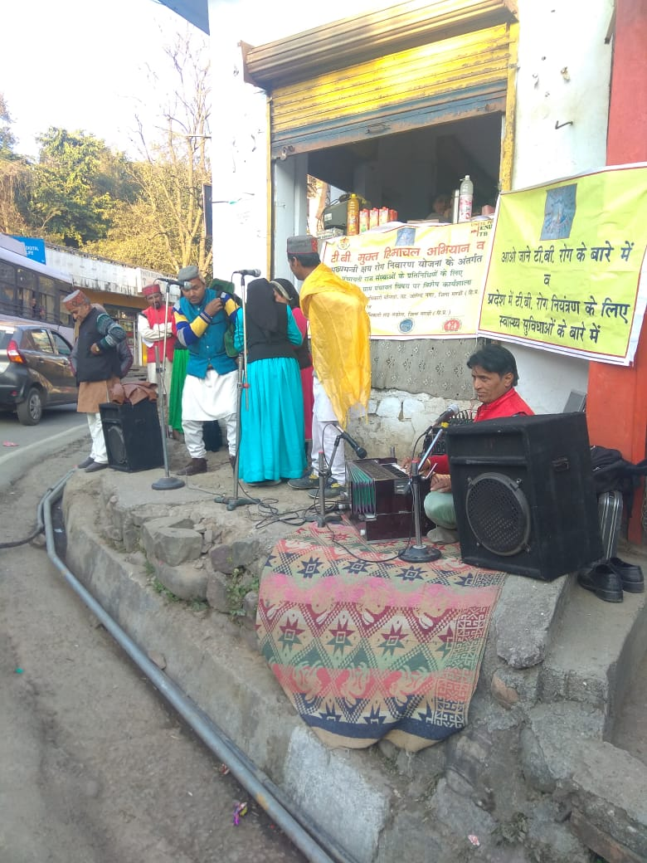
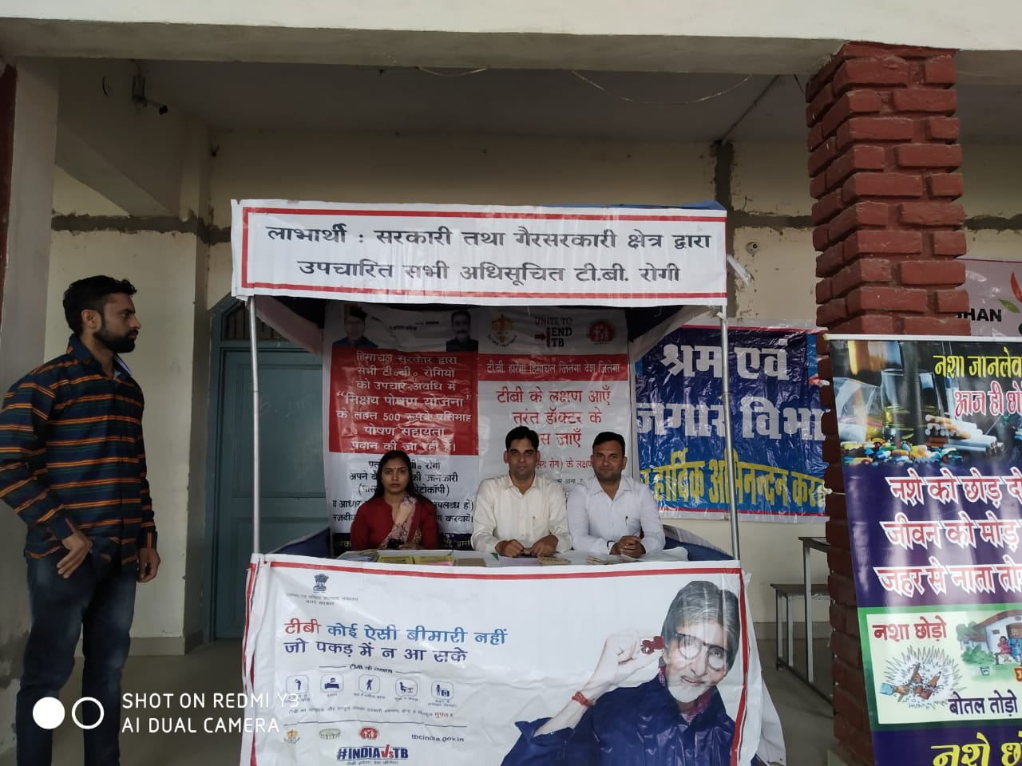

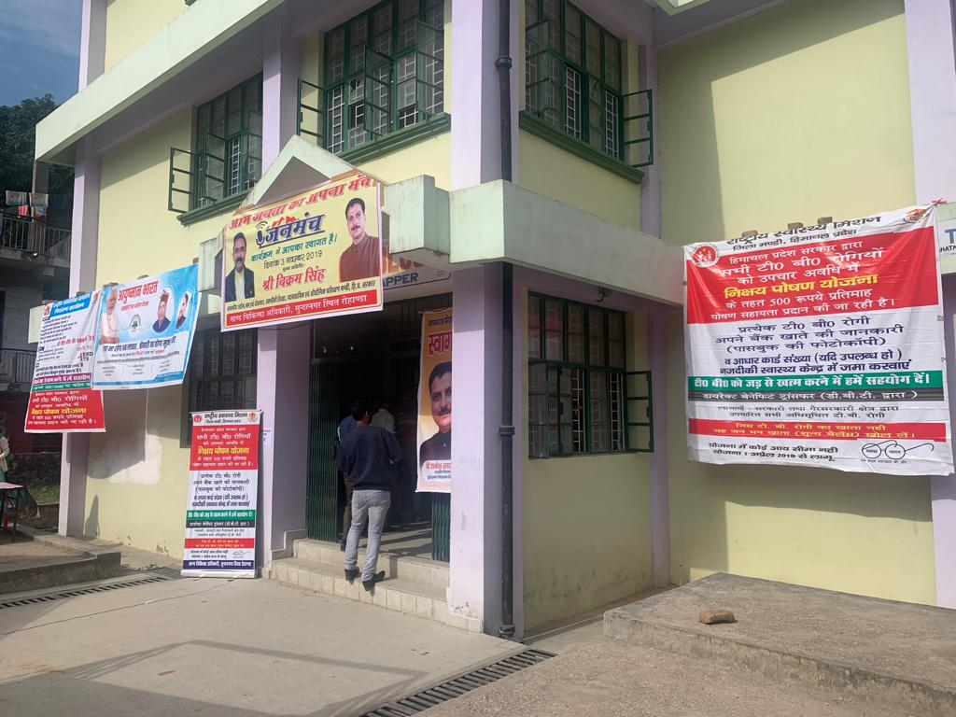
IEC
Jan Manch
Nukkad Nataks

Slide 38
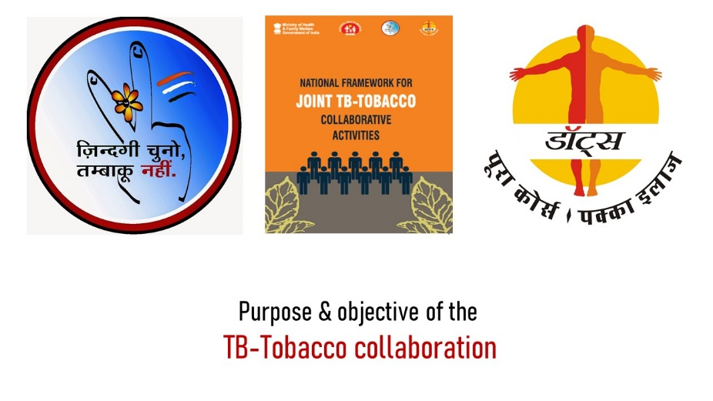
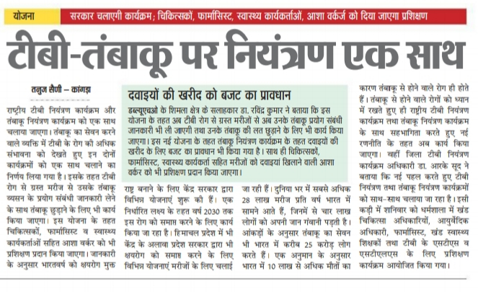
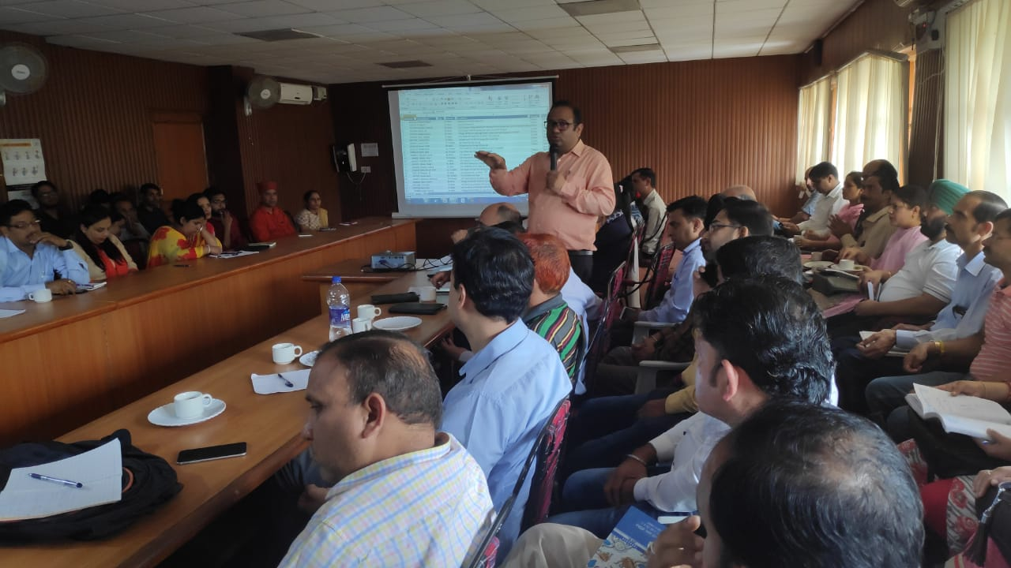
Co-Morbidities
Trainings of RNTCP staff (5 batches) conducted on TB-Tobacco collaboration in August 2019 at State level under MMKRNY
State level TOT and Distt level TOT on TB-Tobacco collaboration conducted
Cascade of trainings conducted at block level

Slide 39
IMPACT
With MMKRNY, program achieved highest level of political and administrative commitment.
Annualized TB case notification of 226/lac/annum was reported in 2018; highest in India.
Himachal Pradesh has tests 1825 presumptive cases/lakh/annum- Highest in India, whereas country average is 904/lakh/annum
Expanded CBNAAT facilities resulted 73% Universal DST; one of the highest in India.
Demand generation about TB services increased exponentially; State has paid 66% of due amount to TB patients under Nikshay Poshan Yojna; second highest among States in India after Andhra Pradesh (68%).
In 2019, total 1371 patients sputum has been referred by PPs for CBNAAT testing, out of which 420 were MTBC detected.
PLHIV – TB testing is 93% as against 74% national figures.

Slide 40
IMPACT
Mukhya Mantri Kshay Rog Nivaran Yojna (MMKRNY) is proving instrumental in expediting the State’s mission to achieve the End TB targets ahead of national timeline.
Budgetary provisions supported capacity building activities, IEC activities and expansion of infrastructure for TB diagnosis.
This scheme has generated mass awareness among different stakeholders and public to go TB free considering high mortality and morbidity due to TB disease.
Intersectoral coordination achieved.

Slide 41
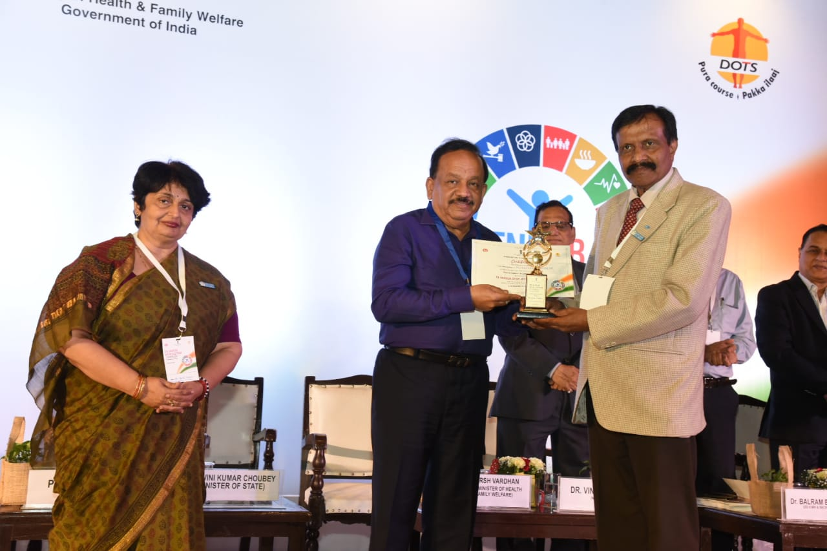
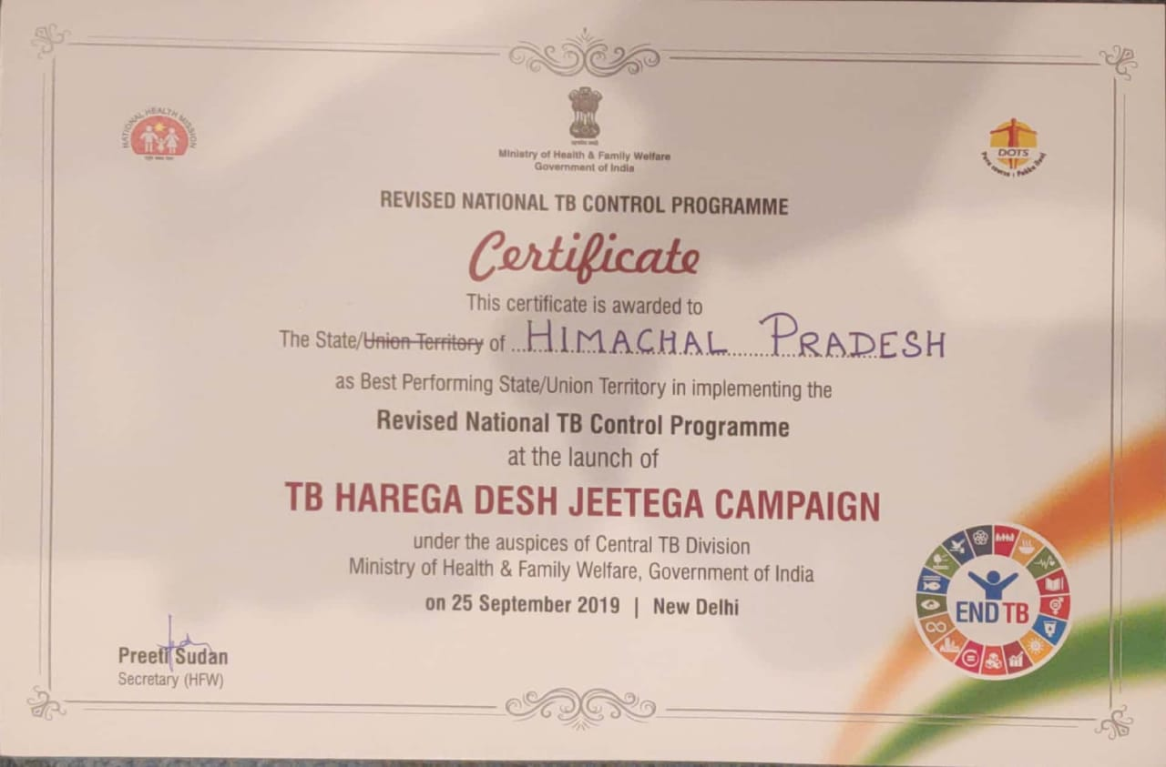
Reward & Recognition
Hon’ble Union Health Minister Government of India awarded Department of Health Himachal Pradesh with “Best performing State award” on 25/09/2019 at New Delhi

Slide 42


THANKS

