Slide 1



Ministry of Panchayati Raj
Government of India
Gram Panchayat Development Plan People’s Plan Campaign
Sabki Yojana Sabka Vikas

Slide 2


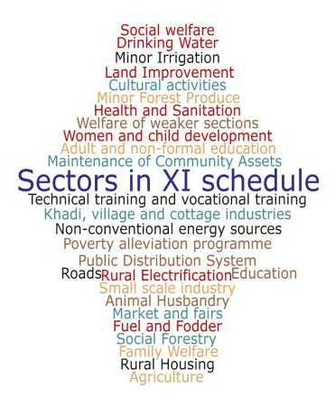
















PPC Coverage: Participating Line Ministries/ Department & Sectors

Slide 3
Panchayat Development Plan
PPC rolled out as Sabki Yojana Sabka Vikas from 2nd Oct, 2020 to 31st January, 2021
  PPC to extend to all 3 tiers of the Panchayats incl. Traditional Local Bodies
  Refreshed PPC guidelines launched
  Mission Antyodaya (MA) data collection in all Gram Panchayats; Mission Antyodaya gaps available at all 3 tiers of the Panchayats
  Structured Gram Sabha/ Panchayat meetings for Panchayat Development Plan (PDP) formulation for 2021-22
All 29 sectors listed in XI Schedule included
  Frontline officials of related departments to attend special Gram Sabha/ Panchayat Meetings for PDP and give structured presentation
e-Gram SWARAJ strengthened- MA data & Resource Envelope pre-populated for evidence based planning
Public Information Board (PIB)- Installation/ updation of PIBs in all Gram Panchayats

Slide 4
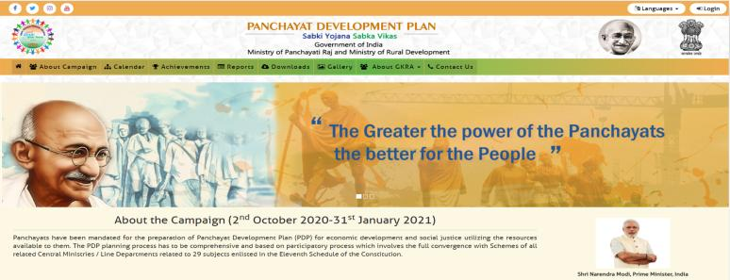
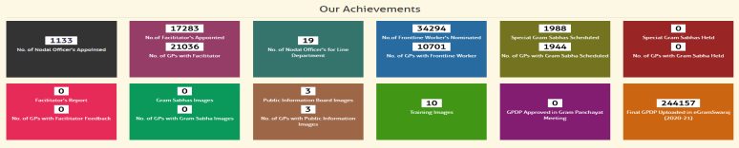
People’s Plan Campaign Portal

Slide 5
Activities under the campaign (1/2)
Appointment of Nodal Officers for the campaign, baseline survey of GPs (Mission Antyodaya)
Registration on web portal (www.gpdp.nic.in)
Appointment of facilitator for every Panchayat/ Rural Local body
  District Panchayati Raj Officer & Block Development Officers to officiate as Facilitators at District Panchayat & Block Panchayat levels respectively
Training of Facilitators
Finalization of Panchayat wise calendar for holding of Gram Sabhas/ Panchayat meeting
Structured presentation by frontline workers of all departments on the related 29 subjects in Gram Sabhas

Slide 6
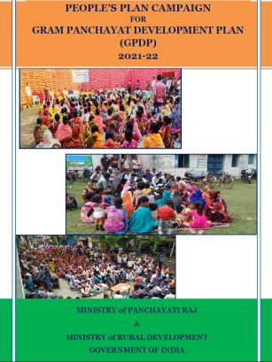
Activities under the campaign (2/2)
Organizing special Gram Sabhas/ Panchayat meetings for Panchayat Development Plan
Display of Public Information Board in every Gram Panchayat and uploading of geo-tagged photographs of it on the web portal
Uploading of Geo-tagged photograph(s) of Gram Sabha/ Panchayat meetings in progress
Preparation of Panchayat Development Plan
Publishing of approved plan on e-Gram SWARAJ
A booklet detailing various activities of the campaign launched

Slide 7
Role of Facilitators
Carrying out the survey under Mission Antyodaya (MA) using MA mobile app.
Coordinating with frontline staff of participating ministries/ departments
Facilitating special Gram Sabha/ Panchayat meeting for Panchayat Development Plan on the designated day
Ensuring community mobilization including vulnerable sections like SC/ ST/ Women during the Gram Sabha meeting
Submit a report regarding conduct of the Gram Sabha/ Panchayat meeting on the portal
Upload Geotagged Pics of Gram Sabha/ Panchayat meeting in progress & of the Public Information Board
Supporting preparation of Panchayat Development Plan

Slide 8
Monitoring of People’s Plan Campaign
Portal for tracking People’s Plan Campaign
  Gram Sabha/ Panchayat meeting visuals
  Public Information Board visuals
  Report of Facilitators etc.
e-Gram SWARAJ for uploading of PDP for all 29 sectors
Visit to Gram Sabhas/ Panchayat meetings for every District/ State/ Central level official of concerned Departments
NLM visits to random Gram Sabhas/ Panchayat meetings

Slide 9
PPC Helpdesk
Dedicated Helpdesk for addressing PPC queries in place
Helpdesk available from Monday to Saturday between 9 AM – 6PM
Helpdesk Contact details: 011-23355373,
011-23356128

Slide 10
People’s Plan Campaign, 2019
Span of the Campaign: 29 States & 6 Union Territories
Duration: 02nd October- 31st December, 2019
2,81,031
2,65,031
2,42,273
Facilitators across 253,558 GPs
GPs covered
reports available
Facilitator
Front Line workers
Mission Antyodaya
Gram Sabha
Facilitator report
GPDP
13,20,312
2,54,512
Frontline workers across 2,62,238 GPs
Special Gram sabhas scheduled and held
2,44,021
GPDPs uploaded on e-Gram SWARAJ
2,02,207 Gram Panchayats with Public Information Boards

Slide 11
People’s Plan Campaign, 2019 assessment (1/2)
State wise GPDP availability in e-Gram SWARAJ

Slide 12
People’s Plan Campaign, 2019 assessment (2/2)
Top 10 participating Line Departments
Top 10 States with Women participation in Gram Sabhas
Top 10 States with SHG participation in Gram Sabhas

Slide 13
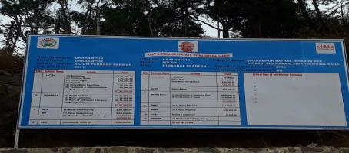
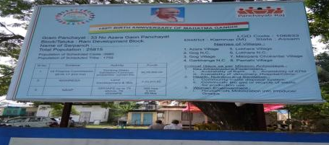
Public Information Campaign
Display of physical & financial progress on Public Information Boards in GP/ VDC
Display Boards, Bill Boards on People’s Plan Campaign
Inter Personal Communication materials with frontline workers

Slide 14
Publication Of GP/ Village Development Plan
Once the data entry for the plan is completed, and the plan is approved, the final plan is published on the e-Gram SWARAJ application
The hard copy of the Plan is to be kept in Panchayat office for public disclosure
The Activities Of PDP are published on Public Information Board at the beginning of the Implementation Year

Slide 15
Learnings from PPC, 2019
Roles and responsibilities of Ministries and departments properly laid down;
Role and responsibilities of facilitators clearly articulated
Timelines of activities to be carried out at the Centre, States and Gram Panchayat levels stipulated
Thrust on Environment creation, involving & sensitizing the Elected Representatives as ‘Agents of Change’
Gram Panchayat Planning Facilitation Team (GPPFT) engaged to deliver trainings in cascade mode till the grassroots level; training footprint extended to cover Line departments
MA Survey expanded by enhancing the number of measuring parameters to 146; linking of activities taken up in GPDP with the gaps identified in the MA survey mandated
PRI-SHG convergence given prominence; Livelihood action plans prepared
Activities relating to Women Component Programme (WCP); Child friendly Panchayats and Low-cost, no cost activities also figure in GPDPs
GPDP: Analysis of fund allocation

Slide 16
PPC, 2020- Unique elements
PPC extended to all 3 tiers of the Panchayat; a detailed framework for District & Block planning will be shared
Mission Antyodaya gaps to be made available at Block & District levels
  Gram Manchitra to be utilised towards realistic Panchayat Planning
COVID-19 guidelines & SOPs to be adhered while conducting Panchayat businesses
  All PPC, 2020 trainings to be delivered through on-line mode
  Usage of technology for conducting Panchayat meetings encouraged
  In exceptional circumstances, GPDPs may be finalized with the approval of the Panchayat elected body, under ex-post-facto approval of the Gram Sabha
D. Gram Panchayats to adopt Sanqalp and Lakshya especially w.r.t Education, Health, & Nutrition goals
E. Role of Panchayats in various schemes of Line Ministries/ departments detailed in PPC, 2020 booklet

Slide 17
Indicative timelines for PPC, 2020 (1/2)
Campaign Duration | 02nd October, 2020- 31st January, 2021
# | Activity | Timelines
1. | Letter to Chief Secretaries, Secretaries (PR & RD) of all States/UTs | 18-Aug-2020
2. | Rollout of Master Trainers Training | 25-Aug-2020
3. | Appointment of nodal officers and registration on GPDP portal | 05-Sept-2020
4. | Uploading of Gram Sabha meeting Schedule | 10-Sept-2020
5. | Pre-Populating Resource envelope | 30-Sept-2020
6. | Appointment of facilitator | 10-Sept-2020
7. | Rollout of Facilitator Training | 18-Sept-2020
8. | Completion of Mission Antyodaya Survey | 23-Oct-2020

Slide 18
Indicative timelines for PPC, 2020 (2/2)
# | Activity | Timelines
9. | Display of PIB & uploading of geotagged image | 25-Sept-2020
10. | Geo-tagged image of Gram Sabha/ Panchayat Meeting | Immediately after the Gram Sabha/ Panchayat meeting
11. | Publishing of approved plans in e-Gram SWARAJ | 31-Jan-2021

Slide 19

The greater the power of the Panchayats the better for the people
- Mahatma Gandhi

