Slide 1



“MAA” (MOTHER’S ABSOLUTE AFFECTION) PROGRAMME
A Nationwide programme for Promotion of Breastfeeding through Health Systems
August 2015

Slide 2

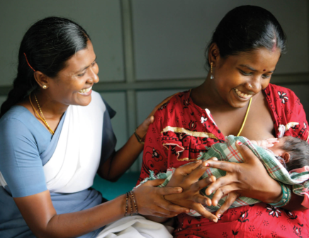
Importance of Breastfeeding
Prevents 20% of newborn deaths
Prevents13% of under-five deaths
11 times lesser chance of diarrheal mortality
15 times lesser chance of Pneumonia related mortality
Benefits on raising I.Q.
Prevention of non-communicable diseases,
Lesser hospital stay of newborns,
Maternal benefits (cancer prevention).

Slide 3
Trends of Breastfeeding indicators
 | NFHS-2 (1998-99) | NFHS-3 (2005-06) | DLHS-3 (2007-08) | RSOC (2013-14)
Early initiation of breastfeeding | 15.8% | 24.5% | 40.2% | 46.5%
Exclusive breastfeeding | 41.2% | 46.4% | 46.4% | 64.9%
Timely initiation of complementary | 35% | 56.7% | 57% | 50.5%
(Source, National Family Health Survey, Rapid Survey of Children)

Slide 4
The MAA Programme
An intensified year long programme for promotion of breastfeeding to bring undiluted focus on promotion of breastfeeding practices.
  To be launched on 5th August 2016
  Covers all states and UTs
  Targets around 3.9 crore pregnant and lactating mothers
  8.8 lakh ASHAs conduct mobilization
  18,000 birthing facilities skilled in lactation management

Slide 5



Components of the “MAA” Programme
ASHA
Skilled provider at Sub Centres
1. Build enabling environment & demand generation
through Mass media & mid media activities
2. Capacity building of community health workers- ASHA & ANMs ; Mother’s meeting by ASHA; Breastfeeding counselling at VHND/SC
Delivery Point
SNCU/NICU/
NBSU/NBCC
Lactation Support & Management
3. Capacity building of ANM/Nurses/Doctors in lactation support & management at facilities & Role reinforcement on Breastfeeding at delivery points
4. Monitoring & Awards

Slide 6
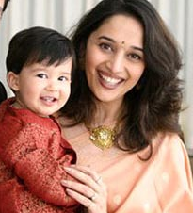
Demand Generation (National/State/District)
  1.1 Mass/Mid media activities
    Prominent level launch by HFM at National level
    State level launch by CM/HM & District level by MLA/MP
    Branding as MAA Programme
    Prominent social figure (e.g. Madhuri Dixit)
    Audio visual campaign
    Weekly Newspaper advertisement in National papers during the fortnight.
    Bulk SMS and voice messages (MCTS) using Kilkari.
    State level activities: Outdoor publicity (bus stands, metro, market, mall), posters at health facilities, av videos in PNC wards (with av facility),posters in waiting and Immunization room, wall paintings in villages, printing of infokits, flipcharts ).
States to adapt to local language

Slide 7
Communication materials developed
TV commercial | Radio Spots | Print IEC
Vaada : 60 seconds Bada Bhai: 60 seconds Treasure Hunt: 60 seconds | Vaada : 30 seconds Bada Bhai: 30 seconds Treasure Hunt: 30 seconds Maa Sab Jaanti Hai | Posters (7 prototypes) on the theme of support for use at Health facility & outdoors Info kit for ASHA Counselling flipchart for ANM Wall painting prototype for Villages Newspaper Ad in National dailies on 5th August
All Print materials being developed in Hindi & English

Slide 8

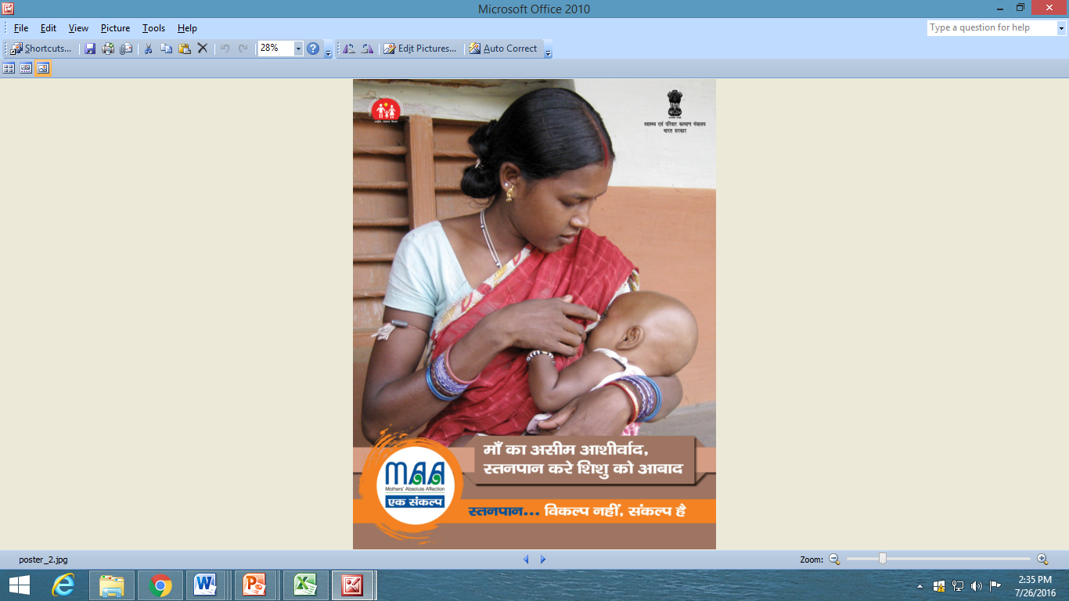
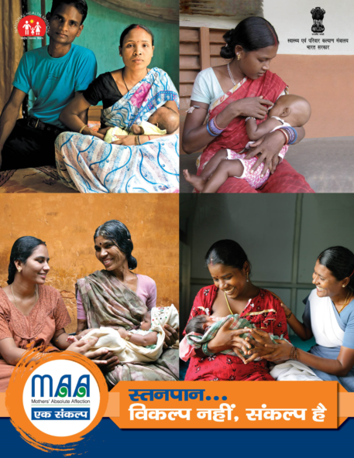

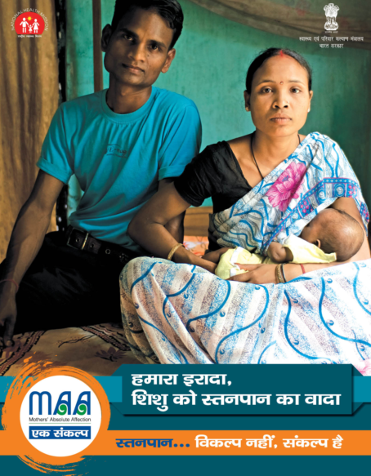
Outdoor posters

Slide 9
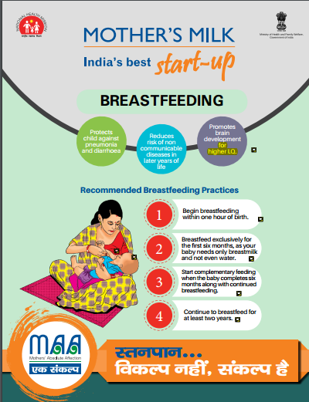
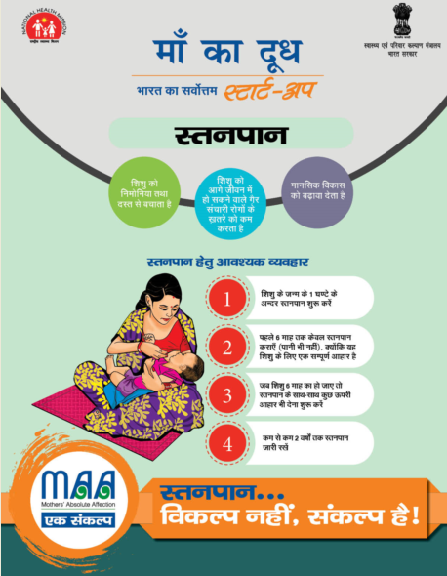
Health facility posters

Slide 10
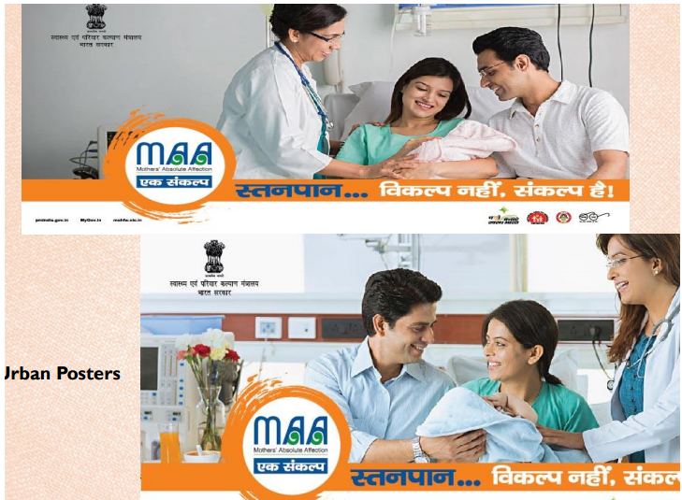
Urban Posters

Slide 11
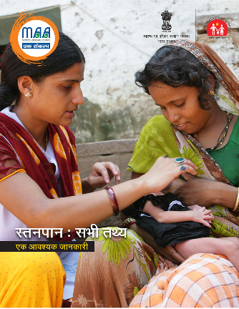
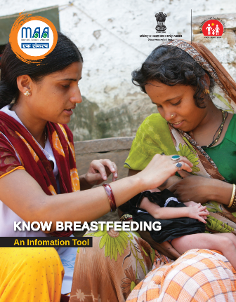
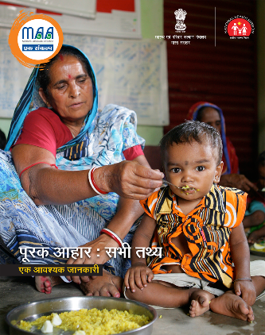
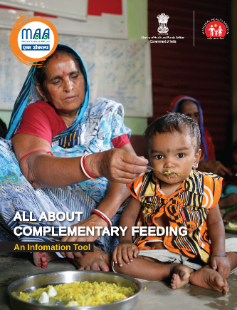
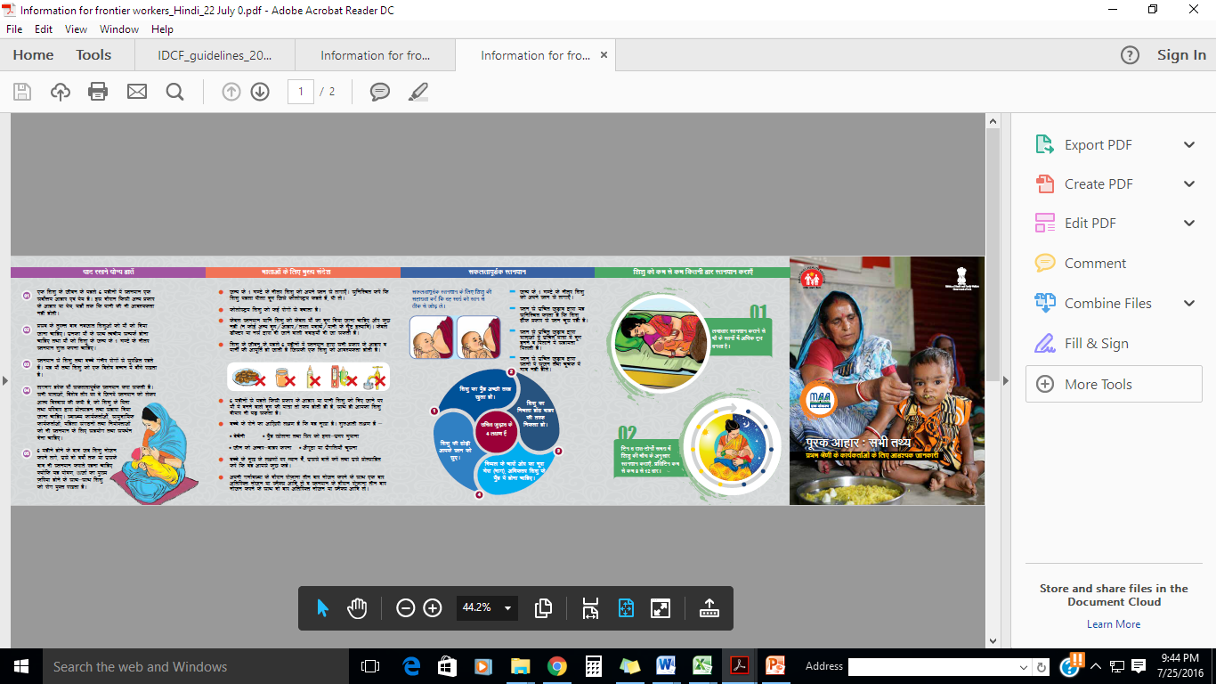
IEC materials developed
Foldable, handy infokit- for use by ASHA, Hindi & English

Slide 12
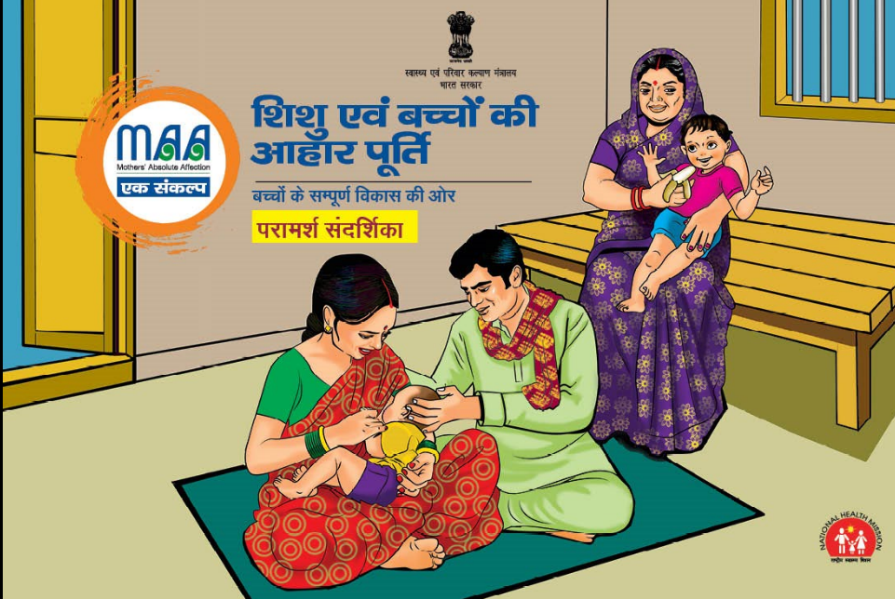
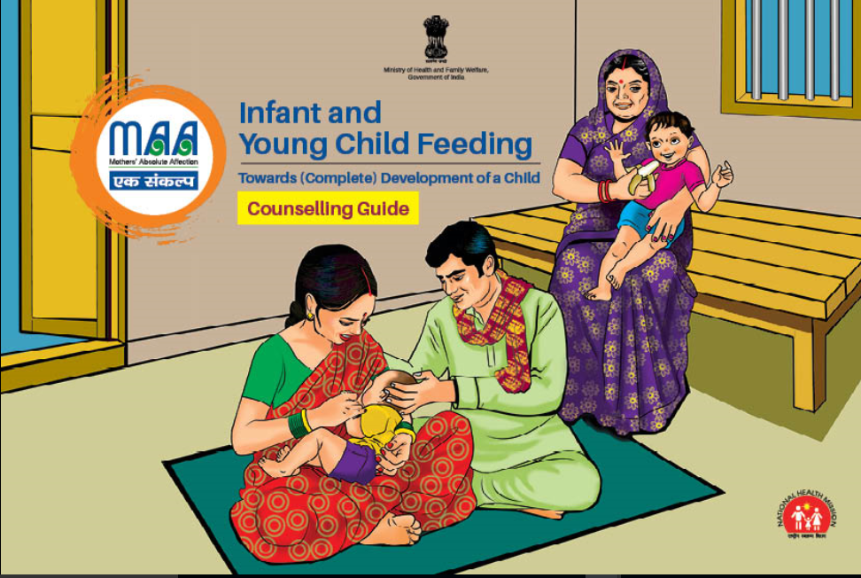
IEC materials developed
Flipchart/counselling guide for use by ANMs

Slide 13

Set of 6 training videos/mobisodes in Hindi- for training of frontline workers

Slide 14



Policy Briefs

Slide 15

IEC materials developed
Hoarding

Slide 16

IEC materials developed
Bus Panel

Slide 17
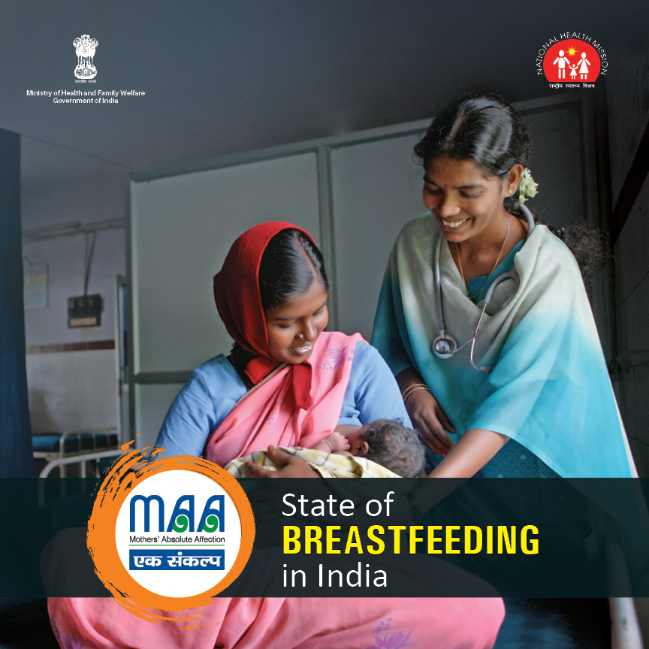
Coffee Table Book

Slide 18
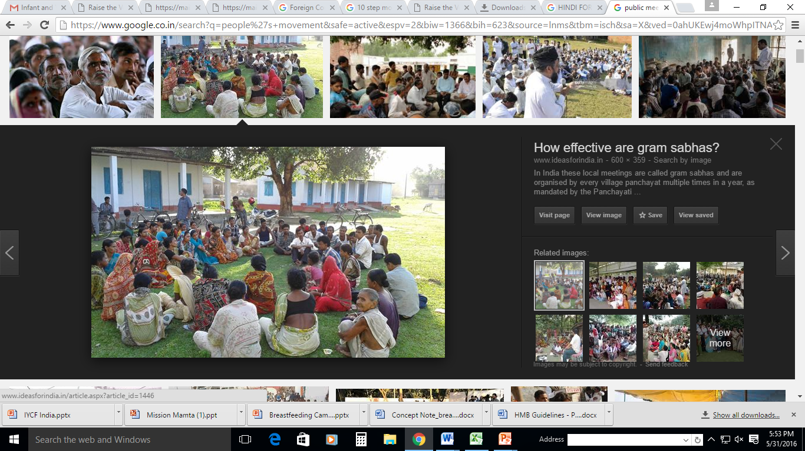
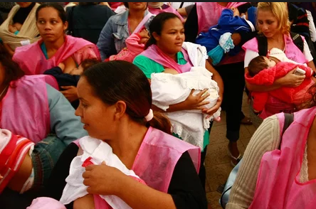
1. Demand Generation (Cont)
1.2 Inter-sectoral involvement
State/District/Block meetings with line ministries such as WCD, Tribal and Panchayati Raj.
Advocacy meetings with professional bodies of Private sector healthcare sector- IMA/IAP for involving private sector.
1.3 Public meetings:
Involving Grass root NGOs/Civil society and religious leaders to generate momentum on the subject.
Involvement of all Development partners for focused implementation in High Priority Districts.
MAA Infokit to be used for meetings
People’s /Mass movement
Break social barrier

Slide 19
Key Messages in Communication Campaign
Not even Water!
Early initiation of breastfeeding and ‘No’ to prelacteals;
Myth of Not enough Milk;
Emotional and overall support to the lactating mothers;
Advocacy of the gatekeepers such as Mother in law/husband and other family members;
Where to go in case of difficulty in breastfeeding;
Breastfeeding in case of working mothers;
Ill effects of Infant milk substitutes.
Reduced incidence of Diarrhoea and Pneumonia
Reduced risk for hospitalization and related mortality,
Increase in 8-10 I.Q. points;
Decrease in risk for Non Communicable diseases in later life etc

Slide 20
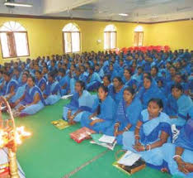
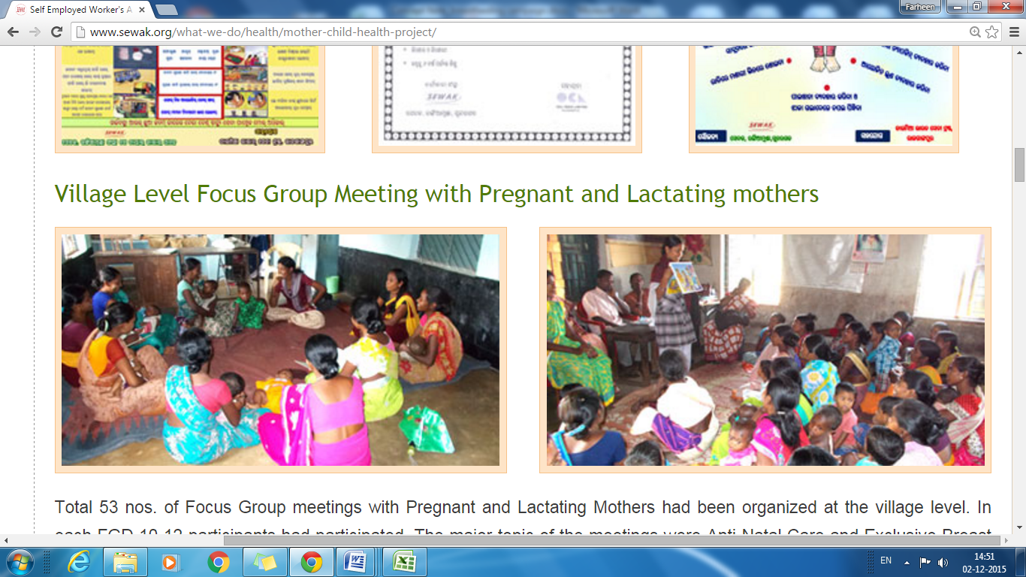
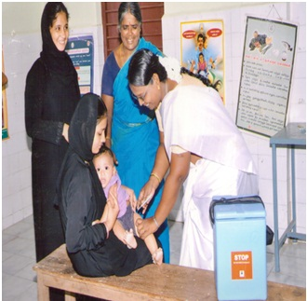
II. Community Level Interventions
2.1 Capacity building & Community dialogue by ASHA
Orientation and equipping ASHA for optimal messaging
ASHA conducts quarterly mothers’ meetings
ASHA would be given an incentive of Rs. 100 to conduct Quarterly Mothers’ meeting i.e. Rs 300 for three quarters
2.2 Skilling of ANM & lactation support
Dedicated training for ANMs in IYCF - in a phased manner over the year
Lactation support and management services at Sub-centre and VHNDs
Capacity building
Community dialogue
Skilled support and at Sub centres

Slide 21
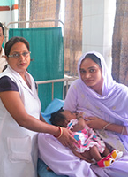
III. Facility Level Interventions
3.1 Reinforcing roles & responsibilities regarding breastfeeding/IYCF by one day orientation after launch of the programme.
  Emphasis on counselling on 9th every month, under PMSMA.
  Role of birth companion in initiating early breastfeeding.
3.2 One day sensitization: One day sensitisation of all ANM/Nurse/Doctors at delivery points would be undertaken.
3.3 Facility strengthening –IEC/ facility for counseling.
3.4 Trainings: 4 day training of ANMs/Nurse /Doctor in phased manner.
Skilled care, support and counselling at all delivery points
Training modules may be translated based on needs of the States.

Slide 22
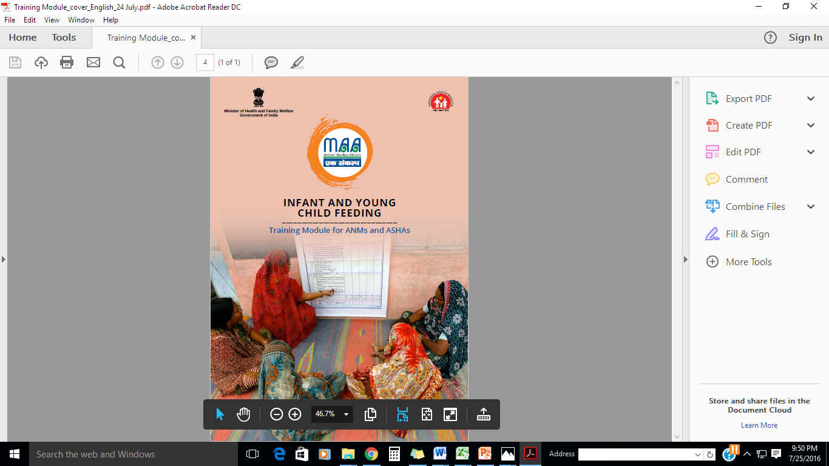
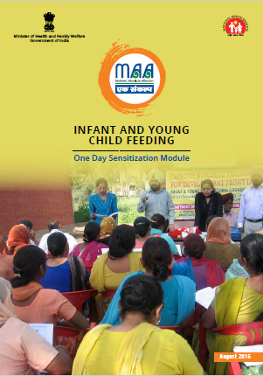
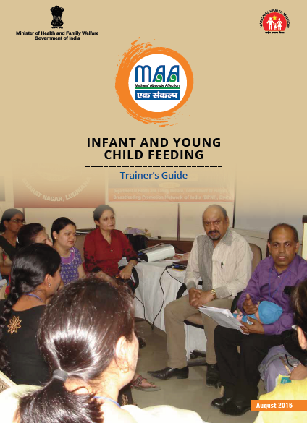
MAA TRAINING PACKAGES DEVELOPED
4 DAY
1 DAY
7 DAY
Branded Training packages in Hindi/English/Regional languages for 18,000 Delivery Points will be printed at State /District level (in a phased manner)

Slide 23
Content of Training Manual on IYCF
IYCF counseling & support
Production and intake of breastmilk
Assessing & observing breastfeeding
Taking a feeding history
Breastfeeding positioning
Addressing ‘Not enough milk’
Breast conditions
Refusal to breastfeed and crying
Expression of breast milk
Hospital practices and BFHI
Overview of HIV and infant feeding
Feeding during Illness and recovery
Relactation
Women and work
Replacement feeding during first 6 months by HIV +ve mothers
Counseling mothers in different situations and filling dietary recall form
Complementary feeding-foods to fill the Nutrient gap
Feeding techniques and strategies
Growth monitoring Taking Weight, Length/Height
Listening and Learning
Building confidence and giving support
Theoretical and Clinical practice

Slide 24
Setting up of National Resource Centre
Role of National Resource Centre:
Overall Technical support on IYCF to the Ministry for Health & FW
Development of technical resource material- training manuals/guidelines
Capacity building for developing Master trainings
Helpline management
Handholding of assessors for Awards
Guidance on operational strategy
Data management
UNICEF has agreed to support the National Resource centre at University College of Medical Sciences, Delhi.
BPNI would provide technical support.

Slide 25

Awards
4.1 Award for delivery point demonstrating breastfeeding processes : MAA Award
  Cash prize of Rs 10,000 per District for one facility/district
4.2 Criterion for awards to be laid out- Following 10 steps of BFHI for at least 6 months
4.3 Facility monitoring by certified assessors- Around a pool of 200 assessors in the country.

Slide 26
Implementation mechanism
Detailed operational guidelines would be shared with all the states.
Dedicated funding of Rs. 4.3 lakh per district is being provided to the States/UTs.
MAA Secretariat would be established in the Ministry of Health and Family Welfare. MAA Steering Committee would be established in states and districts. This has ensured effective roll-out and inter-sectoral coordination.
Stocks taking of preparedness activities would be ensured by constant communication with the states and districts, especially through Video conference. Orientation of programme managers on MAA programme is being undertaken on 29th July.
Facilities would be geared up for IYCF counselling and demonstration sites.
Prototypes of additional IEC material would be made available on the website www.nrhm.gov.in
Technical support from UNICEF and RMNCH+ A lead development partners.

Slide 27
Monitoring and Impact Evaluation
Key monitoring indicators (through Monthly reporting):
Number & % of ASHAs for whom sensitization on IYCF is conducted in block meetings
Number of Mothers’ meetings held
Number & % of Pregnant & lactating mothers attended mother’s meetings
Number & % of ASHAs having IYCF infokit
Number & % of ASHAs provided incentive for mothers’ meetings
Number & % of ANMs & nurses trained on 4 day trainings
Number & % of ANMs for whom one day sensitization was undertaken
Number & % of delivery points, where health care providers have been oriented with one day sensitization module
Number of Facilities received MAA awards (at State level)
Number of districts conducted launch of MAA programme
A State wide evaluation survey would be undertaken after one year of implementation of MAA programme

Slide 28
COSTING OF MAA Campaign
S. No. | Activity | Cost/District (Rs. lakhs)
I. DEMAND GENERATION
1.1 | Branding of IEC campaign, Launch event | UNICEF
1.2 | IEC activities during (in addition to funds sanctioned under PIP) | Rs. 0.5 lakh
1.3 | Costing for Air time /Newspaper ads | Already sanctioned funds under NHM PIP & funds with IEC Division of MoHFW.
II. COMMUNITY MOBILISATION
2.1 | Orientation of ASHA on breastfeeding/IYCF | No dedicated funds- as clubbed with monthly block review meeting.
2.2 | ASHA incentive @ Rs. 100 per ASHA for quarterly MSG meetings. | Rs. 3.32 lakh (Est.1066 ASHA/district x Rs. 300)
2.3 | IYCF training for all Sub centres/Delivery points | (Already an ongoing activity by States under PIP.

Slide 29
COSTING (Cont..)
III. CAPACITY BUILDING AT DELIVERY POINTS
3.1 | Role clarity & review through one day orientation of staff of Delivery points and all ANMs of Sub-centers at District and Block level meetings. | Rs. 0.5 lakhs per district
3.2 | National Resource Centre Establishment cost- includes minor renovation, IEC display, training of staff, stationary, anthropometric equipment Salaries of consultants (2-3) and secretarial staff (2-3) , stationary and IEC material | National level activity
IV. AWARDS
4.1 | Monitoring & Award/Recognition (Budgeted for 200 facilities to be covered per year) | Rs. 0.1 lakh
 | GRAND TOTAL | Rs. 4.3 lakhs

Slide 30

THANK YOU!!

